Slide 1
NEW DIGITAL SOLUTIONS

Slide 2
The Importance of Digital Media: How you know..
Have you ever visited a website, looked at a product online and ads for the same or similar products/services following you around?
You’ve been targeted with digital media!

Slide 3
The Importance of Digital Media: How you know..
Have you ever gone to a specific physical/business location and noticed ads starting to hit your devices from that business or their competitors after leaving?
You’ve been targeted with digital media!

Slide 4
The Importance of Digital Media: How you know..
Have you searched for products or services and notice commercials for showing up as you watch streaming content on Hulu, Sling, Netflix, Tubi, PlayStation, Roku etc.?
You’ve been targeted with digital media!

Slide 5
Before we get into the fun stuff...
Before we get into the fun stuff...
Notes:
Add in platform agnostic – we make decisions based upon your needs…

Slide 6
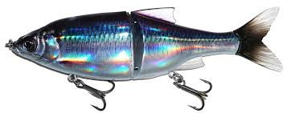
Don't think tactically or use tactics as "shiny objects"...
Walking into a business with a tactic to get attention is not a recommended practice. Until you understand the needs of the business how do you know what "tool" to apply? Until you know the following, you can't really recommend tactics:
Their goal to be achieved
How progress/completion of that goal is to be measured
Their current efforts to achieve it
Notes:
Add in platform agnostic – we make decisions based upon your needs…

Slide 7
TARGETED DISPLAY & VIDEO
Place your brand on popular websites, apps and games, making sure your ads are seen by the right people at the right time.
Strategic Placement: Ensure your ads are seen by the right people at the right time.
High Engagement: Capture attention with visually appealing ads.
Amplify Your Impact: Captivate viewers on their favorite sites with your ads via video or display. This tactic can transform casual browsers into loyal customers, boosting both brand awareness and sales.
TARGETING EXAMPLES:
Who They Are: Male/Female, Income, Age, Number of Children, Language, Job Title, etc.
What They Are Interested In: Sports, Gourmet Foods, Travel, History, etc.
What They Show Intent to Purchase: In-Market Automobile, In-Market Real Estate, etc.
What They Read: HealthCare, Real Estate, Auto etc.
DELIVERY OPTIONS:
Video
Banner
Platforms:
Tablet
Mobile
Desktop
AWARENESS
Notes:
Need audience

Slide 8
Targeted Banner/Video: What makes this so special?
Target consumers in multiple different ways with just ONE tactic:
Reaches everyone in the area for mass awareness branding
Reach consumers reading content real-time if that content has keyword relevance to your clients offer/product
Reach consumers who are the right fit based upon demographics, behaviors or interests
Follows consumers who have recently visited the site with additional messages/offers with retargeting ads. (requires GTM)
What do I need to collect/know?
The Geo: Where do these ads need to be delivered
The URL: When clicked where are we sending traffic
The Creative: What are we saying in the ads? What are the images? Do we have a logo? Are there specific colors or corp. needs?
Content to Target: What type of content makes sense to align with ads?
Behaviors to Target: What are the demographics and interests of ideal consumers?
Solution Details:
Platforms - Mobile, Desktop & Tablet
KPI - Awareness and Site traffic
Medium - Video and/or Banner Ads (Retargeting medium must match initial medium delivered)
Geography – U.S., State, DMA, Cities or Zip Codes
Keyword/content portion will require you define what type of content the user is reading
Behavioral/demographic/interest targeting will require the demographics, behaviors or interests of the desired audience

Slide 9
PROGRAMMATIC AUDIO
Reach a highly engaged audience with impactful audio ads on platforms like Spotify with programmatic audio.
Engaged Audience: Reach listeners on popular audio platforms.
High Impact: Deliver compelling audio ads.
Amplify Your Impact: Let your brand be heard on listeners' favorite music and podcast apps. This tactic captures their attention, driving immediate interest and engagement.
DELIVERY OPTION:
Platforms:
Tablet
:15 or :30 Audio
Mobile
Desktop
AWARENESS
5 Minutes
Notes:
Need audio ICON

Slide 10
Programmatic Audio: What makes this so special?
Reach consumer as they listen to Spotify, Pandora and other online radio players:
What do I need to collect/know?
Can target specific audiences based upon demographics or interests
Extends beyond the reach of radio coverage areas
Reach consumers while they listen to music or are immersed in Podcasting
Non-skippable and non-clickable audio is delivered
An easy half-step for radio buyers to try digital
It’s not about where you deliver (Pandora vs Spotify) it’s about WHO you deliver too
The Geo: Where do these ads need to be delivered
The Creative: Provide radio ad copy or other produced audio
Behaviors/Demographics to Target: What are the demographics and interests of ideal consumers?
Solution Details:
Platform - Mobile
KPI – Awareness
Medium - Audio spots (:15 or :30)
Geography – U.S., State, DMA, Cities or Zip Codes
Behavioral Targeting will require the demographic or interests of the desired audience to reach (pick only ONE segment)

Slide 11
STV – Online video entertainment your way

Slide 12
STREAMING TELEVISION (STV)
Reach consumers who watch their shows and news online by delivering :15 and :30 non-skippable video ads on streaming platforms like Sling, Pluto, and Tubi, through devices like Roku, Amazon Fire, and PlayStation.
Engaged Viewers: Reach consumers watching their favorite shows on popular streaming platforms.
Precise Targeting: Tailor your ads to specific demographics, interests, and behaviors.
Attribution: Measure completions rate, reach and frequency
Amplify Your Impact: Imagine being part of viewers’ favorite shows with non-skippable ads. This tactic ensures your message gets through and resonates deeply, driving immediate engagement and brand loyalty. With over 33 million cord-cutters in the US and a 20% increase in streaming viewership, leveraging STV ensures you capture a significant audience shifting from traditional cable to streaming.
AWARENESS
DELIVERY OPTIONS:
STV Video
Platform:
Smart Televisions

Slide 13
STV: What makes this so special?
Reach consumers as they watch Online TV or Streaming Television (STV):
What do I need to collect/know?
Target specific consumers by behaviors or demographics, content they prefer (Sports, Health, Sci-Fi, True Crime) OR Target everyone in the area
Reach “cord-cutters” and “Cord Nevers” outside of Traditional Broadcast
More flexible than Traditional Broadcast TV
Less expensive than Traditional Broadcast TV
Non skippable and non-clickable TV spots
The Geo: Where do these ads need to be delivered
The Creative: Provide TV Ad copy or other produced video
Behaviors to Target: What are the demographics and interests of ideal consumers?
Solution Details:
Platform – Smart/WIFI Connect Televisions
KPI – Awareness
Medium – Hi-Def Video (:15, :30 or :60)
Geography – U.S., State, DMA, Cities or Zip Codes
If targeted via Behavioral Targeting will require the demographic or interests of the desired audience

Slide 14
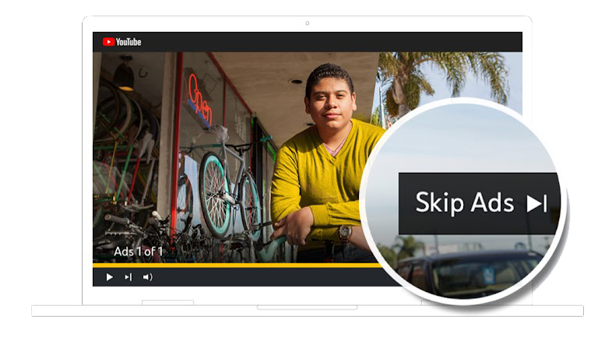
YOUTUBE TRUEVIEW
Deliver highly targeted, skippable pre-roll videos to engaged viewers on YouTube with TrueView.
High Engagement: Capture attention with skippable videos.
Targeted Reach: Deliver ads to specific audiences.
Efficient: Only completed videos count against client budgets
Amplify Your Impact: Hold viewers’ attention right before their favorite videos. This tactic drives immediate engagement and interest, turning viewers into customers.
AWARENESS
DELIVERY OPTION:
Platforms:
Tablet
:15, :30 or :60 Video
Mobile
Desktop
Mocks for illustrative purposes only

Slide 15
YouTube: What makes this so special?
Educate consumers while they are in a learning mindset:
What do I need to collect/know?
Target specific interests or demographics to educate
NO charge to your client if the consumer skips any of the video content
Very efficient way to brand and educate specific consumers
Provides SEO lift over time
The Geo: Where do these ads need to be delivered
The URL: When clicked where are we sending traffic
The Creative: Provide TV Ad copy or other produced video
Behaviors to Target: What are the demographics and interests of ideal consumers?
Solution Details:
Platform – Mobile, Desktop & Tablet
KPI – Awareness (consumers generally don’t click YouTube videos)
Medium – Video (:15, :30 or :60)
Geography – U.S., State, DMA, Cities or Zip Codes
If targeted via Behavioral Targeting will require the demographic or interests of the desired audience

Slide 16
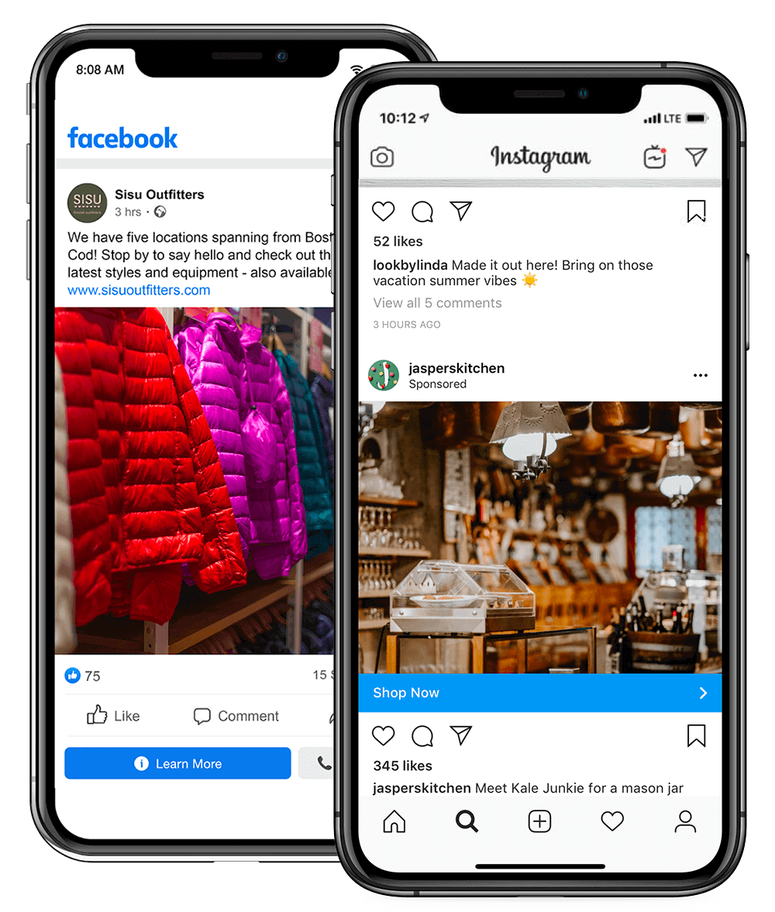
FACEBOOK/INSTAGRAM MARKETING
Deliver your message to a vast audience on the world's most dominant social platforms with Facebook/Instagram marketing.
Vast Reach: Engage a large social media audience.
Precise Targeting: Deliver ads to specific demographics and interests.
Attribution: Select a measure (Clicks, Likes/Shares/Comments or Awareness)
Amplify Your Impact: Be the talk of social media. This tactic reaches millions with targeted ads, driving immediate engagement and conversions.
AWARENESS/INTEREST/CONVERSION
DELIVERY OPTIONS:
Platforms:
Video
Banner Ads
Carousel
Mobile
Tablet
Desktop
Mocks for illustrative purposes only

Slide 17
Boosting vs. Facebook Sponsored Ads
Facebook Boosting
Sponsored FB Ads
Designed to reach current followers. CAN expand beyond followers to target by: interests, demos and location
Designed to reach new consumers. Retargets their website visitors, recent FB page engagers, custom CRM lists, interests, location and gender, & build look-a-like audience of those who were previously retargeted, engaged etc.
Target Audiences
Optimized for Reach with some engagements (likes, shares and comments). Good for growing your page but not actually driving business.
Uses full suite of Meta’s Ai Optimization for various conversions: (Likes, Shares, Comments, Web traffic, Leads, or Purchases on website)
Measures
Targets multiple audiences to find which is top performing. Each audience can use multiple pieces and types of creatives, which is in line with Meta’s best practices
Targets only ONE audience, with ONE identical piece of creative
Creative
Individual business owners lack a background in marketing and so don’t take reach and frequency into consideration
Expertise
Deep understanding of reach AND frequency

Slide 18
Facebook/Instagram: What makes this so special?
Target consumers while immersed in Social Media:
What do I need to collect/know?
Target consumers by demographics and interests
83% of US consumers 18+ spend time in Facebook
Multiple creative placements and KPIs available
Consumers use FB to evaluate and consider businesses
Can target friends of the business page as well as their friends
The Geo: Where do these ads need to be delivered
The URL: When clicked where are we sending traffic (multiple if carousel)
The Creative: What are we saying in the ads? What are the images? Do we have a logo? Are there specific colors or corp. needs?
Behaviors to Target: What are the demographics and interests of ideal consumers?
Solution Details:
Platforms - Mobile, Desktop & Tablet
KPI – Awareness, ThruPlay (:15 second) or Clicks (pick one)
Medium – Video, Single Image Banner Ad, Carousel
Geography – U.S., State, DMA, Cities or Zip Codes
Demographic or interests of the desired audience to reach
Will require website URL to direct online traffic (multiple if carousel)

Slide 19
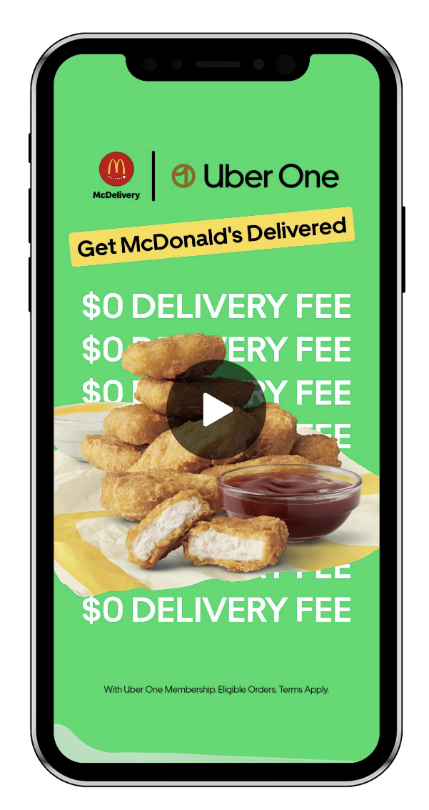
TIKTOK TARGETING
Reach a creative and entertained audience on the hottest video platform with TikTok targeting.
Creative Platform: Connect with an engaged audience.
High Interaction: Capture attention with video content.
Amplify Your Impact: Be part of the latest TikTok trend. This tactic drives high interaction and engagement, boosting your brand’s visibility and impact.
AWARENESS/INTEREST
DELIVERY OPTIONS:
Video
Banner Ads
Platform:
Mobile
Mocks for illustrative purposes only

Slide 20
TikTok: What makes this so special?
TikTok is the most explosive Social App in a decade:
Target specific audience based upon their interests
Target based upon the type of creators or videos they've interacted with
Rich video-heavy format which allows for tons of creativity
What do I need to collect/know?
The Geo: Where do these ads need to be delivered
The URL: When clicked where are we sending traffic
The Creative: What are we saying in the ads? What are the images? Do we have a logo? Are there specific colors or corp. needs?
Interests to Target: What are the interests of ideal consumers? What type of creators do they follow?
Medium, Audience and KPI:
Platform – Mobile
KPI - Awareness and Clicks
Medium - Video and/or Banner Ads
Geography – U.S., State or DMA
Interests or creators to be targeted

Slide 21
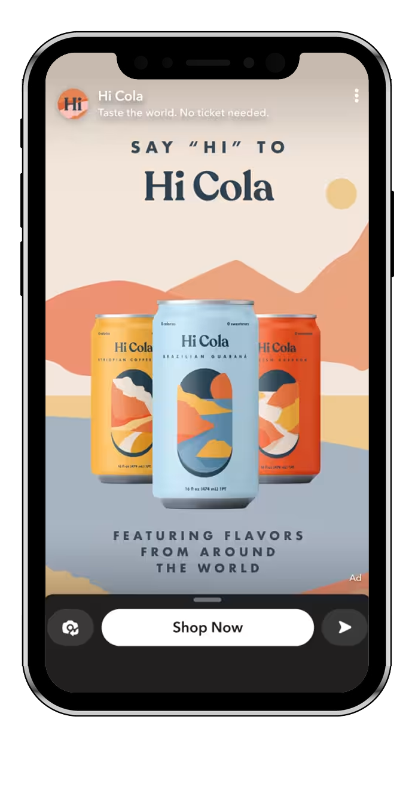
SNAPCHAT
Connect with a younger, mobile audience through playful and engaging content on Snapchat.
Younger Audience: Connect with a mobile-savvy generation.
Engaging Content: Capture attention with playful ads.
Amplify Your Impact: Become part of every fun snap. This tactic engages a younger audience and drives immediate interaction and interest.
AWARENESS
DELIVERY OPTIONS:
Banner Ads
Platform:
Video
Mobile
Mocks for illustrative purposes only

Slide 22
Understand the Social Landscape (pssst...... download these and play around)
Platform | Age Demo | Gender Split | KPI | Environment
Facebook/Instagram | 25 – 65* | 50/50* | Awareness, Site Traffic & ThruPlay | Sharing experiences & Gathering News
Snapchat | 18 - 25 | 50/50 | Awareness & Swip-Up | Fun playful environment, share experiences and images
TikTok | 10 - 44 | 60% Women/40% Men | Awareness & Site Traffic | Learn, be inspired and share fun video content
*Instagram is a younger while Facebook is an older audience

Slide 23
SnapChat: What makes this so special?
Reach younger audiences as they share Social video content:
Primary audience is consumers 18 – 35 years
Video-heavy environment which is playful not educational
Target consumers based upon their interests or demographics
What do I need to collect/know?
The Geo: Where do these ads need to be delivered
The URL: When clicked where are we sending traffic
The Creative: What are we saying in the ads? What are the images? Do we have a logo? Are there specific colors or corp. needs?
Behaviors to Target: What are the demographics and interests of ideal consumers?
Solution Detail:
Platform - Mobile
KPI - Awareness and Swipe Up
Medium - Video and/or Banner Ads
Geography – U.S., State, DMA, Cities or Zip Codes
What demographic attributes or lifestyle preferences to target
Any recent locations users have recently visited (banks, beaches, hair salons)
An buying preferences to target (music streamers, ticket buyers, chocolate buyers)

Slide 24
EMAIL MARKETING
Deliver your message directly to the inboxes of targeted prospects, driving high ROI with email marketing.
Direct Delivery: Reach prospects in their inbox.
High ROI: Achieve strong returns on investment.
Attribution: Match-back Reporting available
Amplify Your Impact: Land your brand’s message directly in your audience’s inbox. This tactic drives immediate engagement and conversions, maximizing your ROI.
DELIVERY OPTION:
Banner Ads
Platforms:
Tablet
Mobile
Desktop
INTEREST/CONVERSION
5 Minutes

Slide 25
Email Marketing: What makes this so special?
Target very specific consumers via email and match who converts:
What do I need to collect/know?
Reach consumers who are the right fit based upon demographics, interests or behaviors
Emails sent can have multiple offers each measured separately and can click to a different part of the clients site
Open rates of 10% +
Can request the email address of consumers who converted from the client and match them to the consumers delivered in the campaign for a Matchback
The Geo: Where do these ads need to be delivered
The URL: When clicked where are we sending traffic from each of the ads
The Creative: What are we saying in the ads? What are the images? Do we have a logo? Are there specific colors or corp. needs?
Behaviors to Target: What are the demographics and interests of ideal consumers?
Medium, Audience and KPI:
Platforms - Mobile, Desktop & Tablet
KPI – Awareness, Site traffic or Conversion
Medium - Banner Ads (multiple)
Geography – U.S., State, DMA, Cities or Zip Codes
Behavioral/Demographics for targeting
Each clickable element in the email will require website URL to direct online traffic

Slide 26
GEOFENCING WITH FOOT TRAFFIC
Target consumers based on their physical location, delivering timely and relevant offers with geofencing.
Precision Targeting: Engage customers exactly when and where they’re ready to buy.
Attribution: Measure foot-traffic visits to your location from competitor locations or other ideal places in the area.
Amplify Your Impact: Reach customers right when they are near your store. This tactic delivers personalized offers that drive immediate purchases, boosting both sales and loyalty.
Delivery Option:
Banner
Platforms:
Mobile
AWARENESS/INTEREST/CONVERSION
5 Minutes

Slide 27
Geofencing + Foot Traffic: What makes this so special?
See how many consumers come to your location from ads:
What do I need to collect/know?
Target consumers who spend time at competitor locations or any other location which may be relevant to your clients business
Measure foot traffic visits from those mobile devices as them come into your clients brick and mortar within 30-days
Reporting breaks out foot-traffic from all targeted locations separately
Understanding the clients Customer Lifetime Value (CLV) is key when speaking to foot-traffic
The Addresses: Where do these ads need to be delivered
The URL: When clicked where are we sending traffic
The Creative: What are we saying in the ads? What are the images? Do we have a logo? Are there specific colors or corp. needs?
Medium, Audience and KPI:
Platforms – Mobile
KPI – Foot Traffic
Medium - Banner Ads
Geography – Specific non-residential addresses
Will require website URL to direct online traffic

Slide 28
ADDRESSABLE GEOFENCING
Target consumers at the household level, delivering precise and personalized ads with addressable geofencing.
Household Precision: Target ads to specific homes.
Personalized Ads: Deliver relevant messages.
Attribution: Measure Foot Traffic, clicks or awareness
Amplify Your Impact: Reach the right households at the perfect moment. This tactic delivers personalized messages that drive immediate engagement and loyalty.
DELIVERY OPTIONS:
Video
Banner
Platforms:
Tablet
Desktop
Mobile
AWARENESS/INTEREST/CONVERSION
STV Video
Smart Televisions

Slide 29
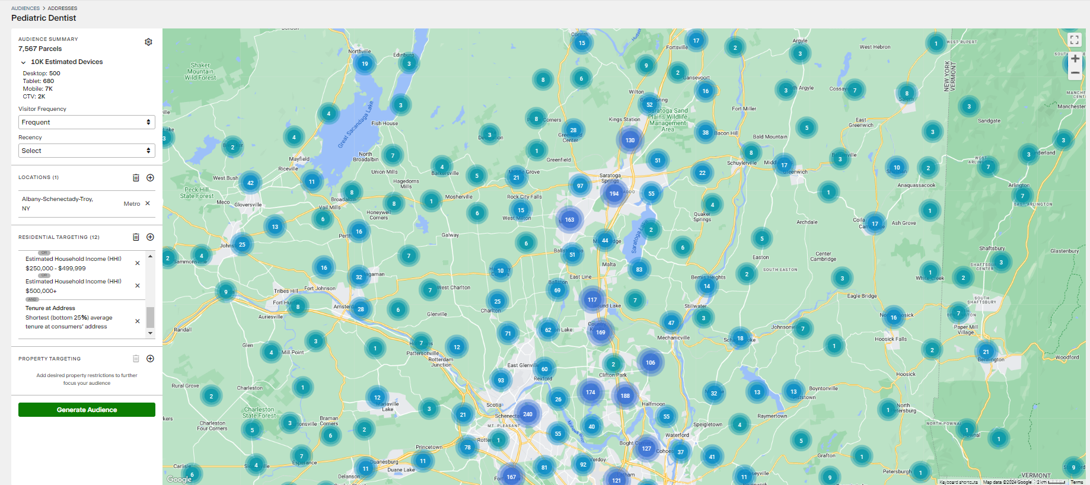
There are 7,567 homes in Albany NY, in which kids 4 – 18 are present, they HHI is $85+ and they have moved into the home more recently than 75% of the market
DELIVERY OPTIONS:
Video
Banner
Platforms:
Tablet
Desktop
Mobile
AWARENESS/INTEREST/CONVERSION
STV Video
Smart Televisions

Slide 30
Addressable Geofencing: What makes this so special?
This is like direct mail on steroids with foot-traffic on top:
Target households, like direct mail but with better data at higher frequency and lower cost than direct mail
Multiple Mediums can be used; Banner, Video and STV Commercials
Audience can be pulled in advance to see volume of homes and devices which can be reached
Measure foot traffic from addresses targeted at the zip code level
If KPI is foot-traffic it is recommended to have more than STV as the medium
What do I need to collect/know?
The Geo: Where do these ads need to be delivered
The URL: When clicked where are we sending traffic
The Creative: What are we saying in the ads? What are the images? Do we have a logo? Are there specific colors or corp. needs?
Household Composition to Target: What are the demographics and interests of ideal households?
Medium, Audience and KPI:
Platforms - Mobile, Desktop & Tablet
KPI – Awareness, Site traffic or Foot-Traffic (pick ONE)
Medium – Video, Banner Ads, STV Video
Geography – U.S., State, Cities or Zip Codes
Household Composition: Many ways to target the household based upon demographics, interests, finance and details of the actual residence

Slide 31
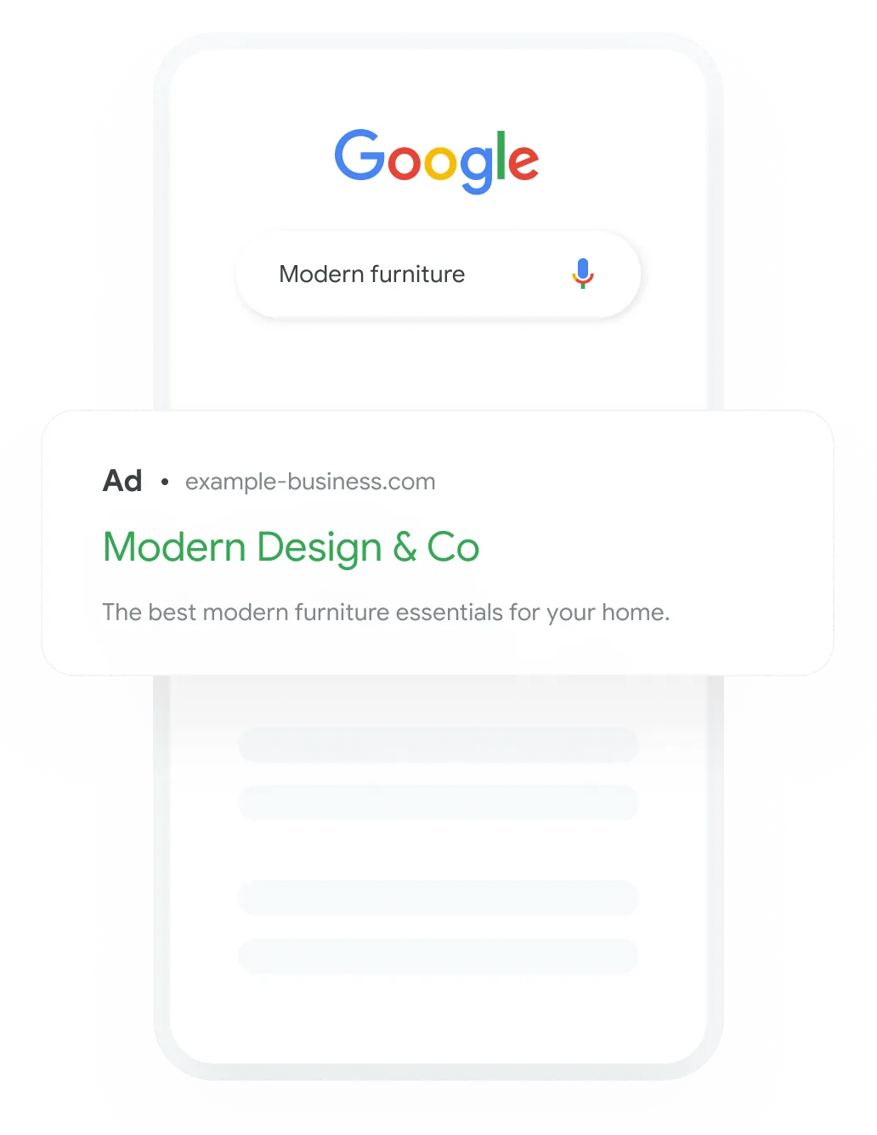
SEARCH ENGINE MARKETING
Drive phone calls, leads, or conversions with targeted text ads on search engines through search engine marketing (SEM).
Immediate Actions: Drive conversions with targeted ads.
High Visibility: Appear at the top of search results.
Attribution: Measure clicks, form fills, phone calls or purchases
Amplify Your Impact: Appear just when customers are searching for you. This tactic drives immediate actions and conversions, maximizing your visibility and impact.
AWARENESS/INTEREST/CONVERSION
DELIVERY OPTIONS:
Text Ads
Platforms:
Mobile
Tablet
Desktop
Mocks for illustrative purposes only

Slide 32
CAMPAIGN MEDIA PLAN
x______________________
Provider Representative
x______________________
Client Authorization
x__________
Date
Timeline:
08/01/21 - 12/31/21
Both parties have the right to cancel 90 days after the start of the campaign with 30 day written notice.

Slide 33
CAMPAIGN MEDIA PLAN
SOLUTION NAME | SOLUTION GOAL | AUDIENCE DETAIL | SOLUTION FOOTPRINT | MEDIA DELIVERED | VOLUME | MEDIA COST | COST STRUCTURE | BUDGET
Programmatic Display | Pull from Prog Display Tab | Enter Audience Detail | US, State, DMA, Zip Codes or Addresses | Display | 123,456 | $0.00 | CPM | $1.000
Addressable Geo (Banner) | Foot Traffic | Enter Audience Detail | Specific Postal Addresses | Display | 123,456 | $0.00 | CPM | $1,000
Retargeting | Site Traffic | Previous Site Visitors | United States | Display | Based on Site Traffic | $0.00 | CPM | N/A
STV | Awareness | Enter Audience Detail | ???? | Video | 123,456 | $0.00 | CPM | $1,000
Social - Link | Site Traffic | Enter Audience Detail | US, State, DMA or Zip Codes | Video or Display | 123,456 | $0.00 | CPLC | $1,000
INVESTMENT | $4,000
x______________________
Provider Representative
x______________________
Client Authorization
x__________
Date
Timeline:
08/01/21 - 12/31/21
Both parties have the right to cancel 90 days after the start of the campaign with 30 day written notice.

