Slide 1
Pre-Discovery Research Training
Pre-Discovery Research Training

Slide 2
Pre-Discovery Research Agenda
Be the Consultant
Step ONE: Take a Logical First Approach
Step TWO: Use Tools!
Google Ad Transparency Tool
Facebook Page Transparency Tool
YouTube

Slide 3
Be the Consultant
Take time to research what you can regarding the marketing strategy before you attend the Discovery Meeting. Bring notes with you. Be prepared and when appropriate to share what you've learned about their current marketing efforts. This is one part of the difference between a "Salesperson" and a "Consultant".
Salespeople...
Consultants...
often enter meetings with assumed packages and ask questions which could have been self-discovered prior to the meeting, thus appearing uninformed.
walk in with knowledge but ask questions to uncover needs while sharing what they learned in advance to support the conversation and thus appear credible.

Slide 4
Step ONE: Take a Logical First Approach
Before we get into the “Tools", as you prepare for discovery, here are some simple things to look for and add to your notes prior to the meeting:
Review their online presence:
Home Page Content - What is on their home page is often what is most important and can be a clue
Locations - The number of locations can be a measure of the size of the opportunity
Online Reviews - Check their online reviews to get a read on how they are perceived in the market be it more positive or negative
Social Media: Visit their Facebook page and see if they provide content, now often and what they see as important
Media Monitoring: Do you see them on TV, hear them on the radio, bus benches, billboards, local sponsorships etc.

Slide 5
Step Two: Consultancy at Pre-Discovery Research!!
Coming across as a consultant requires, we learn as much as we can about the prospects current marketing. Doing this research in advance of the Discovery meeting will keep you in the conversation driver's seat.
Prior to the Discovery Meeting, Find out as much as you can about their current state of marketing. This will not only become valuable during the Discovery Meeting but affords you an opportunity to show your professionalism as you take control of the conversation.
Let’s cover some pre-call research tools you can use:
Google Ads Transparency - https://adstransparency.google.com/?region=US
FB Page Transparency – https://www.facebook.com/
YouTube – https://www.youtube.com/

Slide 6
The steps to pre-discovery research FLOW..
The process below is designed to take less than 5 minutes!
Google Ads Transparency – Are they running ads on Google Maps, Paid Search, YouTube or Shopping
Facebook Page Transparency – Are they sending out ads from their page to consumers? If so, what do they say, how often to do they go out, is it video or banner ads?
YouTube – Is video important to this business? Do they have any I can use? Is it old, new horrible or amazing?
Organize – Find the best method for you to keep everything in one place.

Slide 7
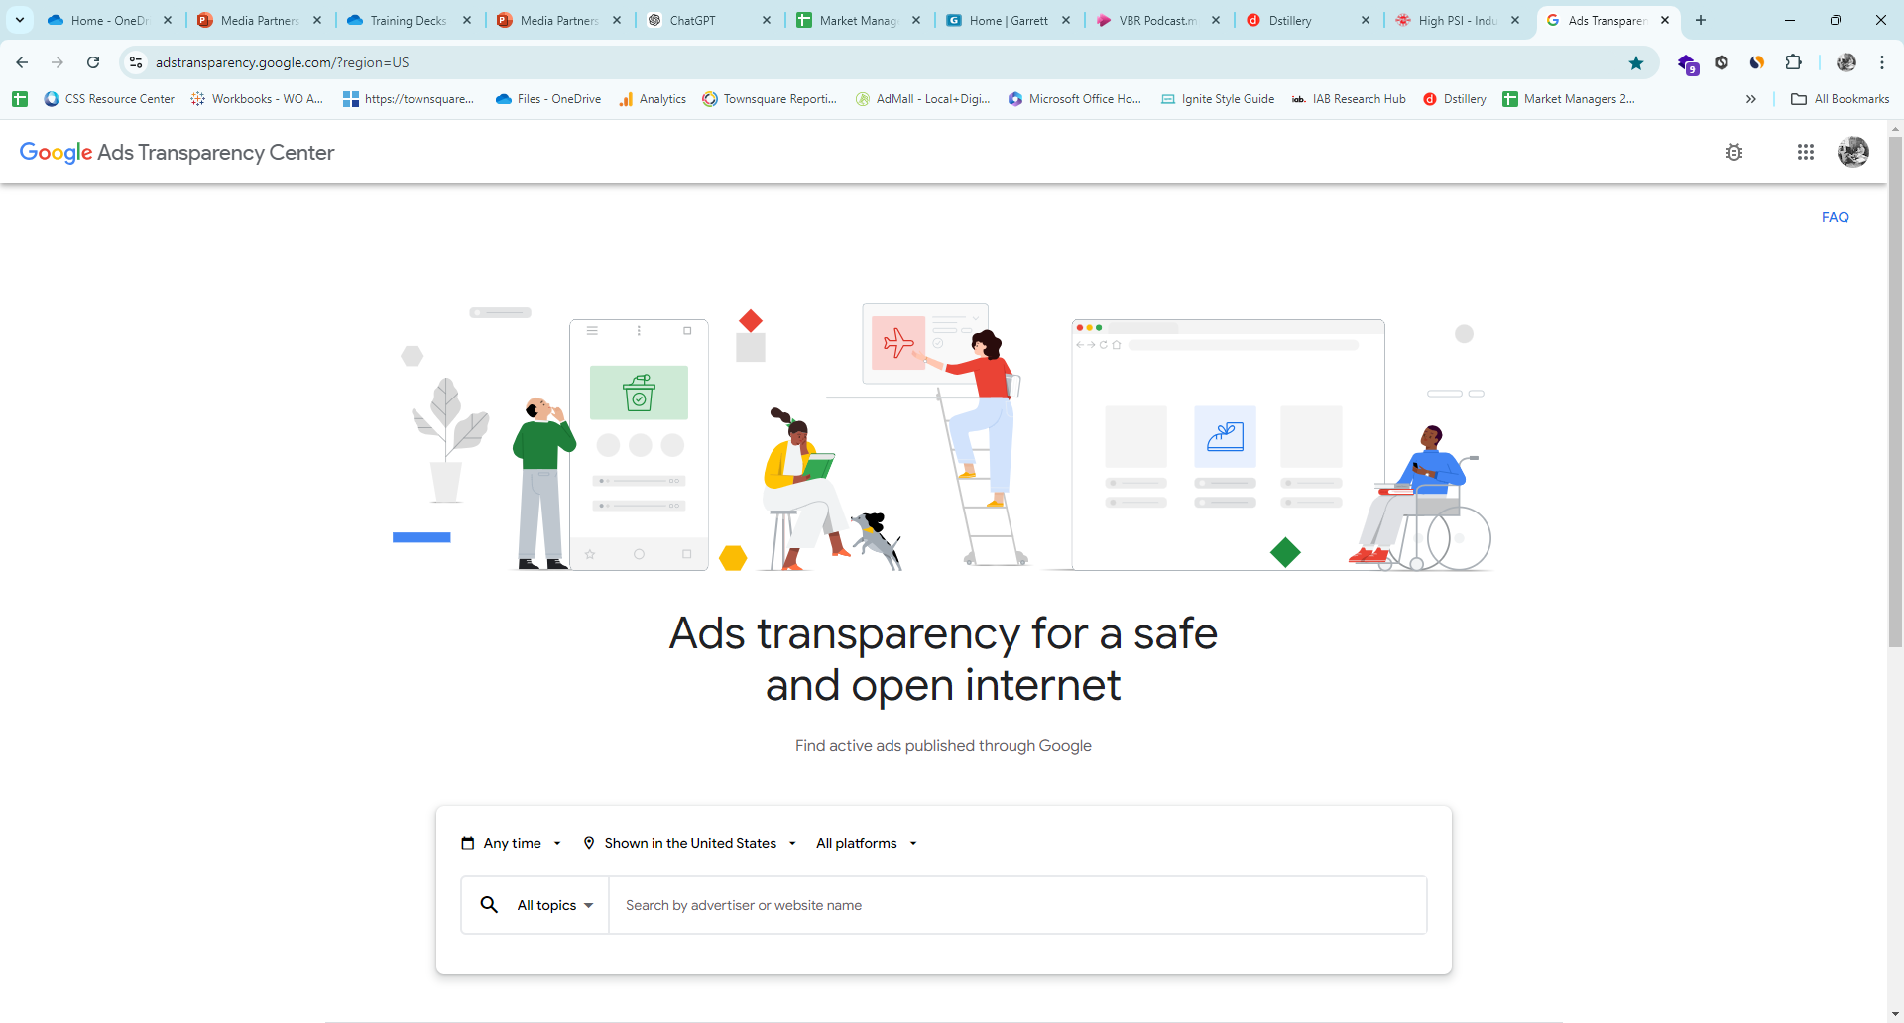
#1. Google Ad Transparency Tool
This Google Tool will show you if they are running ads on:
Google Search
Google Maps
Google Shopping
YouTube

Slide 8
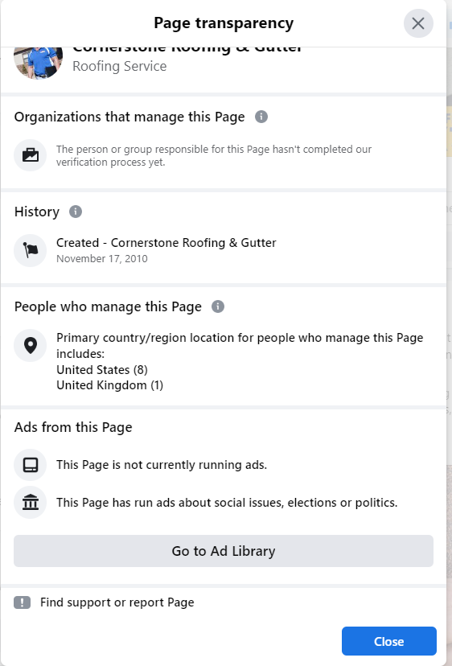
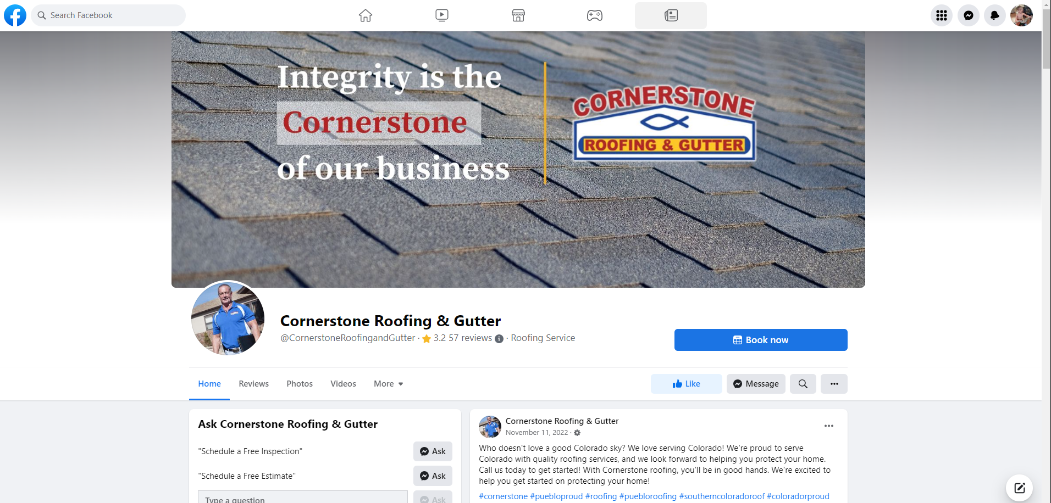
#2. Facebook Page Transparency
FB Page Video Tutorial
FB Page Transparency will show you if their businesses has been sending out Sponsored Ads to targeted audiences.
You can also show what their competition may/may not be doing and educate as to how they can do this for themselves.

Slide 9
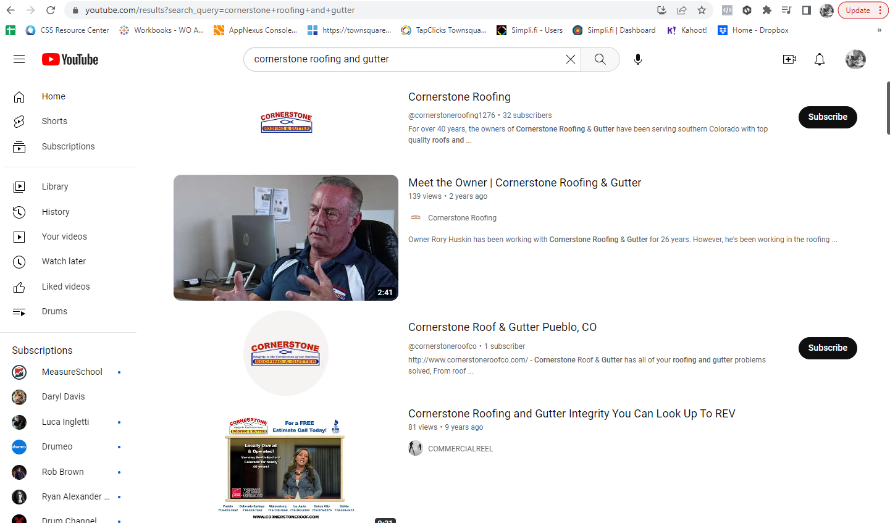
#3. YouTube Research
If a business has video in their marketing strategy it is very likely to show up on YouTube. Do a quick search on YouTube and make note.
Do they have video?
What is the quality/age?
Is it something you could use?

