Slide 1
Campaign Performance STORY TELLING

Slide 2
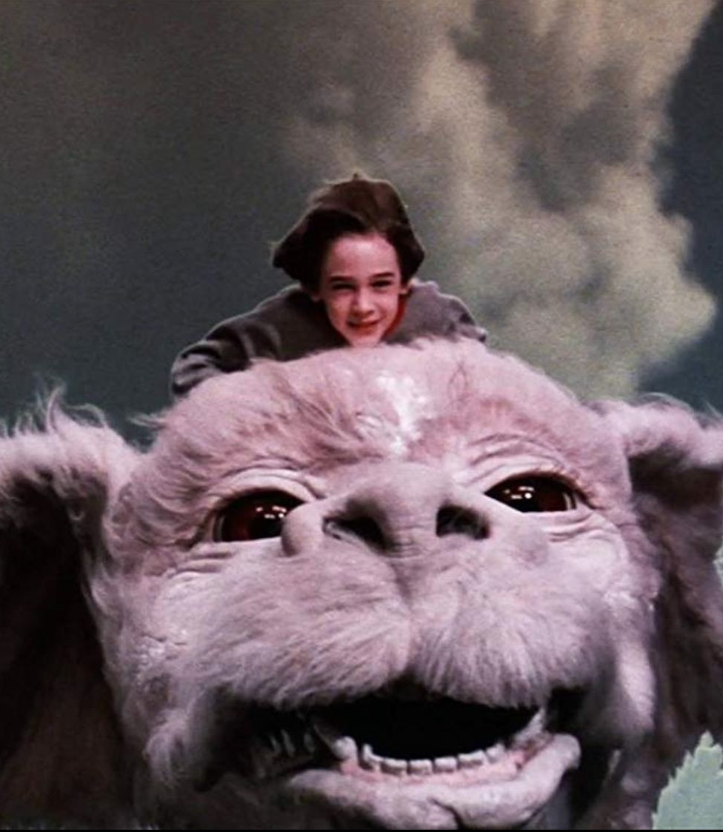
Expressing Campaign
Performance
Steps to prepare for your performance conversation
Know the Plan and Players
Seize the Opportunity
Expressing the value of the campaign in storytelling form!

Slide 3
Preparing for your performance meeting
Consider a few steps to take before your meeting:
Pull up the proposal deck used to close the deal and remind yourself of the; Goal, KPI and Solutions
Hop into the videos covering tactics and brush up on any solutions in which you are not familiar.
Pull up the live campaign a day or two before the meeting to make sure what was sold is running. This will allow you the time to connect with your DCM if you notice anything wrong or missing in advance of the meeting. ​ Better to come in having started to fix an issue than to identify one with your client
If needed, set time in advance of your performance call to meet with your DCM days before the call. Your DCM can help talk through the most important elements of performance and/or provide insights you can share with clients.

Slide 4
Speak to the goal and elements of the plan!
Think of a marketing campaign as a play. Solutions in your campaign are like actors in a play, each with their own role in the process. Understanding their roles in the plan will help you tell a story as you go through the dashboard!
The KPI – Start the review by reminding of the Goal of the campaign.
"Excited to dive into the plan designed to X"
​Solutions – Start at the top of the funnel (awareness solutions) and move down conversationally. Each solution has a role (KPI) in the process.
"The first solution to cover is YouTube which is used to educate the homeowners how your product solves their problem"
RENEW YOUR DISCOVERY - Performance meetings should also be considered a refreshed Discovery.
"Thank you for this time together, are there other business or recruitment goals to discuss?"
​Referrals – Are you using campaign performance reviews to ask for referrals!
"Before I leave, who do you know that may be struggling or needs some help? I promise to treat them as horrible as I do you!"

Slide 5
Express the campaign's performance in story form!
Internal Jargon
Story Telling
"The procedure is going to increase blood flow capacity
in the anterior part of your pulmonary artery with a
drug-eluting stint. Recovery should begin very soon."
"While you are sedated, we will use a tiny little plastic tube which will be coated with medicine and attached to your artery. This will increase the blood flow. You should be feeling better by the time you wake up!"
Clicks
Impressions
Click Through Rate
Conversions
What did these mean to you before you knew them?

Slide 6
Express the campaign performance in story form!
This is as simple as substituting our internal terms with terms that will paint a picture in the mind of the business owner. Consider the following changes but make it sound like YOU:
Internal Jargon
Story Telling
We delivered 30,000 Impressions
“We delivered your message to the homeowners you want to reach 30,000 times in the last 30 days”
“143 times, homeowners who got the ads took time out of their day, stopping what they were doing, and visited your website to learn more about you”
and gotten 143 Clicks
“CTR is the % of people getting the ads to use them to visit your site. The National average is .07%. We are running at a .46%, almost 7x the national average, which is a sign we are reaching homeowners with a message they find compelling”
with a Click Through Rate of .46%
And you've gotten 25 Conversions
“25 times homeowner filled out your “contact us” form to begin a conversation about your products and services”

Slide 7
Now let's spend some time in LIVE campaigns!

Slide 8
Team Meeting Deliberate Practice (AE)
Now it's time practice to be perfect while making the process fun.
The Goal:
Be playful in a team meeting setting while practicing together! Each AE should have a chance to story tell in front of the group. Make a silly noise if the Storyteller shares data with internal jargon rather than to tell a story.
Take the following steps:
Each AE selects a client with campaign performance to discuss, in the near future
Each AE should have 5 minutes to "story tell" their campaign in a team meeting setting
The group is to use a bell, buzzer or funny sound and "alert" when the Storyteller uses: impressions, clicks, CTR or conversions
AE can "Phone a Friend" from those in the meeting for examples of how to better paint the picture rather than sharing data if they get stuck

Slide 9
Expressing Performance Deliberate Practice (AE)
Now it's time practice to be perfect.
Take the following steps:
Select a client you intend to meet and discuss campaign performance within the next week
Reach out and set a meeting with your DCM to discuss the campaign and gather talking points:
What was the KPI and how are we making progress
What are the tactics, and which is performing vs underperforming
What are any recommendations to change this campaign
Take your notes and practice expressing the performance in a non-technical way, while using the insights from your DCM
Email your MP/DOS and set up a time or use your regular 1:1 to have a 10 min role-play as if they are the client
In the role—play:
Start the role-play by confirming we understood the ask (the KPI)
Go tactic by tactic telling stories (don't share data points)
Don't use the words: Impressions, Clicks or conversions
Ask if there are any other goals or initiative to address

Slide 10
Expressing Campaign Performance (MP/DOS - DP Kit)
Now it's time to demonstrate what they've learned.
Take the following steps:
Your AEs should have already met with and discussed this campaign with their DCM to gather talking points. Confirm this happened
This a short 10-minute role-play in which they present your campaign results in a non-technical way while also confirming the KPI
Listen/look for the following:
They start the role-play by confirming the current KPI
As they go through the tactics in the campaign, they should not use words like:
Impressions
Clicks
Conversions
They should be telling stories not sharing data points throughout the conversation
They should check for understanding along the way
They should confirm that there are no other goals to hit or challenges the business is facing to be addressed

