Slide 1
Discovery 101 The Essential 6
Discovery 101
The Essential 6

Slide 2
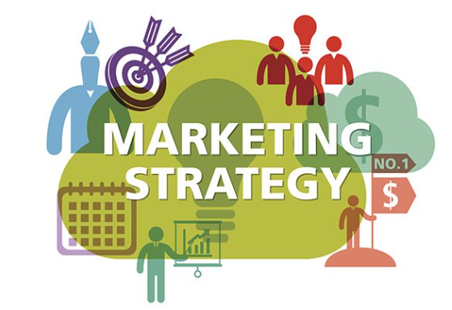
Discovery 101
Agenda
Define your Moment
Notes Shape Opportunities
Dropping their Guard
The Essential 6
Unpacking the 6

Slide 3
Define Your Moment
You've spent hours, days or even months trying to nail down this lead.
Calls, emails, Voice Mail.
Now you are here, and it's time, don’t miss the moment

Slide 4
What are you to achieve here?
You are in a fact-finding business conversation. Your goal is to put the business owner at ease so they will be transparent and share relevant information.
Your first step is to get out of the "typical salesperson" box, by setting the tone as a consultant. This starts to happen from the time you step into this meeting.
What is so special about being a consultant?
Business owners see consultants as valuable assets, trusted source of information, an educator or expert in their field.
Let's start earning that CONSULTANT status....

Slide 5
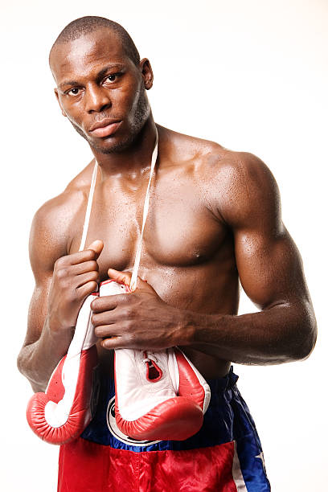
Listening, keeps guards down
Listen, really listen, don't wait to talk or just sit there to formulate a reply...
Take detailed and organized notes on what you hear.....
Let your Discovery sessions be dominated by inquisitive dialogue not assumptions.....
Seek to understand before being understood.....

Slide 6
Opening dialogue, requires lowering guards
There is a reason that the business owner chose to give you some of their time, now let's make the most of it, starting by "lowering their guard".
Consider starting the meeting like this:
"Why am I here? I'm sure you get bombarded by sales calls, but you chose to take time with me, and thank you, but why the yes?"
Let them talk for a minute or two and see if they land on a goal to be achieved. This is important to get things started in a more casual way. If for some reason they don't land on a goal quickly, try this next:​
​
"I speak with a lot of businesses. Usually what draws their eyes on a P&L is a problem which could be resolved with more revenue or more employees."
"How about for you?"
Get ready to take great notes....

Slide 7
Notes shape opportunities (so take good ones)
Consultants take great notes and business owners want you taking notes...
Have you ever had to rely on someone else's notes, and they were incomplete or just plain bad? Remember how hard it was and the extra questions you had to ask to fill in the blanks?
Taking the time to take great notes:
Shows that you're organized
Keeps the conversation on a track
Helps to remind of questions to be asked
Helps to record potential follow-up steps for either party
Provides context for others to follow when shared
If you are not already a great note taker, consider using a template. These can be helpful to make sure to consistently document the important elements of conversation.

Slide 8
The Essential 6
The Goal
The KPI
Let’s look at six mission critical pieces of information you’ll need to gather to build an effective marketing strategy.
1.
2.
Assets, Pixels, GA & Goals
6.
3.
The
Audience
5.
4.
The
Geography
Current Marketing

Slide 9
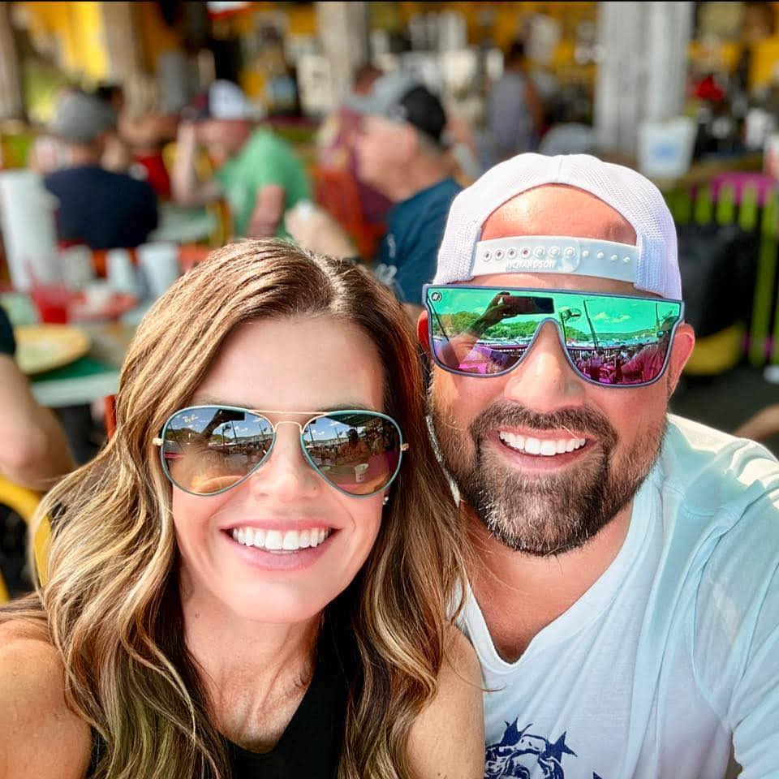
Always Have Something to Measure
Taking on the assignment (goal) at face value, is not good enough, you will just lose the business later.
“The people that tell you they want awareness are liars, NOBODY wants awareness, no matter what they say”
Tony Townsend

Slide 10
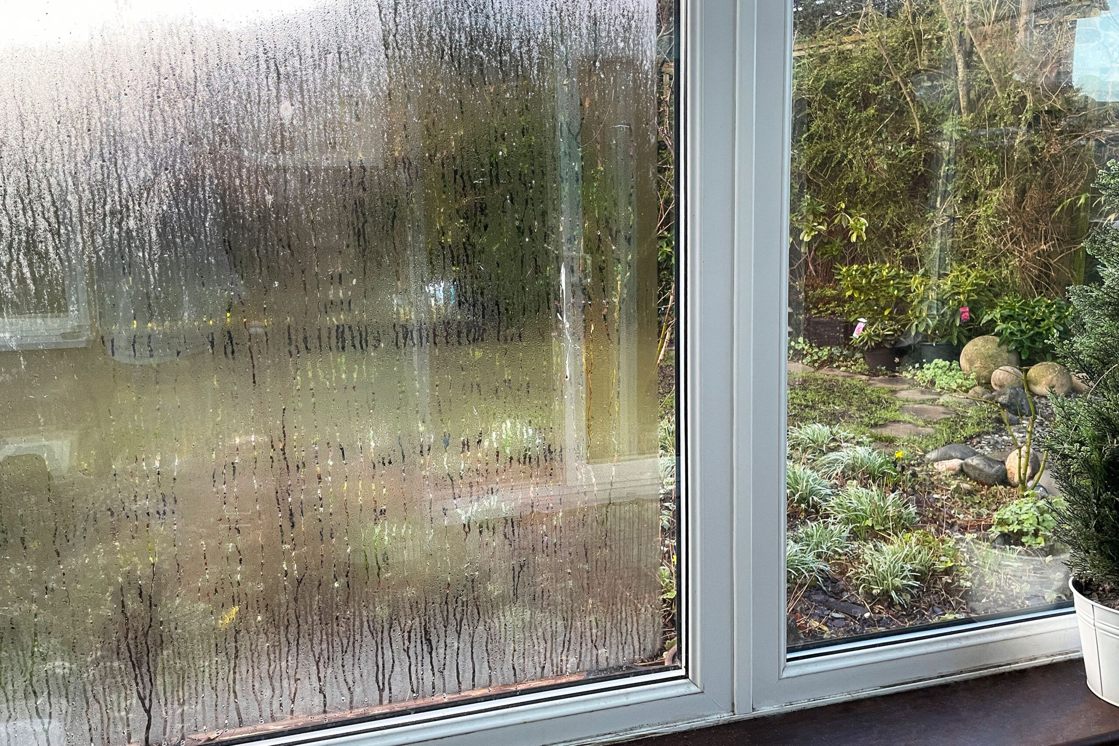
Diving Deeper will set you/us apart
Tony is correct….
...let’s play this out. You ask: "Why am I here?" and get "I need more people to be aware of my business." If you probe a little further, see how quickly we take that from awareness to an actual goal.
Prospect: “I want awareness”
You: “Why is that important?”
Prospect: “So more people know I am here”
You: “Why is that important?”
Prospect: “So more people can find me”
You: “Why is that important?”
Prospect: “So more people can come in and buy my products”
You: “Ahh so what we really need to measure is increased sales!”

Slide 11
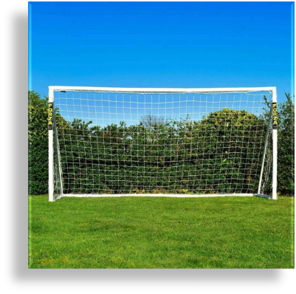
#1 – Discuss The Goal
Remember we are looking for a goal to be achieved. One critical enough to toss us a "hi-five" when we show up and it's been completed. It should not take but a few minutes to get to what is important to be solved for the business. Below are sample of what you are likely to hear.
Common Marketing Goals:
"I want to double my sales"
"Need to Increase leads by 30 per month"
"Need new patients/clients"
"I need more employees"
"I need more listings/homes to sell"
"I need more people on my website"
" Want to sell tickets to my event"
Build this into your notes...

Slide 12
Cornerstone Roofing & Gutter
https://www.cornerstoneroof.com
Discovery Meeting Notes
Goal: He needs to increase an additional 10 leads per month.
KPI:
Audience:
Geo:
Current Marketing:

Slide 13
#2 – Get The KPI
​A Key Performance Indicator (KPI) is HOW we are going to measure progress to a goal.​
Most business owners won't be happy with you just bringing in more site traffic as a KPI. Even less will be happy with Awareness as the KPI. The KPI will become your “North Star” as you repeatedly meet with your client to talk about progress.
Consider: "Cool with our north start being (goal) what is the best way to measure progress along the way? (If possible) In my experience the best way to measure is..."
These are your most common and measurable KPIs.
Common KPIs:
Store Visit (Foot Traffic)
Increased Site Traffic
Video Completions
Site Visit Conversions (SVC)
A SVC conversion occurs when a user receives a display ad they DON’T click however that same devices visits your website within 30-days later. This is a measure of branding or delayed consumer response.

Slide 14
Cornerstone Roofing & Gutter
https://www.cornerstoneroof.com
Discovery Meeting Notes
Goal: He needs to increase my leads per month.
KPI: Leads are 90% phone calls. KPI = Increased Site Traffic
Audience:
Geo:
Current Marketing:

Slide 15
#3 – Reveal The Audience
Define The Audience:
Figure out the right audience because audiences tie back to goals. Consultants start with what they know and then ask for help filling in the blanks.
Consider trying:
“Okay more leads is the goal and we will focus on an increase in site traffic to get you more opportunities. In my experience this product/service is for homeowners with higher incomes, not renters. (let them talk) Is that right but..."
You can also ask:​
Think in terms of:
"Are there other demographic attributes?"
Gender, Age, Income, Children, Language, Job Title​...
"Are there certain common interests they'd share?"
Football, Gourmet Foods, Travel, History​...
"What about details around their lifestyle?"
Luxury Buyers, Outdoors Enthusiast, Fitness Enthusiasts...​
"Do these men spending time at specific places?"
Coffee Shops, Malls, Banks...
"Are certain events likely to trigger their need?"
Engaged, Divorced, Recently Graduated, Retiring...
Keep adding to those notes...

Slide 16
Cornerstone Roofing & Gutter
https://www.cornerstoneroof.com
Discovery Meeting Notes
Goal: He needs to increase my leads per month.
KPI: Leads are 90% phone calls. KPI = calls
Audience: Homeowners with homes 10+ years old and incomes $100k+
Geo:
Current Marketing:

Slide 17
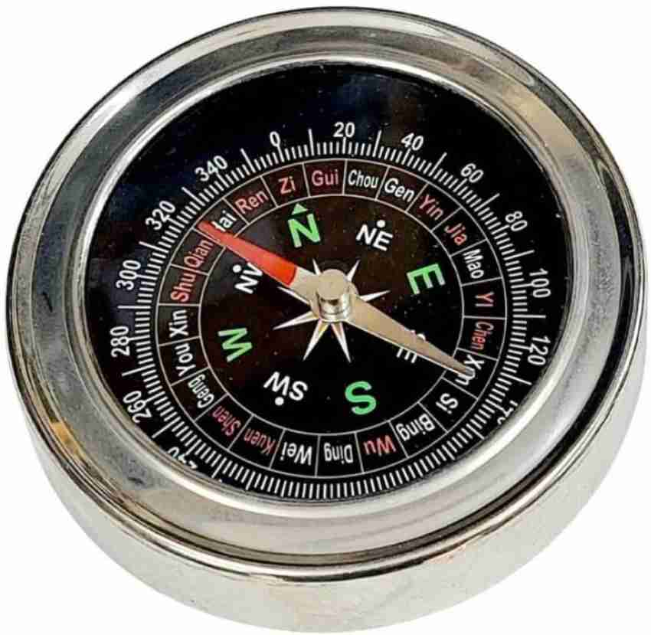
#4 – Define The Geography
Define The Geography:
The geography or campaign footprint always ties back to the goal. Customers may only drive 15 minutes to purchase. If the goal is recruitment, they may know an 1-hour commute is normal.
Have a brief conversation about where we should be targeting the audience for the goal we have been assigned;
"How about the area of opportunity for this (product/service), how far does it make sense to reach with messaging?“
"Are certain areas better than others?“
"How far will an ideal employee commute before you know there may be attendance/lateness issues?"
Notes, notes & notes...

Slide 18
Cornerstone Roofing & Gutter
https://www.cornerstoneroof.com
Discovery Meeting Notes
Goal: He needs to increase my leads per month.
KPI: Leads are 90% phone calls. KPI = calls
Audience: Homeowners with homes 10+ years old
Geo: Pueblo, Colorado Springs & Castle Rock Colorado
Current Marketing:

Slide 19
#5 - Walk-Through Current Marketing
Learn the details of their current marketing in place to achieve this specific goal you’ve been given. Take time to find out what is working or what is not.
Consultants start with what you know in advance, which could sound like:
"I took some time to learn about your current marketing before the meeting, I see you are using Paid Search (SEM)..."
For all current marketing, ask them for each: ​
What was the goal of this marketing channel? ​
What is your opinion of how that’s working? ​
What is your monthly SEM budget?​
What do you get for that?
You'll hear things like:
"Our goal leads from my SEM in the form of phone calls"
"I should be getting more leads and Reach Local is a pain"
"I pay about $2000.00 per month"​
"I should get 120-240 clicks for that spend but I’m more focused on leads than clicks"​
Once you’ve gone through what you knew in advance, ask what are other things you didn’t see in advance of the meeting. Then ask the same questions and keep going until you have uncovered all their marketing to achieve whatever goal you’ve been assigned.
Detail in notes is key here as well...

Slide 20
Cornerstone Roofing & Gutter
https://www.cornerstoneroof.com
Discovery Meeting Notes
Goal: He needs to increase my leads per month.
KPI: Leads are 90% phone calls. KPI = calls
Audience: Homeowners with homes 10+ years old
Geo: Pueblo, Colorado Springs & Castle Rock Colorado
Current Marketing:
SEO – Our SEO has been handled by a local agency for about 5 years, they do a great job and are inexpensive only about $600.00 per month.
FB – We have an industry specific firm who handles our Facebook marketing. Goal is to get more exposure and leads and I feel like I get some but don't have a way to track. I know it's important to be on Facebook. I pay about $1800 per month for this.
Local News Weather: I am the paid sponsor of the evening weather for 2 of the 3 main networks here. This is all about exposure and I feel like everyone knows my brand, but I am also reaching a lot of non-homeowners. I pay about $6,500 per month and it comes with a TV schedule and banner ads on the News sites as well.
Direct Mail – 1 drop per quarter that delivers about 2,500 pieces to reach homeowners in the area at about $3,500 per drop. I get a 1.5% or so come back, so it’s OKAY. Not a huge fan of this type of marketing but we know what we get.
YouTube Channel – We are hoping to capture the attention of people by making this content and share our story. It's hard to get people on the channel. There really isn't any cost associated with this, my video production is done on trade.
Goals & Assets:

Slide 21
#6 – Assets & Pixels
We need to find out if they are using Google Analytics (GA) and have Google Tag Manager (GTM) set-up for their website. Don't worry, you don't need to be knowledgeable with GA or GTM to collect this information!
Try asking:
“Thank you for all of this information a few more things, do you have Google Analytics in place for your website?”
IF NO: “We recommend that you set up Google Analytics which will help us see progress within the campaign and is a great tool for you to see how consumers behave on your website. It’s very easy to do, here is a short tutorial which may help: GA4 setup tutorial video
IF YES: “Are you open to pixels being placed so we can retarget people who visit your website?”
2. “Do you have previous ads, videos, images, logos or specific creative guidelines?”

Slide 22
Cornerstone Roofing & Gutter
https://www.cornerstoneroof.com
Discovery Meeting Notes
Goal: He needs to increase my leads per month.
KPI: Leads are 90% phone calls. KPI = calls
Audience: Homeowners with homes 10+ years old
Geo: Pueblo, Colorado Springs & Castle Rock Colorado
Current Marketing:
SEO – Our SEO has been handled by a local agency for about 5 years, they do a great job and are inexpensive only about $600.00 per month.
FB – We have an industry specific firm who handles our Facebook marketing. Goal is to get more exposure and leads and I feel like I get some but don't have a way to track. I know it's important to be on Facebook. I pay about $1800 per month for this.
Local News Weather: I am the paid sponsor of the evening weather for 2 of the 3 main networks here. This is all about exposure and I feel like everyone knows my brand, but I am also reaching a lot of non-homeowners. I pay about $6,500 per month and it comes with a TV schedule and banner ads on the News sites as well.
Direct Mail – 1 drop per quarter that delivers about 2,500 pieces to reach homeowners in the area at about $3,500 per drop. I get a 1.5% or so come back, so it’s OKAY. Not a huge fan of this type of marketing but we know what we get.
YouTube Channel – We are hoping to capture the attention of people by making this content and share our story. It's hard to get people on the channel. There really isn't any cost associated with this, my video production is done on trade.
Goals & Assets: They do have Google Analytics, but no goals set. We can be provided high quality logos and some images for ads. Client has video but it's old, would need to create more. Good with setting up GTM for pixels if need be.

Slide 23
Discovery 101 Practice (AE)
Now it's time practice to be perfect.
Take the following steps:
Practice using the question below, to open the Discovery Meeting, in an attempt uncover a goal to be achieved.
Use the intro Question:
"Why am I here? I'm sure you get bombarded by sales calls, but you chose to take time with me, and thank you, but why the yes?"
If you don't uncover a goal, pivot to another question until you get something more than awareness!
"I speak with a lot of businesses. Usually what draws their eyes on a P&L is a problem which could be resolved with more revenue or more employees. How about for you?"

Slide 24
Discovery 101 (MP/DOS - DP Kit)
Now it's time to demonstrate what they've learned.
Take the following steps:
Your AEs should have practiced using a new question to open the Discovery Meeting. This question is designed to reduce your anxiety as the business owner and get you talking towards a goal to be achieved
They should have set a meeting with you to role-play this interaction and get feedback afterwards
Listen for the following elements:
After rapport they should start the Discovery with: "Why am I here? I'm sure you get bombarded by sales calls, but you chose to take time with me, and thank you, but why the yes?"
Reply with: "I need more people to be aware of my business"
They should not accept awareness as a goal, and should continue to probe until you give one of these:
Increase in revenue
Hire Staff
Increase Patient Load
Once they get to the actual goal the role-play has concluded!
Have a brief discussion around their delivery and offer both positive and constructive feedback

