Slide 1
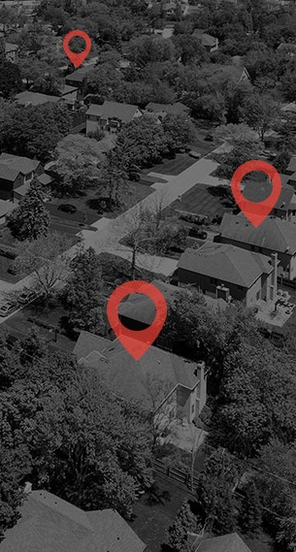
Common Digital Terms and how to express as a story
Understanding the basic language around digital marketing is important. As important is knowing how to express these definitions in a way that a client will understand...

Slide 2
Common Digital Terms and how to express as a story
Definition (Internal Jargon)
Story Version
Impression: Number of times and ad unit was served “we’ve delivered 100,000 impressions”
“We’ve delivered you to homeowners using video 100,000 times”
Clicks: A user hitting the ad to travel to a website;
“34 people clicked the ads”
“34 times the homeowners dropped what they were doing and used the ads we sent to come to your website”
Click Through Rate (CTR): The % of consumers who receive an ad and click it to go to a website. National average for Display ads is .07%;
“The CTR is .35% which is really good”
“The national average click through rate is .07%, we are running at a .35% which is 5X the national average and an indication we are hitting the right homeowners”

Slide 3
Common Digital Terms and how to express as a story
Definition (Internal Jargon)
Story Version
Key Performance Indicator (KPI): The very thing we are to measure to show progress to a goal;
“Our Campaign KPI is increased foot traffic”
“The goal of the campaign is increased revenue which we are going to measure by showing an increase of people coming into your location”
Site Visit Conversion (SVC): Measures when a consumer receives a banner ad, which they do not click, but end up on the client's site within 30-days of NOT clicking the ad;
You have received 42 SVC conversions”
“SVC measures branding or delayed consumer response. It shows consumers who saw a banner ad from the campaign but didn't click it. We keep an eye on their specific device to see if it ends up on your website within the next 3-days. This tells us we are reaching the desired audience enough that they show up when searching later!”

Slide 4

Common Digital Terms and how to express as a story
Definition (Internal Jargon)
Story Version
View Completion Rate (VCR): The % of consumers who received the video and watched it to completion; “Your View Completion Rate is 99%”
“99% of the time we got your video to the eyeballs of homeowners, they watched the whole thing to learn more about you”
Conversions: The desired action taken by the consumer (primarily on a website):
Foot Traffic
Phone Calls
Form Fills
Online Purchases
“We had 13 Foot Traffic Visits”
“13 of the homeowners who we hit with your message took time to come into your retail location. Considering the Customer Lifetime Value of $750 for each new customer, that is $9,750 in potential new revenue!”

