Slide 1



Where Your
Community Watches,
We Connect
WHERE YOUR COMMUNITY WATCHES, WE CONNECT

Slide 2

117
10
CAMPAIGN
MANAGERS
MARKET RESEARCH
DATA ANALYSTS
STREAMING TV POWERHOUSE
Experts in digital marketing who work directly with you to create tailored campaigns that fit your business needs.
Delivering easy-to-understand insights to help you reach the right customers in your local area.
Over 200 dedicated professionals ready to help your business grow with the care and communication style of a close-knit team.
65
26
PLATFORM
EXPERTS
CREATIVE
EXPERTS
Specialists who know exactly where
and how to advertise your business
for the best results.
A talented team that turns your ideas into engaging ads that attract customers.

Slide 3

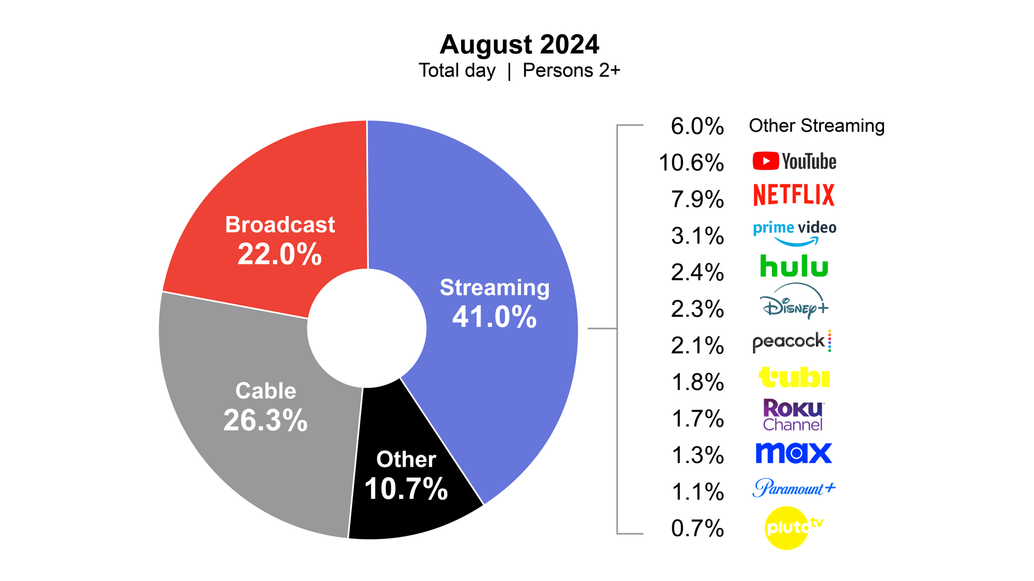
THE EVOLVING STREAMING
& LINEAR TV LANDSCAPE
AUGUST 2024 - STREAMING HITS 41% OF U.S. TV
Dominant Market Share: Streaming accounts for 41% of total TV usage, surpassing both cable (26.3%) and broadcast (22.0%), indicating where audiences are shifting.
Precise Targeting: Unlike linear TV, streaming platforms enable advanced audience targeting and personalized ad delivery, maximizing ROI.
Growing Momentum: As streaming outpaces traditional TV, ad dollars are following audience behavior, making it critical to invest in streaming for long-term brand exposure.
Nielsen. (2024). The Gauge: August 2024 [Report]. Nielsen Media Research. https://nielsen.com
5 Minutes

Slide 4
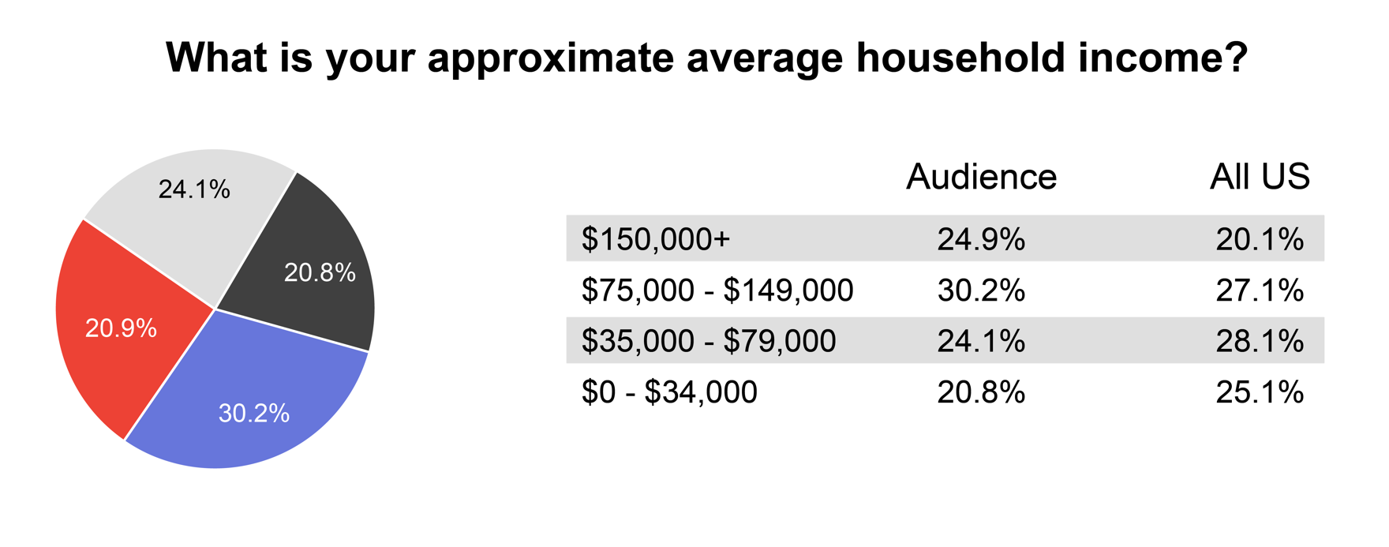
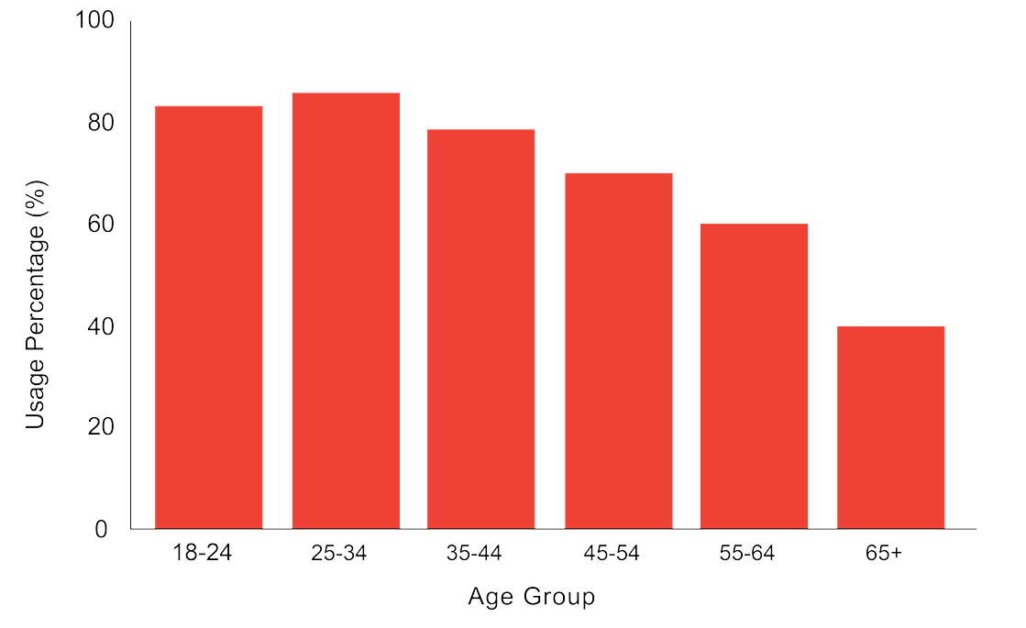
DEMOGRAPHICS OF STREAMING TV USERS
UNLOCK PREMIUM AUDIENCES WITH STREAMING TV
STV Usage by Age Group (2024)
Streaming TV: Access to Affluent, Engaged Audiences
Core Audience: Ages 25-44, led by high-earning professionals
35-44 group exceeds national streaming averages by 23%
Growing adoption among older viewers, signaling a shift from traditional TV
Pew Research Center. (2023). Media consumption across generations. https://pewresearch.org

Slide 5

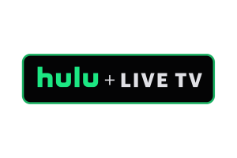






















MODERNIZE YOUR TV BUYING STRATEGY BY USING STV
If you're only buying one or two streaming/video platforms and/or using multiple providers for your buys, you're missing the mark.
As an all-in-one service provider, we give advertisers exclusive access to all major streaming/video platforms, channels and the most notable DSPs.
Consolidating your buying strategy simplifies the process, reducing vendor complexity while boosting your reach across platforms.

Slide 6











LIVE SPORTS
High-Impact Advertising That Delivers Results
OUR PREMIUM
SPORTS MEDIA PARTNERS
IMPACT YOU CAN MEASURE:
18% Lift in Purchase Intent
Sports ads drive stronger consumer buying decisions.
21% Lift in Watch/Subscribe Intent
Viewers are more likely to subscribe after seeing sports ad
58% Lift in Brand Recommendation
Sports ads boost brand advocacy and recommendations.
Interactive Advertising Bureau. (2023). Impact of sports advertising on consumer behavior. IAB. https://iab.com

Slide 7







STV CAPABILITIES OVERVIEW – KEY HIGHLIGHTS
STREAMING TV
VIDEO
Advanced Streaming TV
Leverages thousands of behavioral, demographic and consumer data points to hit target audiences across all relevant streaming platforms.
Live Sports
Engage audiences during live sports broadcasts with dynamic, in-game ads that create real-time engagement opportunities.
Live Sports Team and League
Target sports enthusiasts in real time during key moments of live sports broadcasts, capturing attention with contextual ads.
Meta
Video ad placements on Facebook and Instagram Reels, with extended viewability metrics to enhance engagement and storytelling.
Addressable TV
Targets the streaming devices of consumers at specific households or businesses based on a list of addresses provided or curated based on demographic, psychographic and location.
Pinterest
Targeted video ads on Pinterest, capturing users in the inspiration and discovery phase with visually compelling content.
TikTok
Delivers engaging short-form video ads on TikTok, allowing brands to connect with younger, mobile-first audiences.
YouTube
Broadcasts pre-roll across YouTube; advertiser only pays for ads that have not been skipped.

Slide 8

CREATIVE SERVICES
Having the right creative can make or break your campaign’s performance, and we’re here to take that challenge off your plate. With our Creative Services team, you get top-notch solutions tailored to your needs, ensuring your campaign is set up for success from the start.
Creative Vision Alignment: Ensure your campaign’s creative vision is fully realized with a dedicated team that aligns ad copy and design to your goals
Optimized Design: Get visually stunning designs tailored for maximum engagement, driving results that resonate with your audience
Impactful Video Production: Capture attention with dynamic video content designed to perform across platforms like STV and social, delivering high-quality results that drive your campaign's success

Slide 9

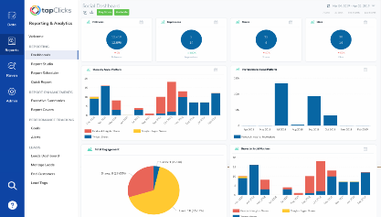


REPORTING & CAMPAIGN SUPPORT
24/7 NEAR REAL TIME DASHBOARD
KEY METRICS FOR EFFECTIVE AD CAMPAIGNS
Reach & Frequency:
Measures how many unique viewers saw the ad and how often, revealing campaign exposure and engagement.
Geographic Targeting:
Tailors' ads to specific locations (zip codes, cities, states) for better alignment with local audiences.
Device Usage:
Optimizes ads for the most-used devices (smart TVs, smartphones, tablets) to enhance cross-screen performance.
Demographics & Preferences:
Targets audiences based on age, gender, income, and interests to boost relevance and engagement

Slide 10

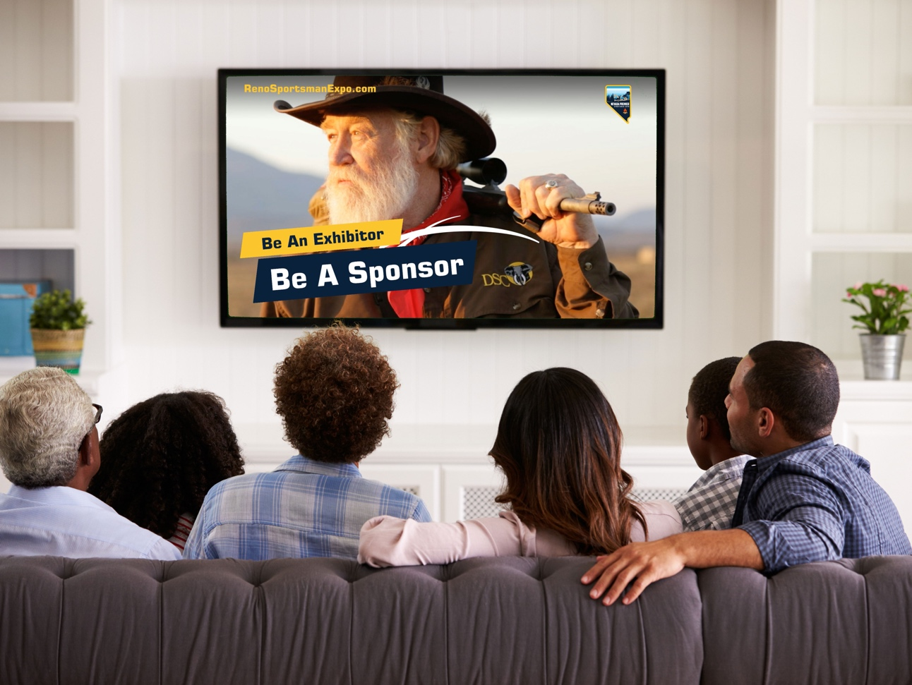





STREAMING TV
COST-EFFECTIVE
RESULTS​
PRECISE
TARGETING
INSIGHTS
ACCESS TO
LIVE SPORTS
PREMIUM
PLATFORMS
Affordable STV options with measurable ROI—optimize your budget and manage campaign frequency effectively
Target ideal customers using geographic, demographic, behavioral, psychographic, and cross-device data for optimal audience reach
STV with us offers detailed campaign tracking, with skilled in-house campaign managers optimizing during the campaign using CTV performance analytics. ​
Deliver in-game advertising across top sports leagues, including the NFL, MLB, NBA, NHL, WNBA, LPGA, PGA, MLS, NCAA, and action sports like UFC, offering real-time access to highly engaged fans​
Reach audiences on top streaming platforms like Netflix, Hulu, and YouTube TV. Capture viewers as they embrace on-demand content and stay ahead of evolving consumer habits.​

