Slide 1
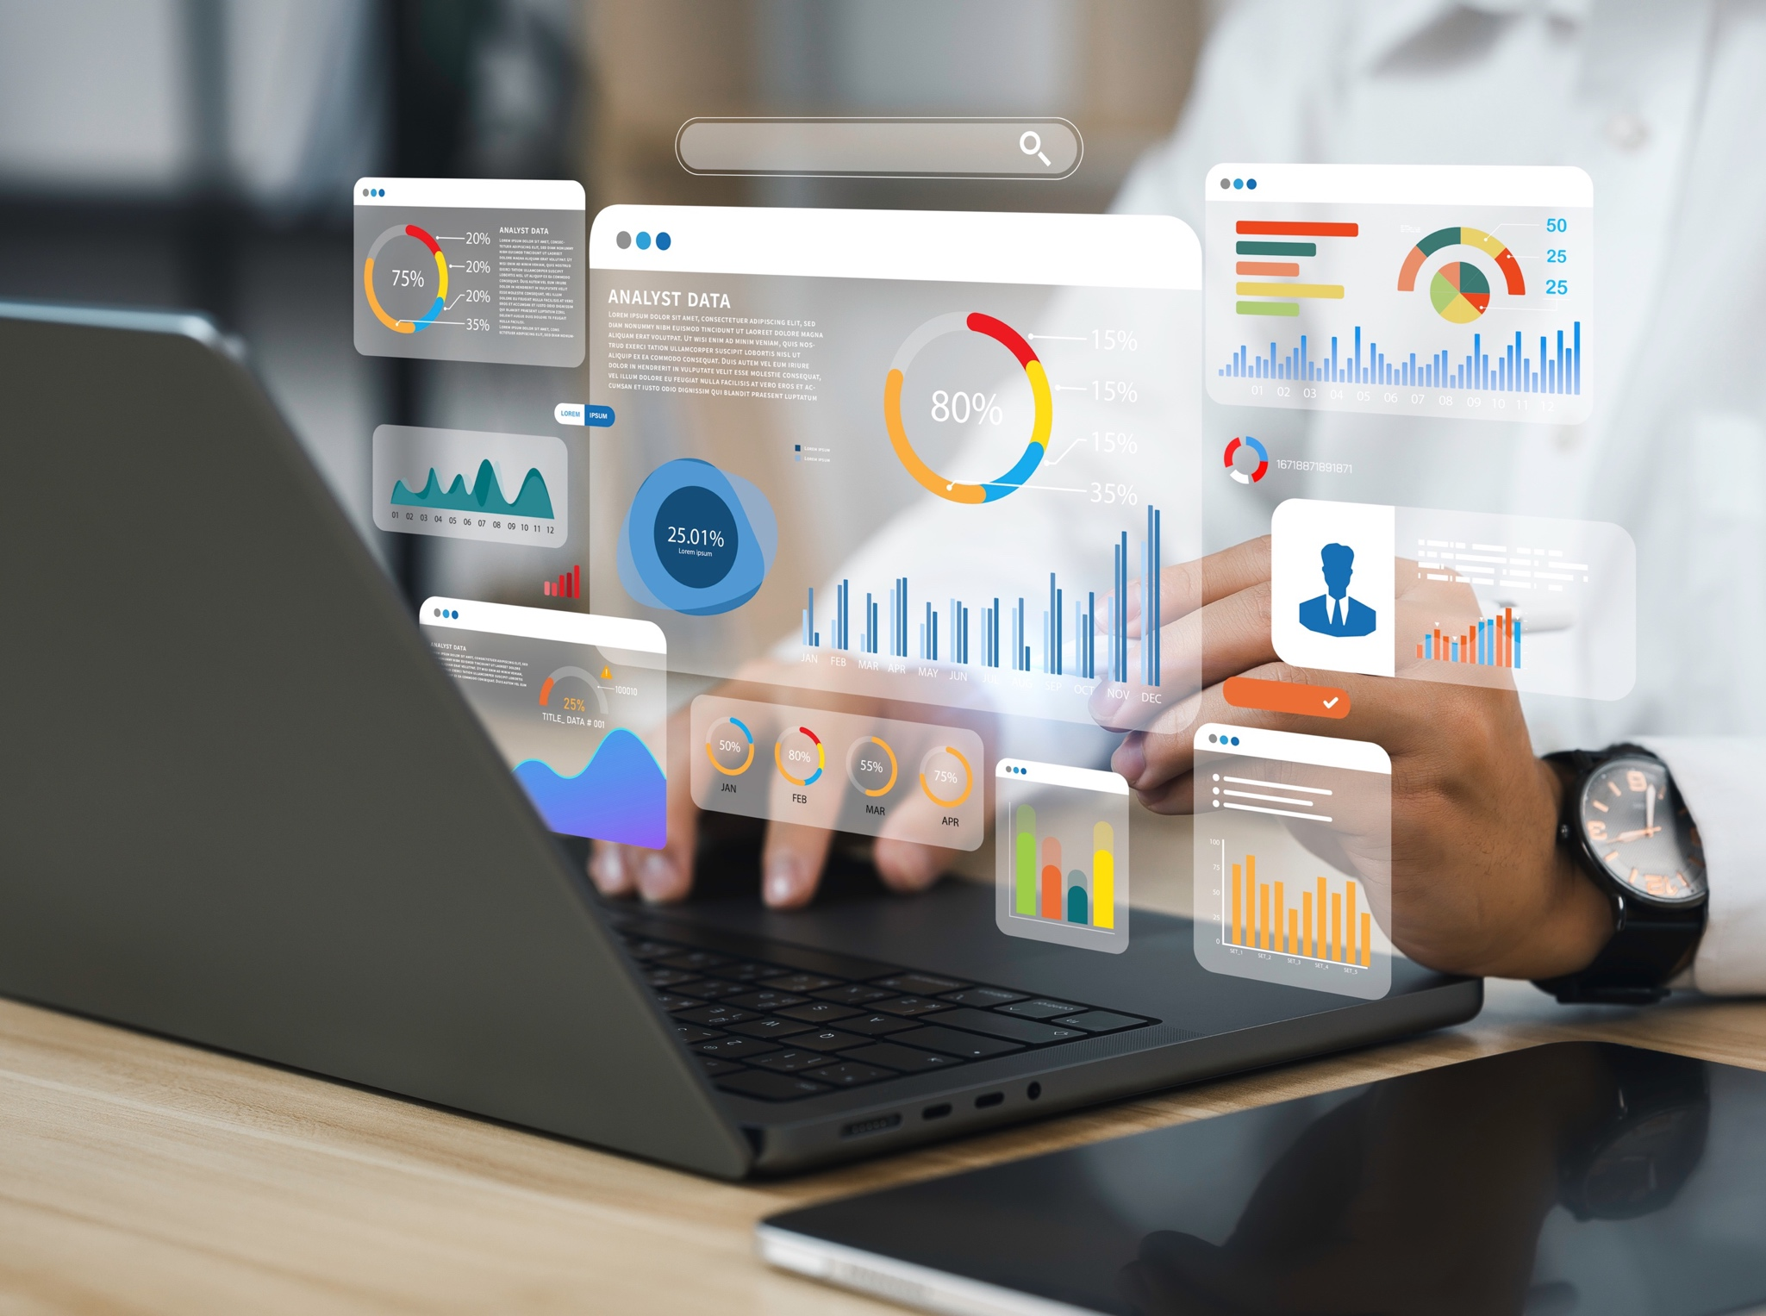

Fueling Business Growth Through Proven Digital Marketing Solutions

Slide 2



WHO IS RENDA MEDIA GROUP?
At Renda Media Group, we are dedicated to transforming brands through innovative digital marketing solutions. Our focus is on connecting brands with their target audiences in meaningful ways, leveraging cutting-edge technology and data-driven insights to maximize impact. We are committed to delivering exceptional results that drive growth and foster lasting relationships in today's dynamic digital landscape.
OVER 260 DIGITAL CLIENTS ACTIVELY RUNNING WITH US IN 2024!
IN-HOUSE TRADING DESK: Connected to five major demand-side platforms (DSPs), social platforms, and search engines, delivering over 300 billion impressions daily.
ROBUST DATA MANAGEMENT PLATFORM (DMP): Access to millions of customer data segments for targeted and effective marketing strategies.
FULL-SERVICE MARKETING SOLUTION FOR SMBS: Providing expert web development, social media management, and SEO services to drive digital growth.
RESEARCH – In-House management of data allows for transparent and updated insights to fuel campaign performance.
EXECUTION – With direct access to all the major DSPs, this allows us to seamlessly optimize campaigns across platforms without limitation.
REPORTING – Provides both
high-level overviews and in-depth analytics, allowing users to quickly grasp key metrics or thoroughly analyze data.

Slide 3













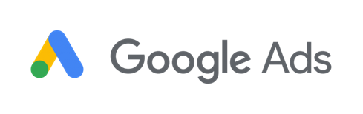


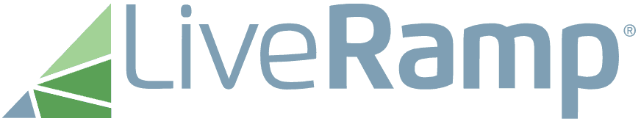




ALL-INCLUSIVE
VIP ACCESS
RESEARCH
In-House management of data allows for transparent and updated insights to fuel campaign performance
EXECUTION – With direct access to all the major DSP's, this allows us to seamlessly optimize campaigns across platforms without limitation
MEASURMENT
Provides both high-level overviews and in-depth analytics, allowing users to quickly grasp key metrics or thoroughly analyze data.

Slide 4


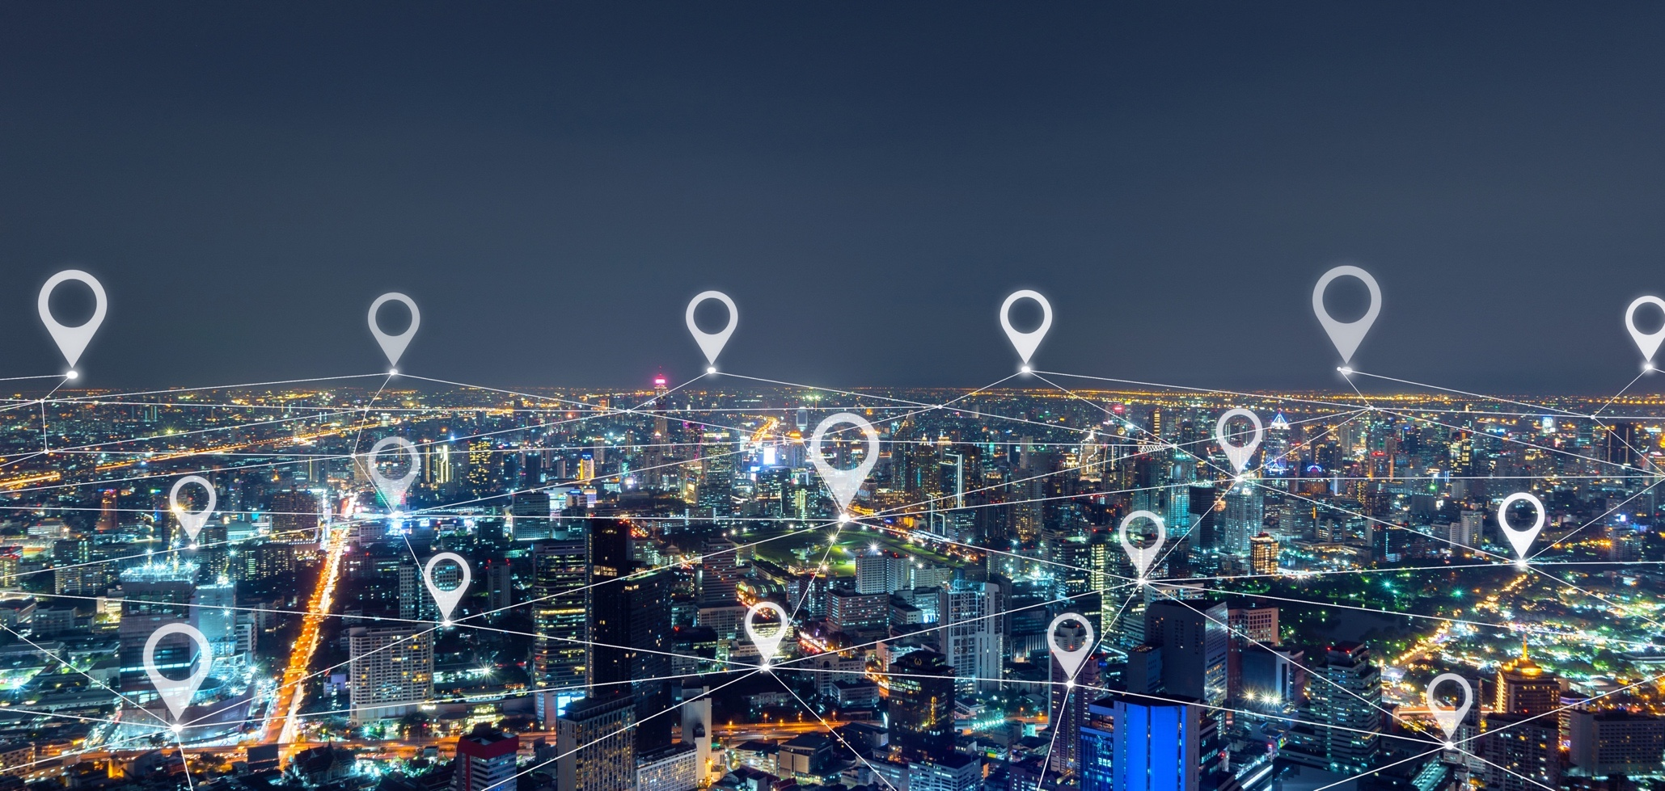

DATA IN ACTION
CUSTOMIZED
RESEARCH
AUDIENCE
BUILDING
INDUSTRY AND
MARKET-LEVEL INSIGHTS
MARKET TRENDS
CREATIVE MESSAGING
Our in-house research team, delivers top-tier insights using the best industry resources. Identify your client base through CRM and foot traffic analysis, understand what drives them to buy, and see how you stack up against competitors. Data-driven strategies power your success.
The future of targeting is in custom audiences. Use pixel-based retargeting, look-alike modeling, and CRM integration to grow and enhance your audience, improving both quantity and quality.
With millions of consumer data points and hundreds of platforms to choose from, digital campaigns can be overwhelming. We uncover your market potential and identifies the best platforms to reach your audience
Get insights into industry trends identifying the top advertising platforms your audience is leaning into, top challenges seen across your industry, spending patterns, CO-OP opportunities and more
Craft messaging that resonates with your audience, guided by data and tailored to your brand’s voice. Ensure your message stands out and drives results.

Slide 5

OUR TECH

Slide 6
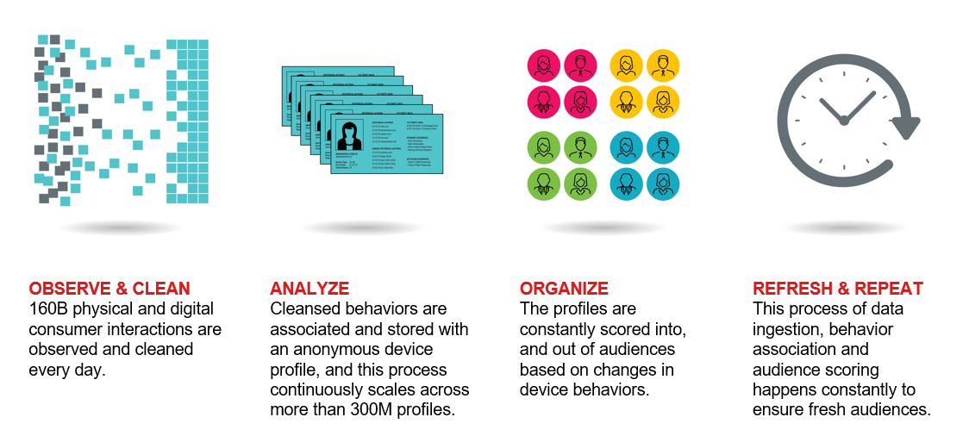
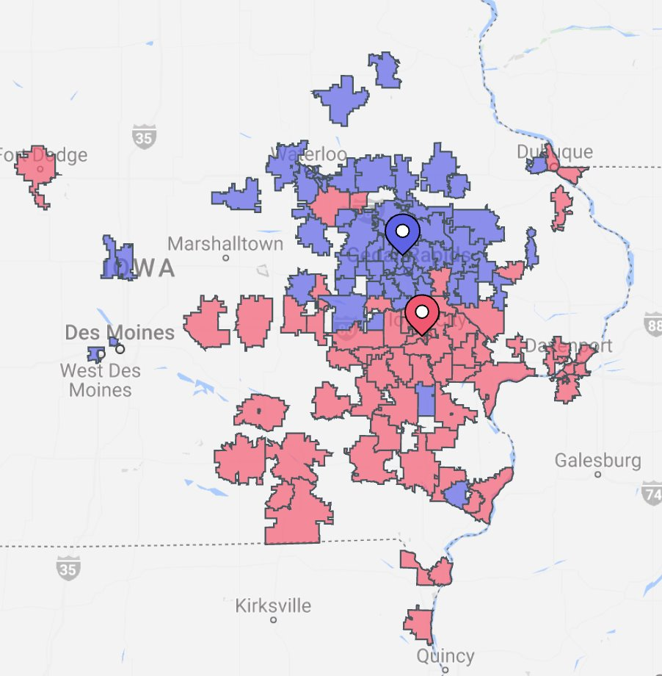
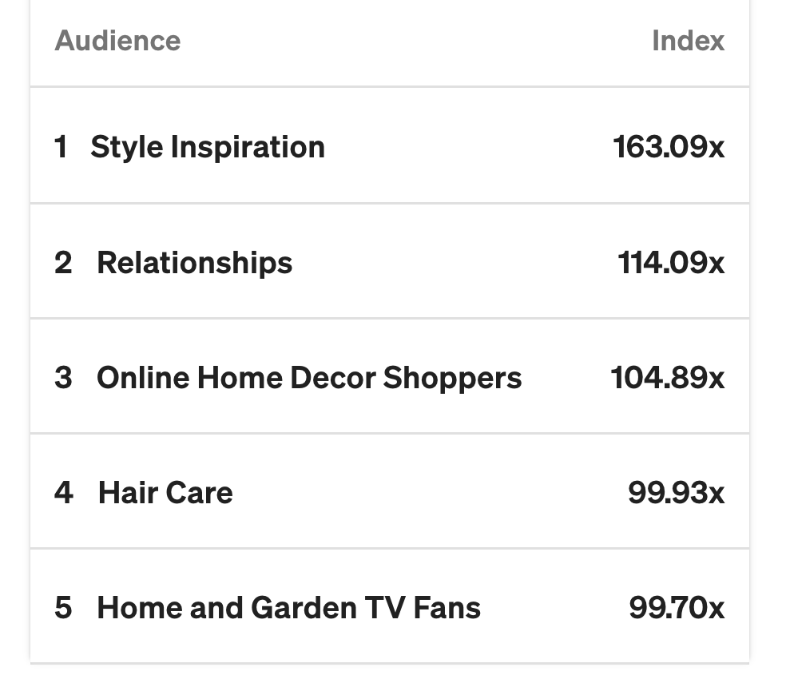

Leverage Data to Drive Precision and Maximize ROI
At Summit Interactive, we leverage powerful data insights from two key sources to optimize campaigns across all verticals:
Dstillery DMP: Analyzes online behaviors and interests, enabling us to build highly targeted custom audiences.
Placer AI: Provides real-world location data, including foot traffic, visit frequency, and dwell time, helping us understand where consumers spend their time offline.
With 25,000 clients and millions in media spend under management, our extensive experience allows us to continuously optimize campaigns for maximum effectiveness.
By integrating behavioral data with location insights, we create smarter strategies that reach consumers both online and in the places they frequent. We also utilize customer data or pixel websites to build look-alike models, ensuring precision targeting and better ROI.
Data-driven marketing has been shown to lead to a 20% increase in revenue for companies by allowing them to target the right audience with the right message

Slide 7


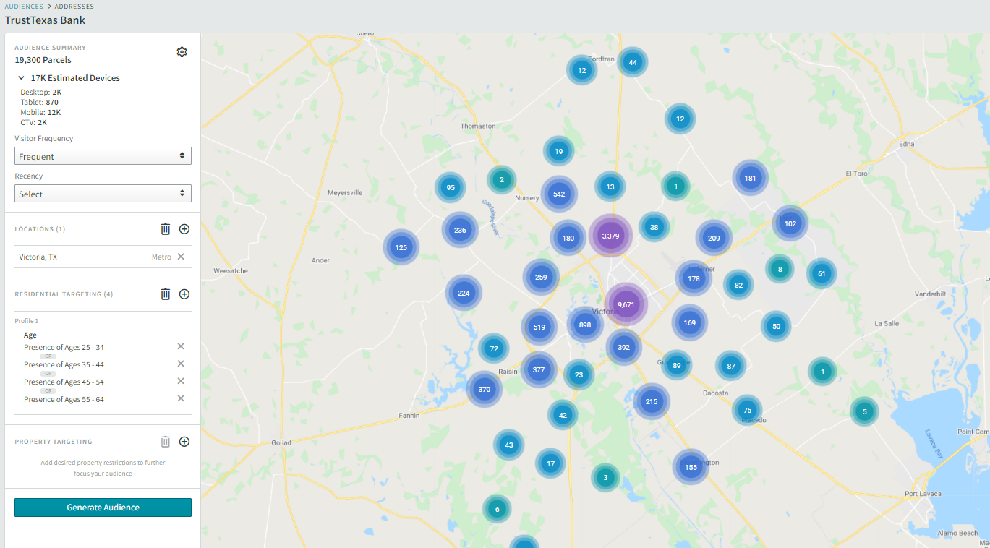
CUSTOM TARGETING WITH ADVANCED DATA & INTEREST
Reach people that are in market for (customize)
There are 19,300 people we can target in the across the Victoria.
Who are persons, 25-64
Pop 67,055
Streaming TV

Slide 8
Tactics

Slide 9























AUDIENCE TARGETED STV
Reach consumers who watch their shows and news online by delivering :15 and :30 non-skippable video ads on streaming platforms like Sling, Pluto, and Tubi, through devices like Roku, Amazon Fire, and PlayStation.
Engaged Viewers: Reach consumers watching their favorite shows on popular streaming platforms.
Precise Targeting: Target your consumer through our content networks: Sports, Entertainment, Lifestyle and News
Attribution: Measure completions rate, reach and frequency.
PLACEMENT ON PREMIUM MEDIA BRANDS:
AWARENESS
DELIVERY OPTIONS:
PLATFORMS:
Smart Televisions
STV Video

Slide 10




PREMIUM PLACEMENT P-STV
TARGETING INCLUDES: Prime, Hulu, YouTube, & Netflix
Reach consumers who watch their shows and news online by delivering 15 and :30 non-skippable video ads on the most popular streaming g platforms like Amazon, YouTube TV, Hulu & Netflix.
Engaged Viewers: Reach consumers watching their favorite shows on popular streaming platforms.
Precise Targeting: Target your consumer through our sports content networks.
Attribution: Measure completions rate, reach and frequency.
PLACEMENT ON PREMIUM MEDIA BRANDS:
AWARENESS
DELIVERY OPTIONS:
PLATFORMS:
Smart Televisions
STV Video

Slide 11



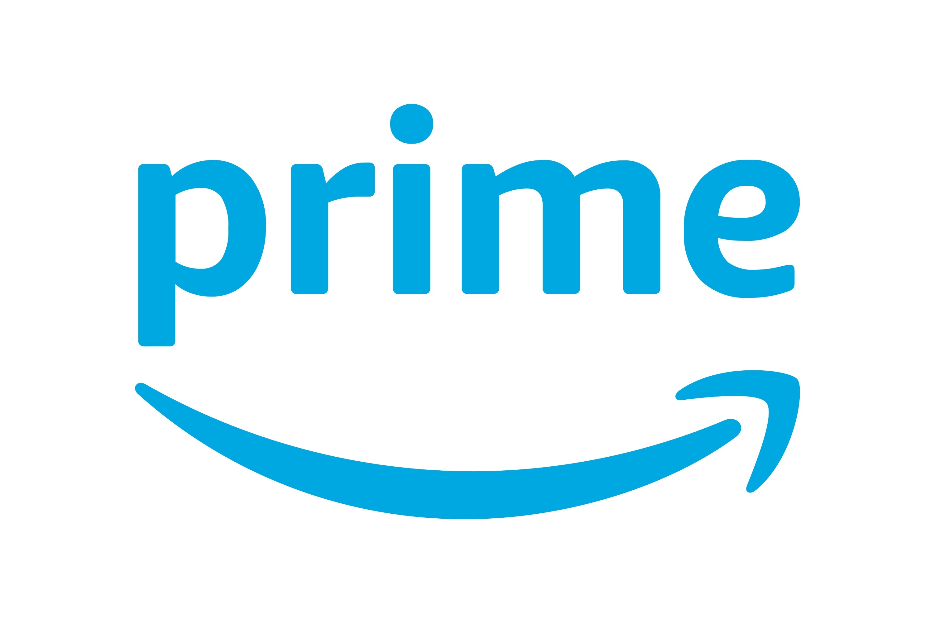





C
Premium STV+
Home Subscriber Bundle
Platinum+ STV provides first-class access to the most-watched streaming platforms, ensuring local advertisers can reach engaged audiences where they stream their favorite content.
Demographic Targeting: Targets include age, HHI, and more
Geo-Targeting: State, DMA, and Zip Code
Inventory: Disney, YouTube TV, Peacock, Hulu, Netflix, Paramount+, Max
Product Insights
Brand awareness and drives instant engagement by positioning your ads within the most-watched, high-impact streaming platforms.
Elevate your brand presence and outshine the competition, getting your message in front of your audience on platforms that typically serve national ads.
5 Minutes

Slide 12

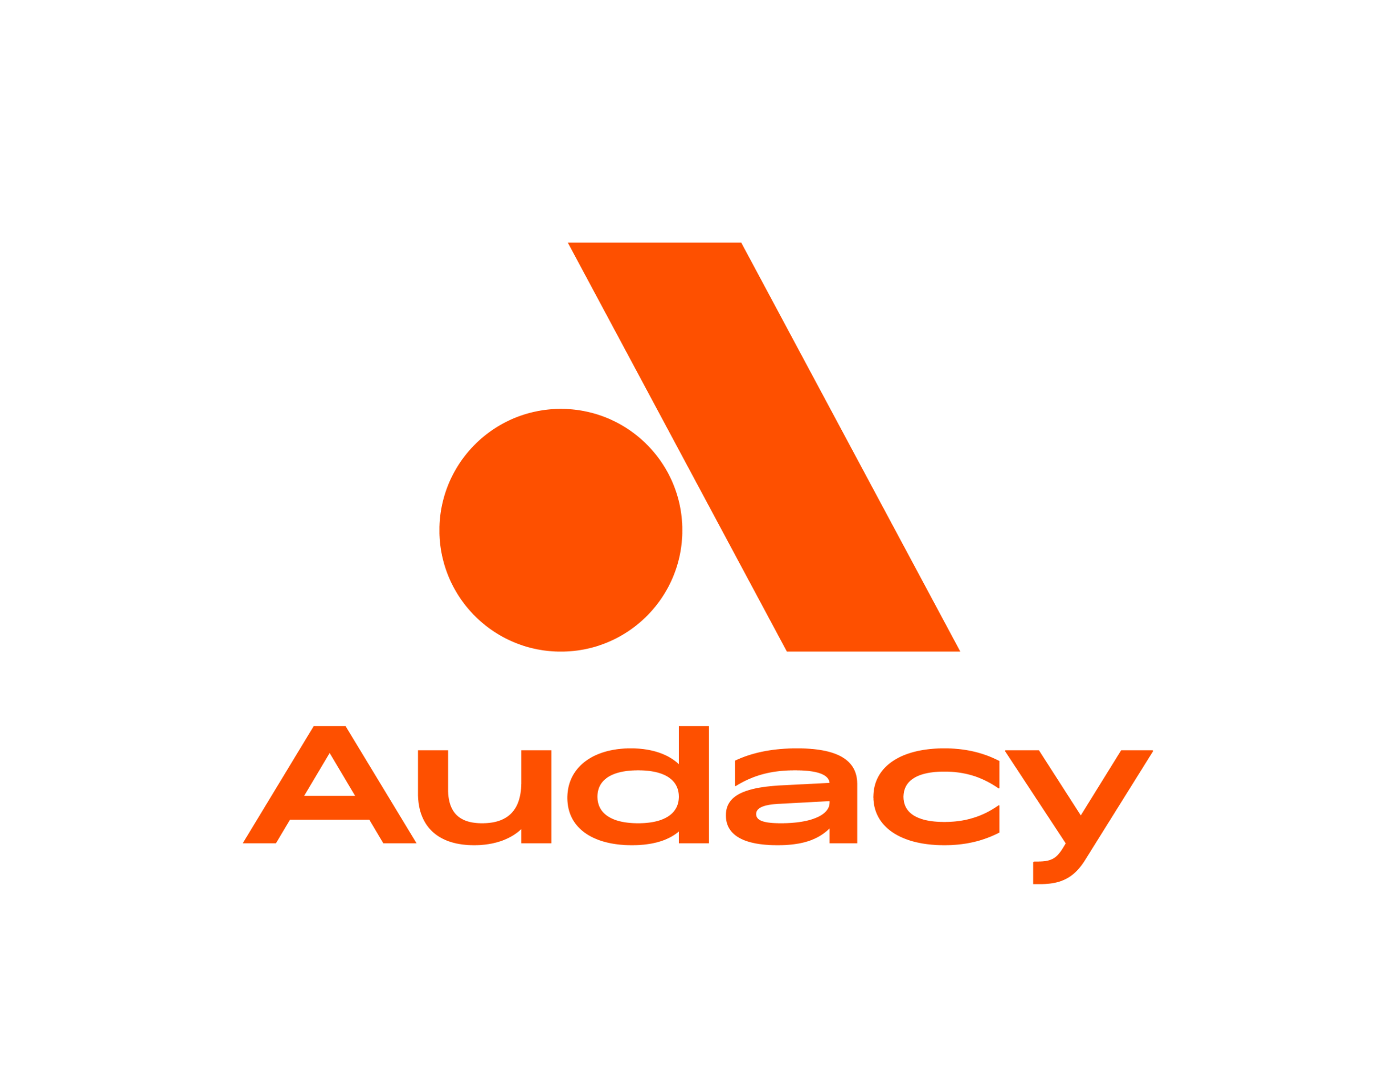



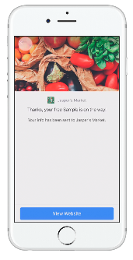

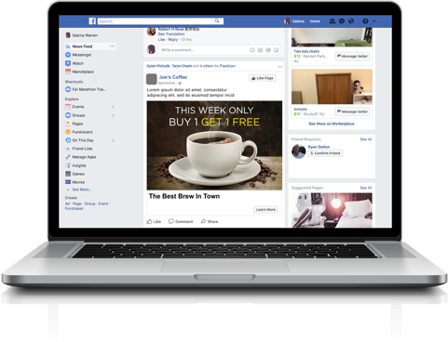
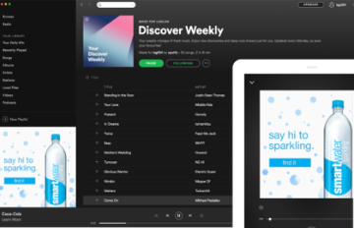
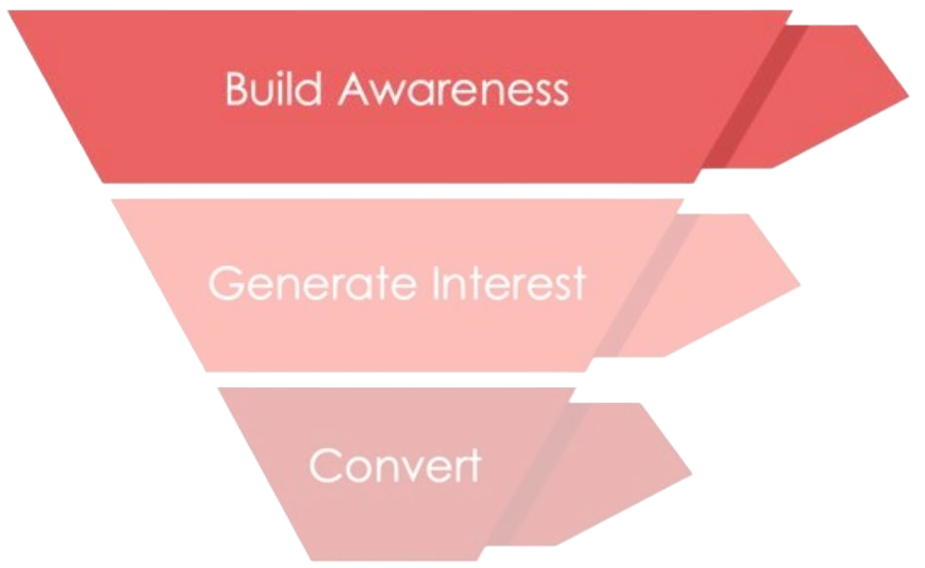


PROGRAMMATIC AUDIO
Reach a highly engaged audience with impactful audio ads on platforms like Spotify with programmatic audio.
Audio ads have shown a 24% lift in recall in comparison to traditional display
Programmatic audio ads are excellent to grow brand awareness
Reach a targeted audience on platforms like Spotify to go beyond the reach of radio
Free companion banner ad
Over 60% of U.S. adults listen to streaming audio weekly: More than 60% of adults in the U.S. engage with streaming audio services like Spotify, Pandora, and Apple Music on a weekly basis, providing a large audience for audio ads.
DELIVERY OPTIONS:
Audio
Display
5 Minutes

Slide 13

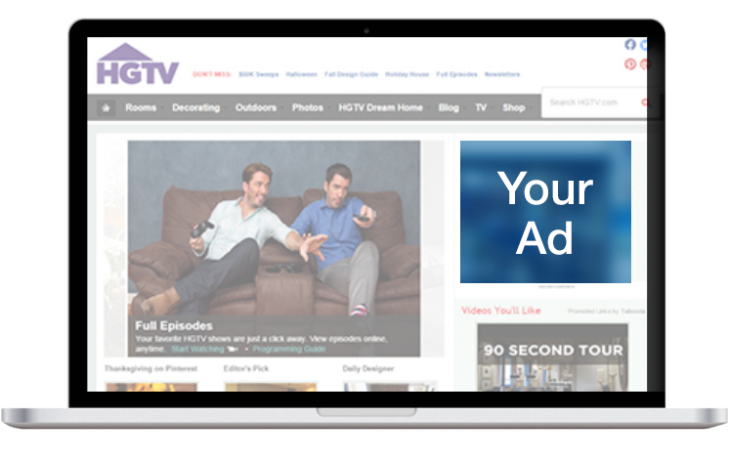
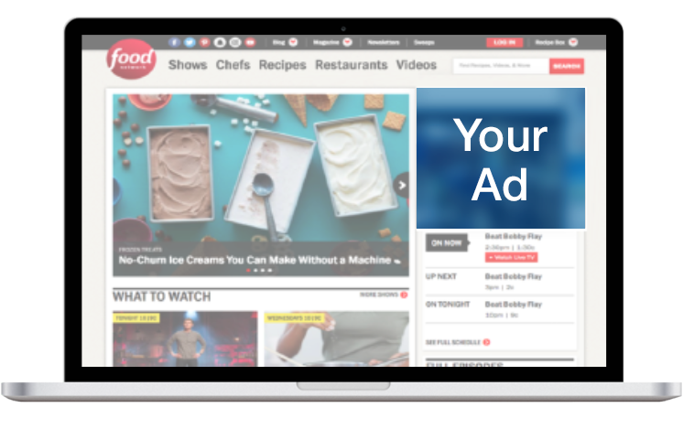
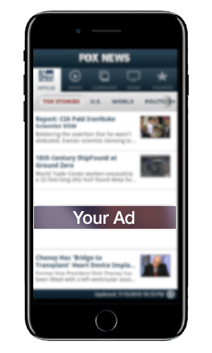
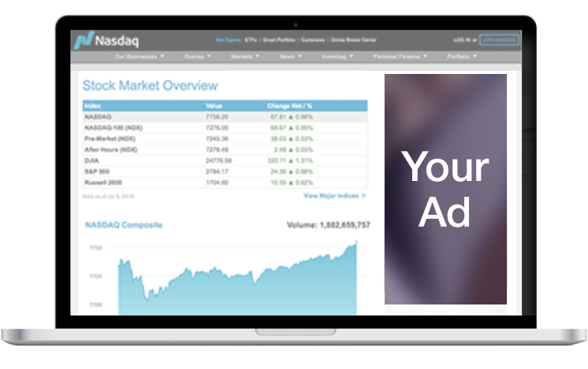
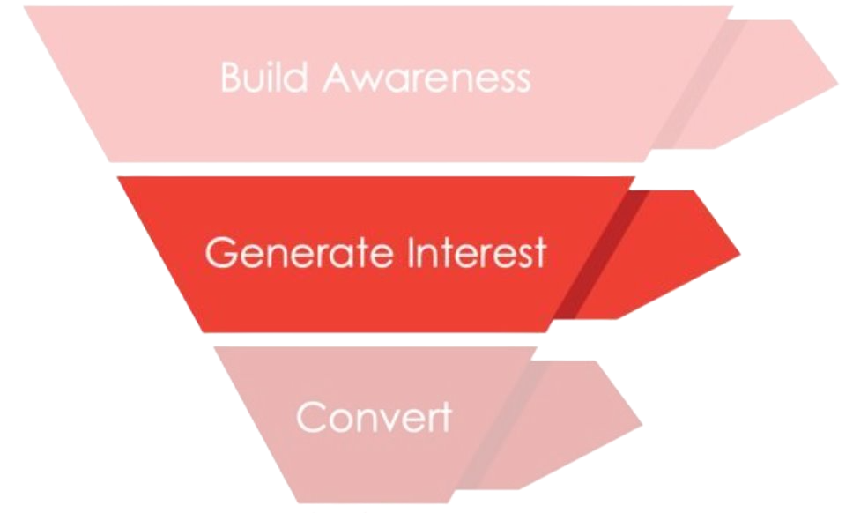

PROGRAMMATIC DISPLAY
Maximize your presence in market across a wide variety of sites by running ads across Summit Interactive’s extended network of local and national websites.
  Targeting Capabilities:
  3rd party data targeting
  Contextual Targeting
  Website Targeting
  Native advertising
  Geofencing
  Retargeting
Programmatic display ads reach 98% of internet users: With access to a vast array of networks and platforms, programmatic ads can reach up to 98% of internet users worldwide, giving businesses unparalleled reach and visibility.
DELIVERY OPTIONS:
Display
Native
5 Minutes

Slide 14


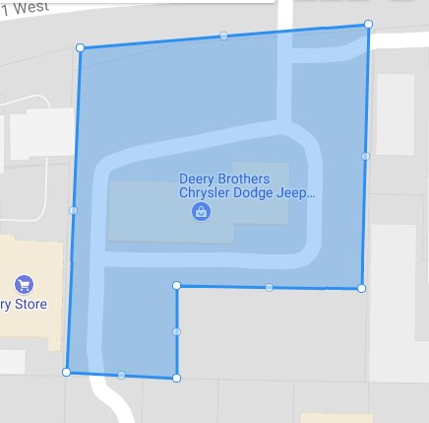
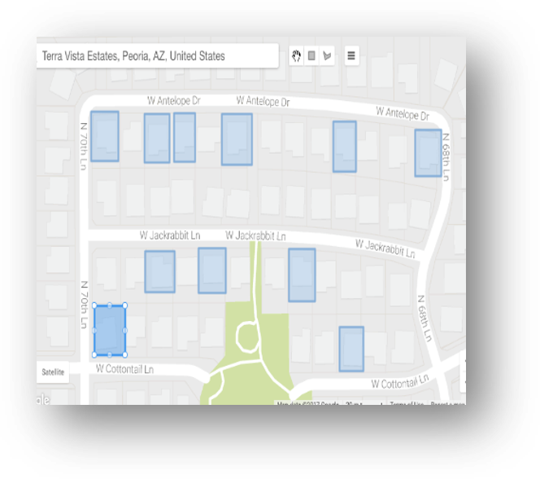


LOCATION BASED TARGETING
Geofencing targets users based on location, while addressable targeting delivers personalized ads based on demographics and interests. Combined, they ensure your ads reach the right people at the right time, boosting relevance and engagement.
Tens of thousands addresses can be targeted in one campaign
Foot traffic lift to advertisers locations can be measured using geo conversion lift capabilities
Ads delivered to devices that have been detected at the addresses, both while they are at the specified addresses and while they are away from them.
Geofencing drives a 20% increase in conversion rates: Studies show that using geofencing can result in a 20% boost in conversion rates, as the ads reach consumers when they are in proximity to a physical location, prompting immediate action.
DELIVERY OPTIONS:
Video
Display
CTV
5 Minutes

Slide 15

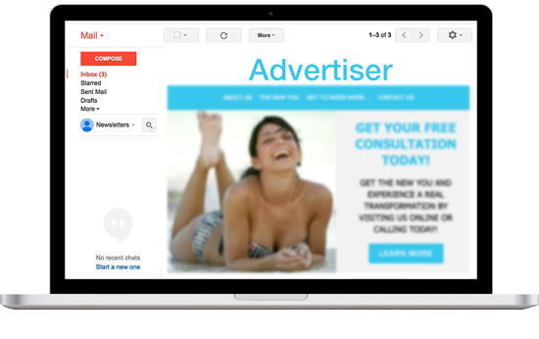

EMAIL MARKETING
Deliver your message or promotion directly to the inboxes of viable prospects through a targeted email marketing campaign.
Leverage a rich set offline and online 3rd party audience data
Target your ideal audience based on demographics, interest and intent
Guaranteed 10% open rate
Guaranteed 1% click through rate
Retarget email openers
Option to acquire physical addresses of people that opened the emails
Email marketing drives 81% of B2B and 77% of B2C customer acquisition: Email is a critical tool for both B2B and B2C businesses, with 81% of B2B and 77% of B2C marketers relying on email to acquire new customers.
DELIVERY OPTIONS:
Banner Ad
Email
5 Minutes

Slide 16









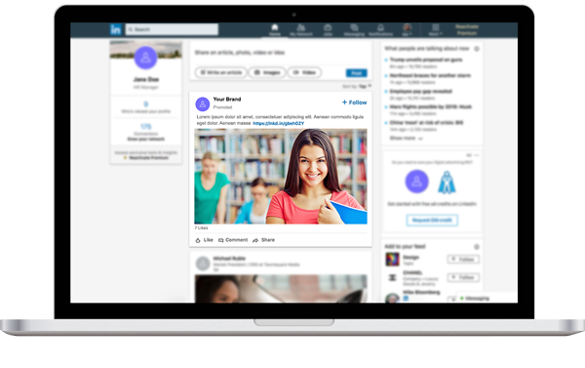
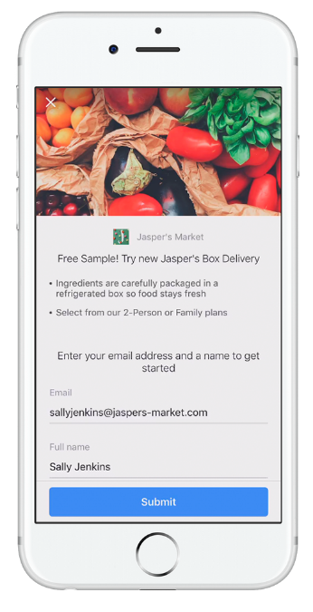
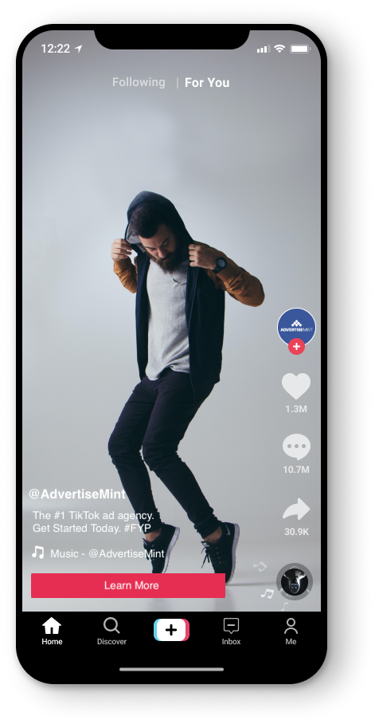

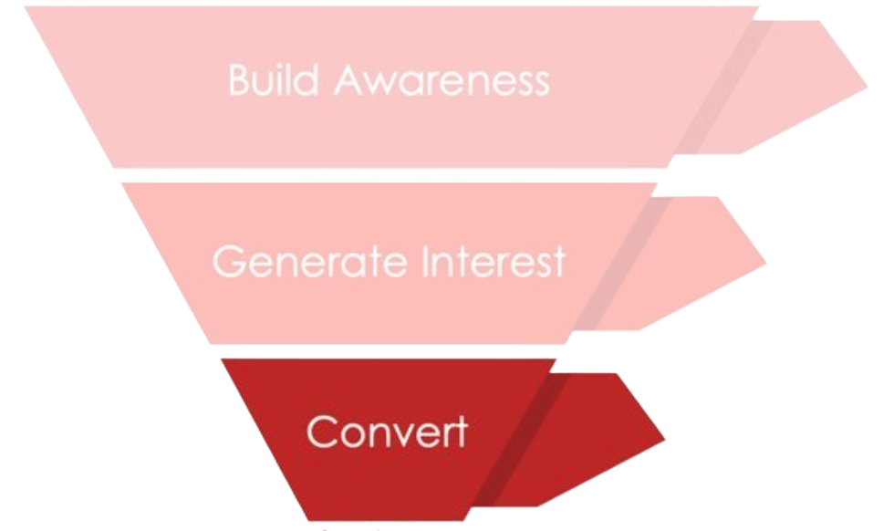
SOCIAL ADVERTISING
Expand reach on social network users who are within your target geography and who fit your target audience
Target by geo, demo, interests, behaviors
Integrate Summit’s partner 3rd party data for more precise reach
Look alike modeling
Optimize for completed views, clicks, landing page views or conversions
The average user spends 2.5 hours a day on social media and 52% of users discover new products and services through these platform.
DELIVERY OPTIONS:
Video
Display
5 Minutes

Slide 17

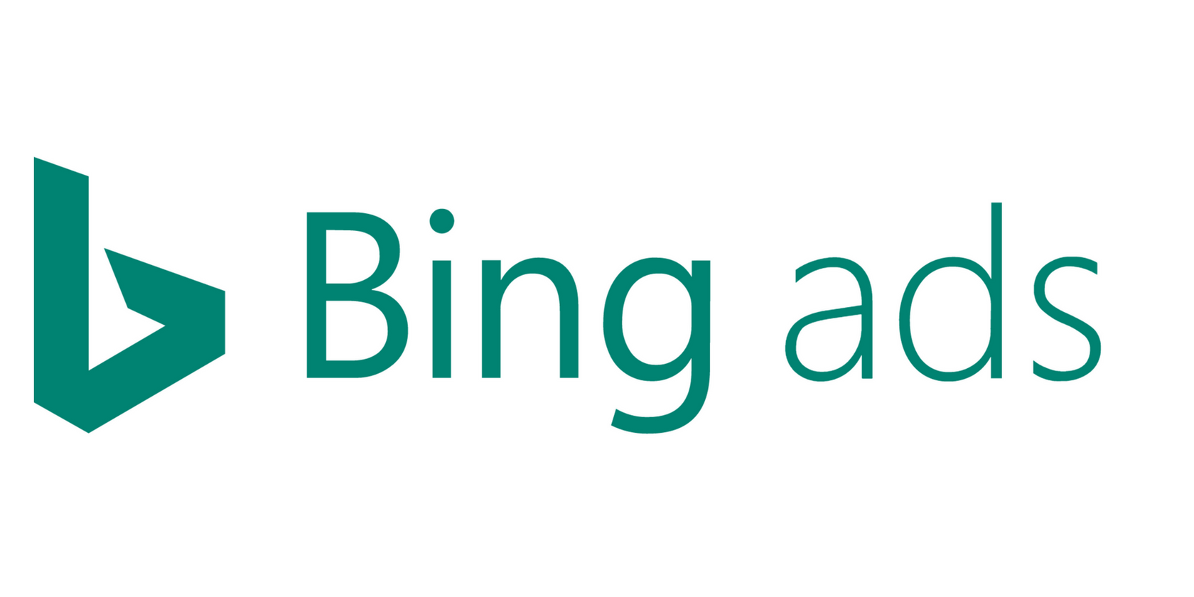
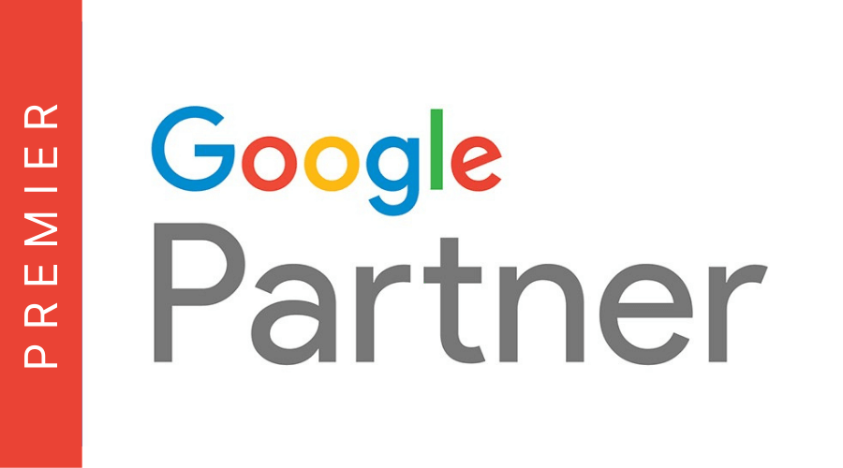
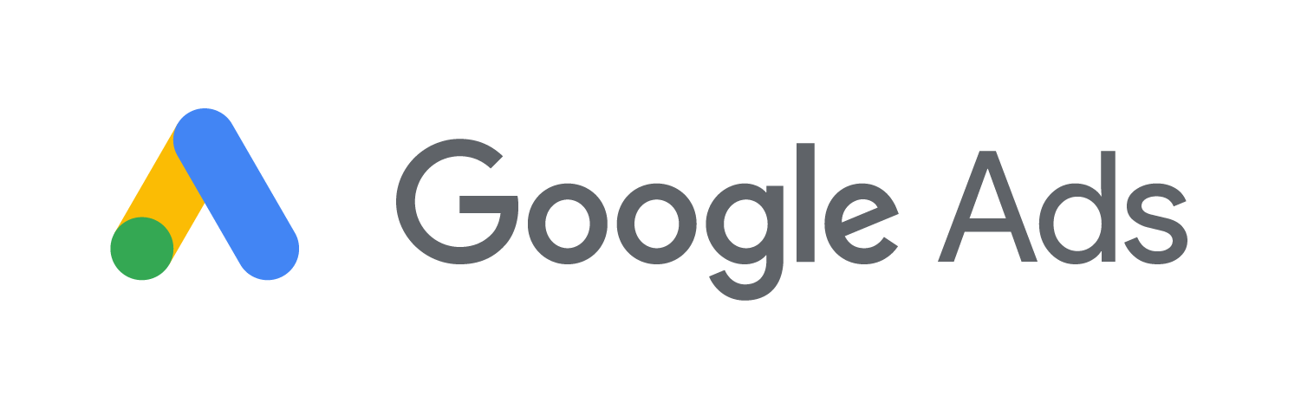
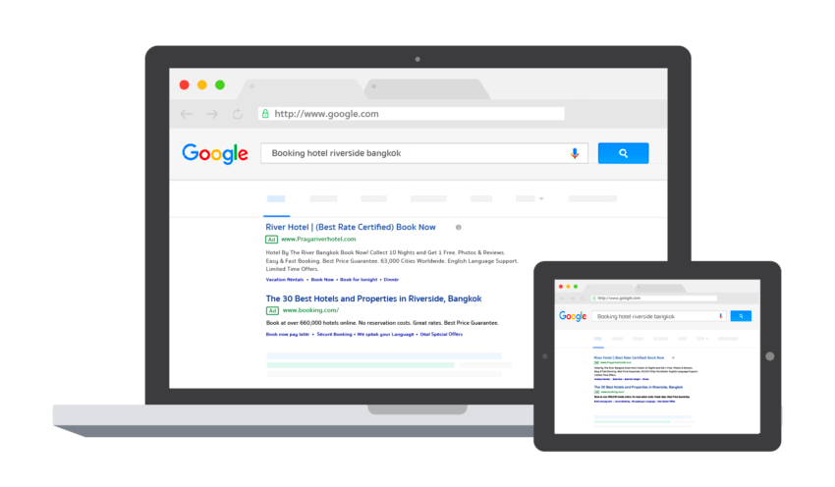

SEARCH ENGINE MARKETING
Drive conversions with a campaign that places your brand on the same page as relevant search results.
Great way to reach in market consumers for
branding or direct response purposes
Customizable to increase relevancy to searcher
Target audience at the optimal point in the purchase process
Increase customer acquisition
Links to Google Analytics
Call Tracking capabilities
Optimize towards conversions or conversion value (ROAS)
Search Engine Optimization add on available
Over 45% of online searches have a local intent, making it a key tactic for local small businesses to drive calls, leads, and revenue. Summit Interactive is a Google Platinum partner placing it in the top 3% of all digital agencies
DELIVERY OPTIONS:
Search
5 Minutes

Slide 18





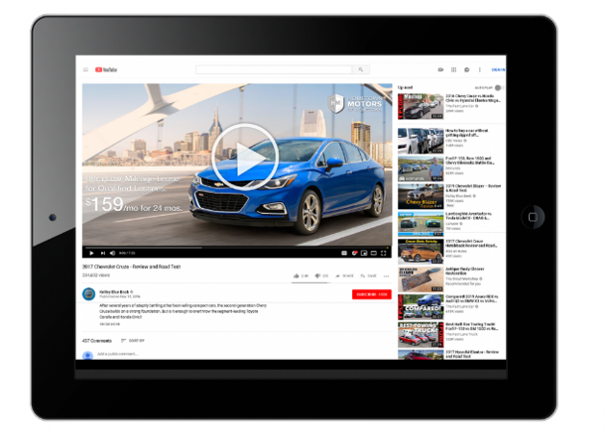
Google Performance Max AI (Spark)
Reach your customer across the buying journey on multiple platforms with the common goal to drive conversions
Great way to reach in market consumers for
direct response purposes
Target audience at the optimal point in the purchase process
Utilize 1st party data to guide targeting
Reach customers on video, display, social, and search
Increase customer acquisition
Optimize towards conversions or conversion value (ROAS)
Google Shopping integration and dynamic product ads connected to Google Merchant Center
AI-driven marketing can increase ROI by 30%: Businesses using AI-powered marketing strategies report an average increase of 30% in return on investment (ROI), highlighting the effectiveness of AI in optimizing ad performance and budget allocation.
DELIVERY OPTIONS:
Video
Display
Search
5 Minutes

Slide 19
FULL SERVICE

Slide 20

OUR TEAM : YOUR TEAM
200+ Employee Manpower​
with the communication style of an internal team.
117 campaign managers
65 platform specific buyers
26 creative experts
10 Market Research Data Analysts
200 Digital strategist
CLIENT
ACCOUNT EXECUTIVE
DIGITAL STRATEGIST
DIGITAL CAMPAIGN MANAGER
PROGRAMMATIC BUYER
SOCIAL BUYER
SEM BUYER
GRAPHIC DESIGNER
VIDEOGRAPHER
DATA AND ANALYTICS

Slide 21

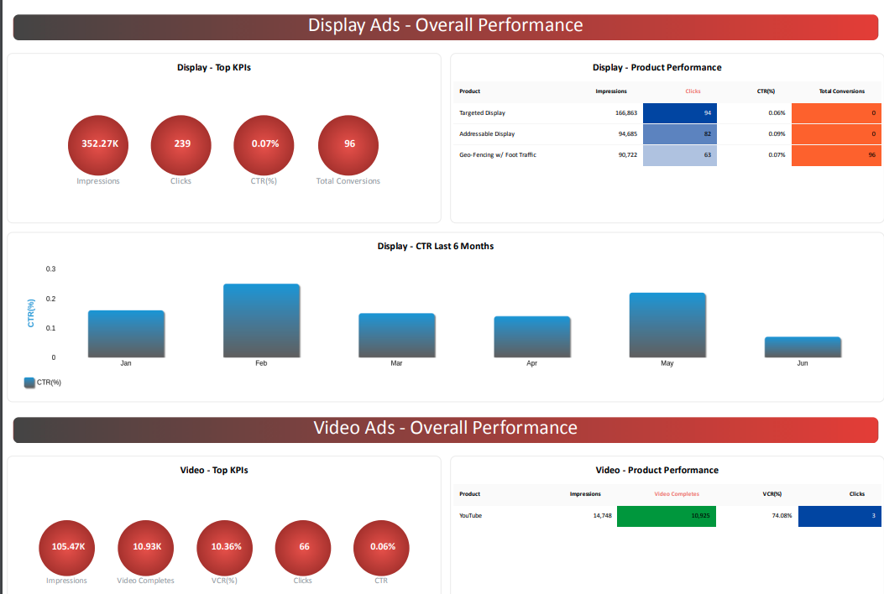


MEASURE SUCCESS
In a crowded digital advertising landscape, it is essential to understand how we stack up against the competition. Here's why Summit’s Interactive stands out:
Pulse dashboards empower you to:
Track real-time campaign performance
Navigate a user-friendly, customizable interface
Visualize clear, impactful metrics
Access on any device
Dive into advanced analytics and reporting
Integrate multiple data sources seamlessly
Leverage predictive insights and trend analysis
Customize KPI tracking
Why it matters:
Make quick, informed decisions
Enhance client communication with clear visuals
Save time with streamlined reporting
Optimize strategies with deep insights
Stay proactive and prepared for market shifts

Slide 22

















CAPABILITIES OVERVIEW
CROSS-PLATFORM
SOCIAL
STREAMING TV
Targeted Display, Video, and Native
Uses 1st and/or third-party data to target consumers based on audience, content, keyword targeting, retargeting, website, and CRM Matching.
Facebook and Instagram
Amplify image or video messaging to targeted users on two of the most popular social media platforms.
Audience Targeted
Deliver targeted ads to specific audiences based on behavior and demographics across streaming platforms.
Addressable: Display, Video, STV
Targets the devices of consumers at specific households or businesses with based on a list of addresses provided or curated based on demographic, psychographic and location.
Snapchat
Capture engaged consumers attention through targeted static or video ads based on their location and demographics.
Channel
Reach viewers through curated channels, ensuring your ads align with content that resonates with your audience.
TikTok
Provides unique engagement solutions and immersive formats to creatively and authentically connect with audiences.
Addressable
Target specific households with personalized ads across streaming services for precise engagement.
Email Marketing
Delivers messaging directly to inboxes of viable prospects with available match-back reporting.
Spark
Leverage the power of today's technology and Artificial Intelligence to drive conversions across a range of advertising channels.
LinkedIn
Positions your messaging in users’ feeds in the world’s largest professional networking environment
Premium Subscription Services: YouTube TV, Hulu, & More
Access high-quality ad placements on premium streaming platforms like YouTube TV and Hulu, reaching engaged subscribers.
Search Engine Marketing
Delivers ads next to relevant search results for the greatest opportunity to measure conversions.
Nextdoor
Target customers in your neighborhood with this hyperlocal social networking service for local communities.
Live Sports
Capture the attention of passionate sports fans with ads during live streaming sports events on major platforms.
YouTube
TrueView and other YouTube advertising formats and placements available.
MOBILE
Geofencing
Targets mobile users based on their current location or locations previously visited (up to 365 days in the past).
Geofencing + Foot Traffic
Delivers ads to mobile users based on location, recency and tracks foot traffic to your business.
Streaming Audio
Delivers audio messaging through some of the world's largest streaming platforms.

