Slide 1
IGNITE YOUR REACH Digital Training
WHERE YOUR COMMUNITY WATCHES, WE CONNECT
WHERE YOUR COMMUNITY WATCHES, WE CONNECT
WHERE YOUR COMMUNITY WATCHES, WE CONNECT
WHERE YOUR COMMUNITY WATCHES, WE CONNECT

Slide 2
AGENDA
Trends in Digital
Tactics by Funnel
Customer Needs Analysis
Strategy for KPI

Slide 3
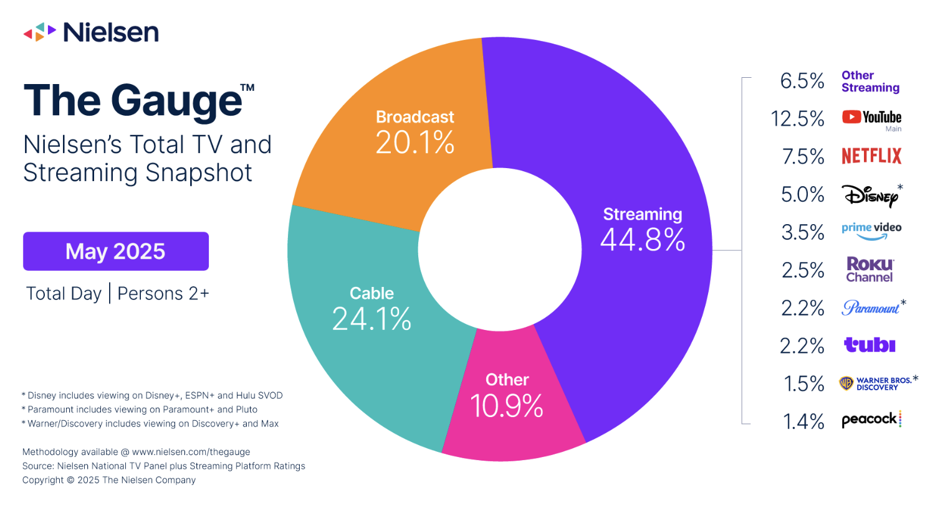
THE EVOLVING STREAMING & LINEAR TV LANDSCAPE
May 2025 - STREAMING HITS 44.8% OF U.S. TV
Dominant Market Share: Streaming accounts for 44.8% of total TV usage, surpassing both cable (24.1%) and broadcast (20.1%), indicating where audiences are shifting.
Precise Targeting: Unlike linear TV, streaming platforms enable advanced audience targeting and personalized ad delivery, maximizing ROI.
Growing Momentum: As streaming outpaces traditional TV, ad dollars are following audience behavior, making it critical to invest in streaming for long-term brand exposure.
Share of total U.S. TV time in May 2025. (Nielsen)

Slide 4
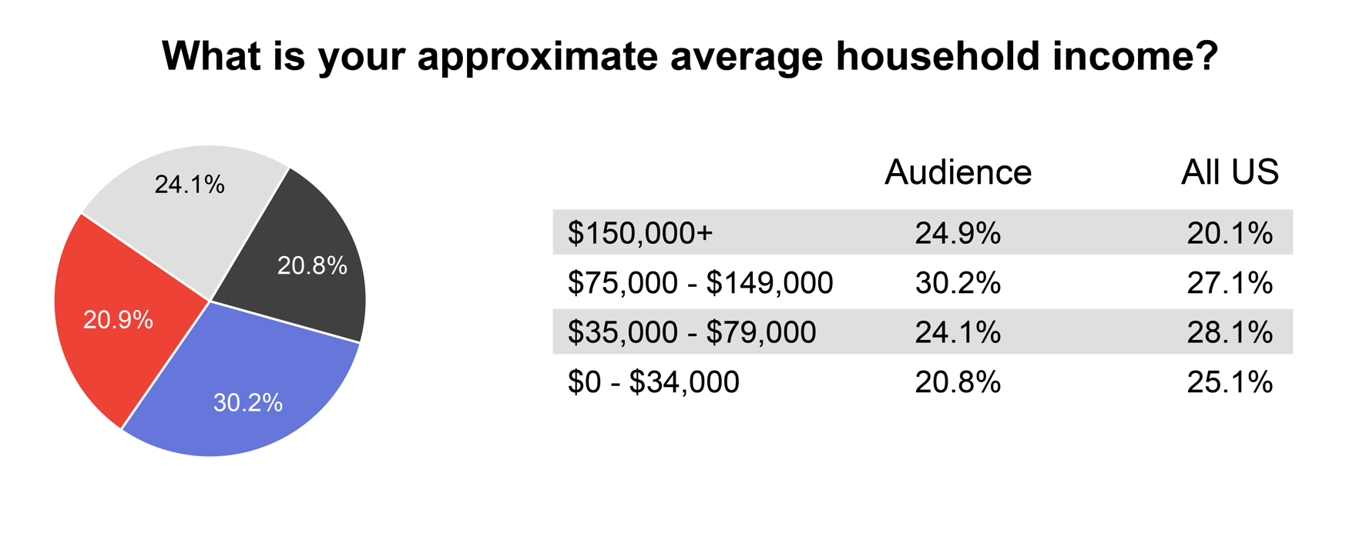
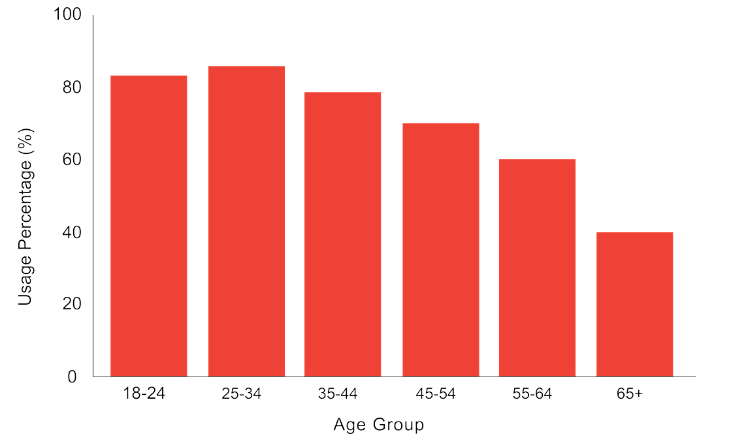
DEMOGRAPHICS OF STREAMING TV USERS
UNLOCK PREMIUM AUDIENCES WITH STREAMING TV
STV Usage by Age Group (2024)
Streaming TV: Access to Affluent, Engaged Audiences
Core Audience: Ages 25-44, led by high-earning professionals
35-44 group exceeds national streaming averages by 23%
Growing adoption among older viewers, signaling a shift from traditional TV
Pew Research Center. (2023). Media consumption across generations. https://pewresearch.org

Slide 5
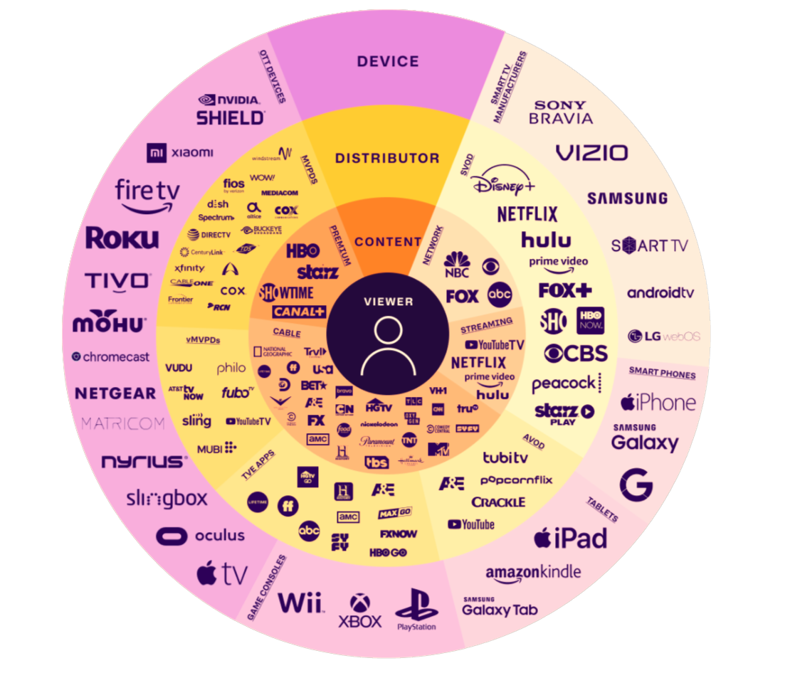
THE VIEWER IS NOW THE PROGRAMMER
VP Sales
RISD
DSM
Solo Hunter
DSM

Slide 6
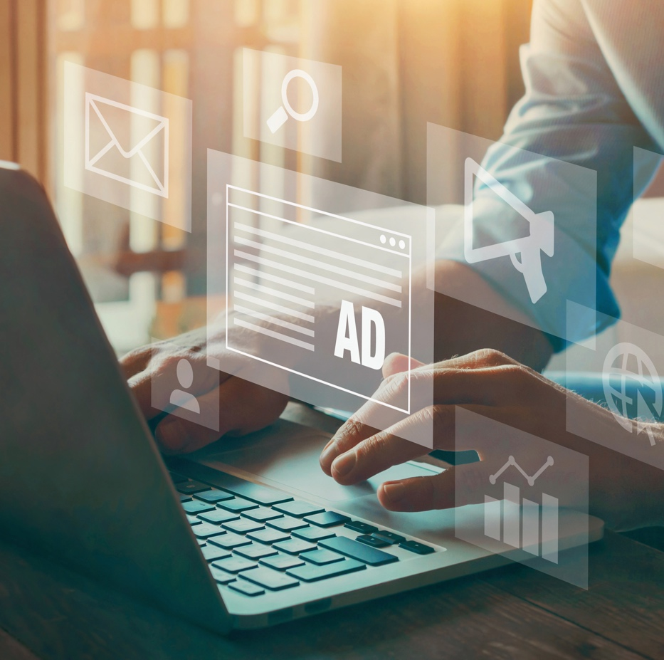
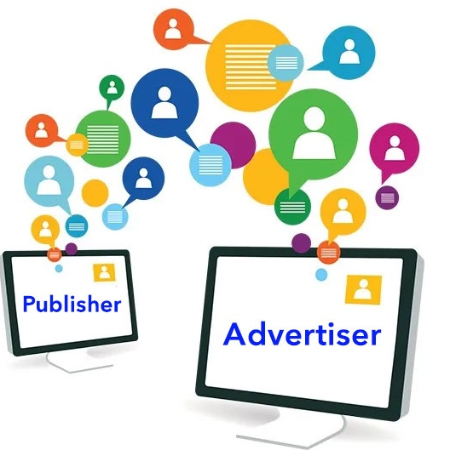
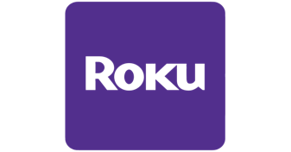
3 WAYS INVENTORY IS SOURCED
PROGRAMMATIC
PLATFORM DIRECT
PUBLISHER DIRECT
How Purchasing Works:
Automatically via real-time bidding on a DSP (Demand-Side Platform)
Benefits: Ensures broad reach, and cost efficiency
How Purchasing Works: Buy directly from specific platforms
Benefits: Offers premium inventory and precise audience control
How Purchasing Works: Through direct negotiations or agreements with a publisher
Benefits: Provides exclusive placements and direct publisher relationships

Slide 7
What does success mean to your Business?
We prioritize your business success by aligning our strategies with your specific goals—whether it's driving awareness, increasing website traffic, or maximizing conversions.
Our detailed conversion tracking allows us to measure performance across every stage of the customer journey.
By closely monitoring key metrics tied to your objectives, we continuously optimize campaigns to ensure they deliver meaningful, measurable results, helping you achieve sustainable growth and a strong return on investment.
Awareness
Maximize Reach
Video Completion
Traffic
Cost Per Click
Click through Rate
Landing Page View
Conversions
Form fills
Frequency Control
Foot traffic
Calls

Slide 8
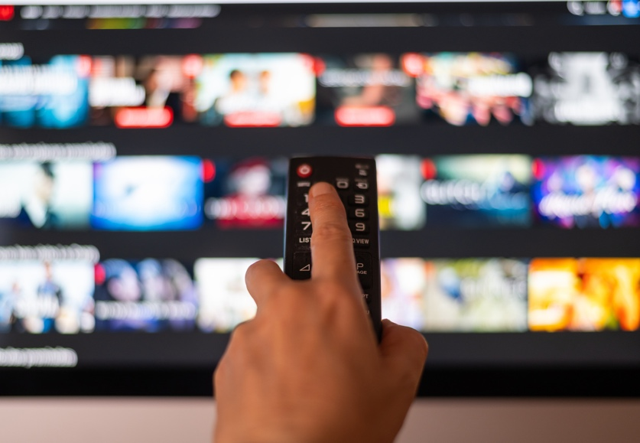
How we consume media today
RADIO
STREAMING AUDIO
STREAMING TV
97% of adults listen to radio or streaming on their way to work and AM/FM radio reaches 91% of 18+ Americans.
*Edison Research in 2022
Weekly online radio consumption has increased to 70% in 2023, increasing from 12% in 2007.
*Statista 2024
75% of households will watch streaming TV this year and cord cutters now outnumber traditional TV subscribers.
*E-marketer US OTT viewership forecast

Slide 9
Which Tactic should you choose?
Awareness
STV, Programmatic Audio, YouTube, TikTok, Facebook Video, Preroll Video, Snapchat
Consideration
Programmatic Display, Facebook Link Click, Tik Tok Link Click, SEM (max click goal), Remarketing from Awareness exposure
Intent
Meta converions, Facebook lead gen, Spark AI, SEM (max conversion goal), Tik Tok Conversion
Notes:
Plan details: Nov 1st - 30th Denver DMA

Slide 10
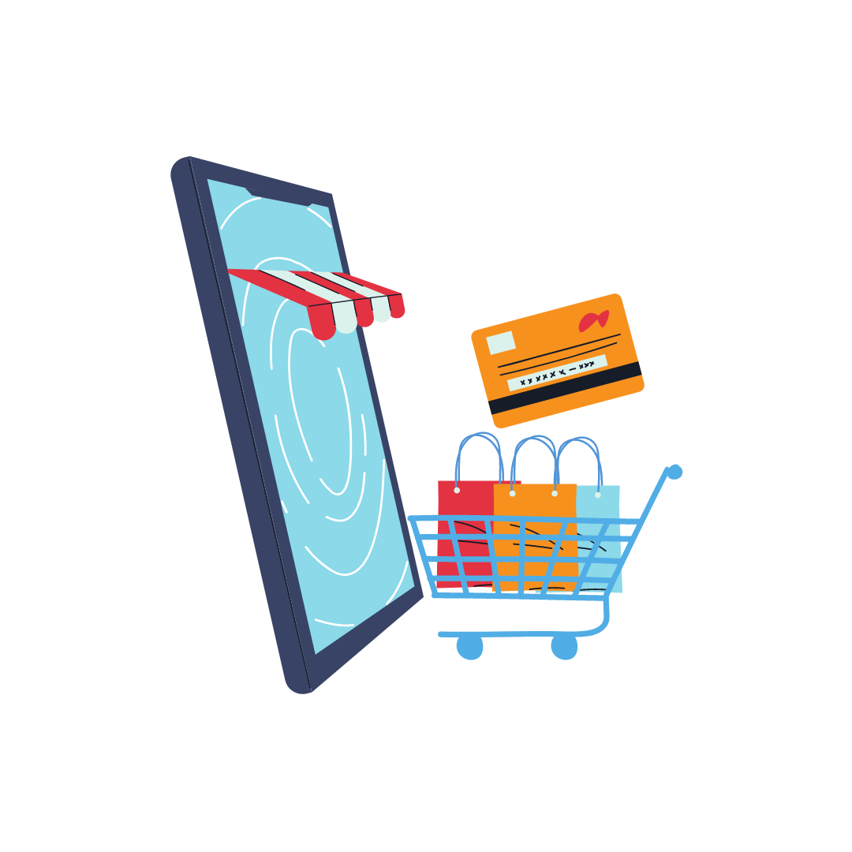
Sell solutions, not products
To focus on customer solutions we have to simplify the offerings and give autonomy to buying team to optimize for goals
Build Awareness | Generate Traffic | Foot Traffic | Lead Generation | Sales
Local Radio Programmatic Audio YouTube Preroll Video Facebook Thruplay Tik Tok Awareness Snap Chat Awareness Amped Display + RON Programmatic Pinterest Awareness Streaming Television | Programmatic Display Facebook Link Click Twitter Link Click Snap Chat Swipe Ups Tik Tok Link Clicks SEM Maximize Clicks Pinterest Link Clicks LinkedIn Link Clicks | Addressable Display Addressable Video Addressable STV Conversion Zones | SEM Form Opt / Calls Facebook Lead Gen LinkedIn Lead Gen Facebook Messenger Ads Facebook Conversion Ads Twitter Conversion Ads Pinterest Conversion Ads TikTok Conversion Ads Email + Match-back Report | Google Performance Max Facebook Catalog Sales Facebook Advantage Sales TikTok shopping Ads

Slide 11
Understand your Clients Needs
To sell effective campaigns we must understand the goals of the customers and how we plan to achieve them
S Specific | M Measurable | A Achievable | R Relevant | T Timely
What do you want to do? | How will measure success? | Is it possible to achieve your goals? | What is the goal worth? | Within what time frame do you want to achieve your goal?
Define your goals clearly What do you want to accomplish How are these goals currently achieved? Why are you looking to increase your goal Are there any constraints? | Can we track the progress and measure the outcome? How will you know when your goal is achieved | Is the goal reasonable enough to be accomplished? What would limit us achieving the goal? | What is the value of the goal completion? Is each goal completion the same value? What is the lifetime value of the goal completion? | Within what time do you want to reach your goals Is there a seasonality that comes into play reaching the goals and the value of the goals?

