Slide 1
RECOMMENDED SOLUTIONS

Slide 2
TARGETED DISPLAY & VIDEO
Place your brand on popular streaming channels and websites, making sure your ads are seen by the right people at the right time.
Strategic Placement: Ensure your ads are seen by the right people at the right time.
High Engagement: Capture attention with visually appealing ads.
Amplify Your Impact: Captivate viewers on their favorite sites with your ads via video or display. This tactic can transform casual browsers into loyal customers, boosting both brand awareness and sales.
TARGETING EXAMPLES
Who They Are: Male/Female, Income, Age, Number of Children, Language, Job Title, etc.
What They Are Interested In: Sports, Gourmet Foods, Travel, History, etc.
What They Show Intent to Purchase: In-Market Automobile, In-Market Real Estate, etc.
DELIVERY OPTIONS:
Video
Display
AWARENESS

Slide 3
STREAMING TELEVISION (STV)
Reach consumers who watch their shows and news online by delivering :15 and :30 non-skippable video ads on streaming platforms like Sling, Pluto, and Tubi, through devices like Roku, Amazon Fire, and PlayStation. Utilize precise audience targeting to deliver ads to specific demographics, interests, or behaviors.
Engaged Viewers: Reach consumers watching their favorite shows on popular streaming platforms.
Precise Targeting: Tailor your ads to specific demographics, interests, and behaviors.
Amplify Your Impact: Imagine being part of viewers’ favorite shows with non-skippable ads. This tactic ensures your message gets through and resonates deeply, driving immediate engagement and brand loyalty. With over 33 million cord-cutters in the US and a 20% increase in streaming viewership, leveraging STV ensures you capture a significant audience shifting from traditional cable to streaming.
AWARENESS
5 Minutes

Slide 4
AUDIENCE TARGETED STV
Reach consumers who watch their shows and news online by delivering :15 and :30 non-skippable video ads on streaming platforms like Sling, Pluto, and Tubi, through devices like Roku, Amazon Fire, and PlayStation.
Engaged Viewers: Reach consumers watching their favorite shows on popular streaming platforms.
Precise Targeting: Target your consumer through our content networks: Sports, Entertainment, Lifestyle and News
Attribution: Measure completions rate, reach and frequency.
PLACEMENT ON PREMIUM MEDIA BRANDS:
AWARENESS
DELIVERY OPTIONS:
PLATFORMS:
Smart Televisions
STV Video

Slide 5
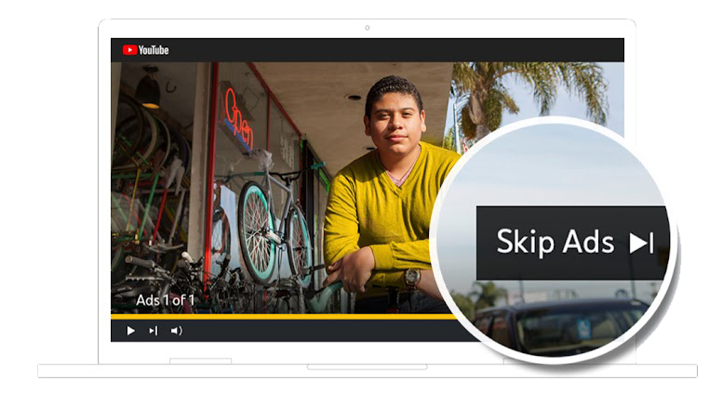
YOUTUBE TRUEVIEW
Deliver highly targeted, skippable pre-roll videos to engaged viewers on YouTube with TrueView.
High Engagement: Capture attention with skippable videos.
Targeted Reach: Deliver ads to specific audiences.
Amplify Your Impact: Hold viewers’ attention right before their favorite videos. This tactic drives immediate engagement and interest, turning viewers into customers.
AWARENESS
Mocks for illustrative purposes only
5 Minutes

Slide 6
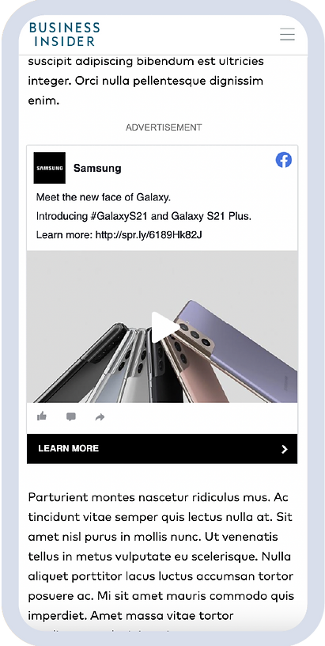
SOCIAL DISPLAY
Distribute your social creative as standard display ads across the web, maximizing reach with social display.
Extended Reach: Distribute social content widely.
High Engagement: Increase interaction with display ads.
Amplify Your Impact: Reach every corner of the web with your social content. This tactic maximizes your ad’s visibility and engagement, driving immediate interest and conversions.
AWARENESS
Mocks for illustrative purposes only
5 Minutes

Slide 7
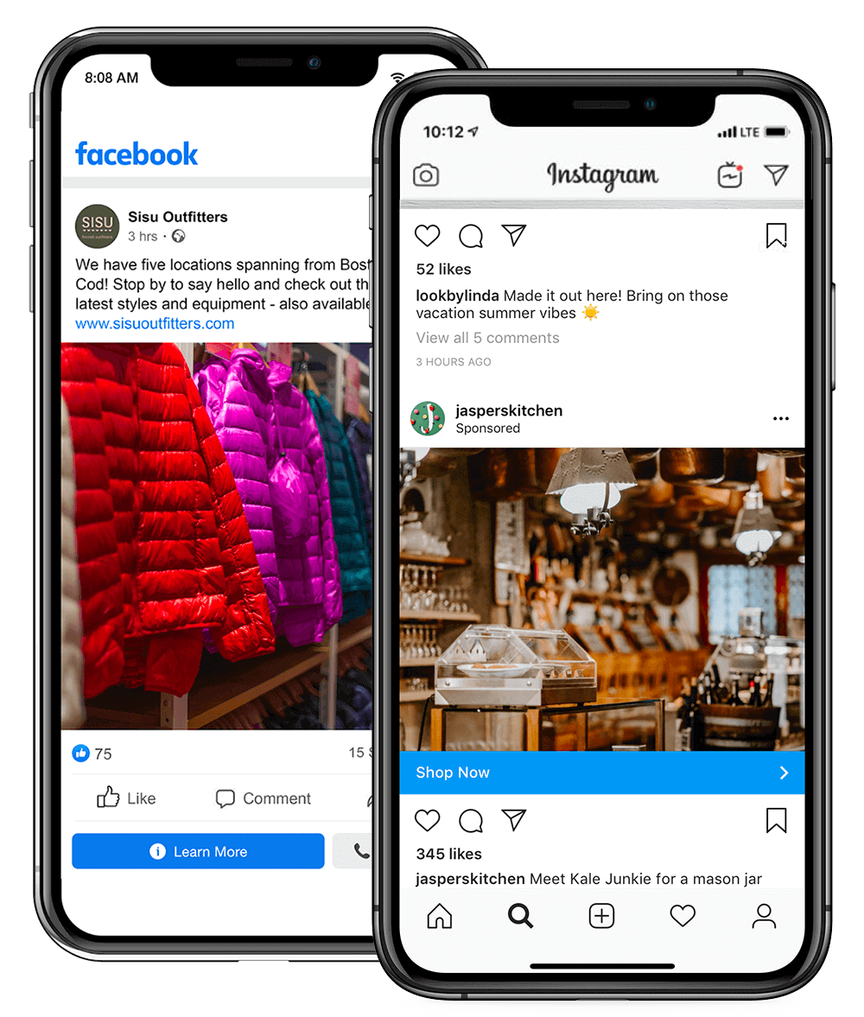
FACEBOOK/INSTAGRAM MARKETING
Deliver your message to a vast audience on the world's most dominant social platforms with Facebook/Instagram marketing.
Vast Reach: Engage a large social media audience.
Precise Targeting: Deliver ads to specific demographics.
Amplify Your Impact: Be the talk of social media. This tactic reaches millions with targeted ads, driving immediate engagement and conversions.
AWARENESS/INTEREST/CONVERSION
Mocks for illustrative purposes only

Slide 8
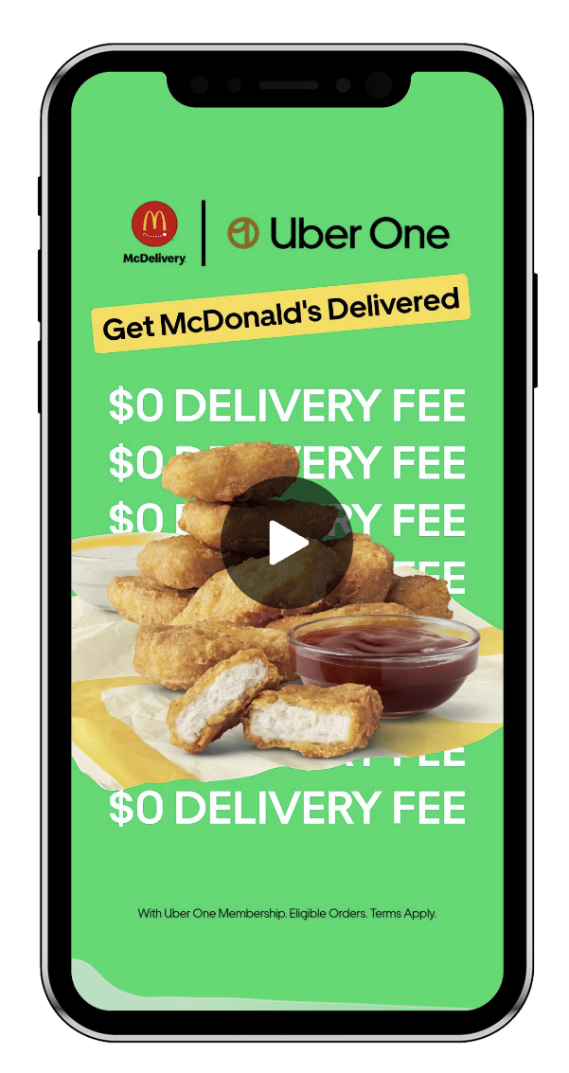
TIKTOK TARGETING
Reach a creative and entertained audience on the hottest video platform with TikTok targeting.
Creative Platform: Connect with an engaged audience.
High Interaction: Capture attention with video content.
Amplify Your Impact: Be part of the latest TikTok trend. This tactic drives high interaction and engagement, boosting your brand’s visibility and impact.
AWARENESS/INTEREST
Mocks for illustrative purposes only

Slide 9
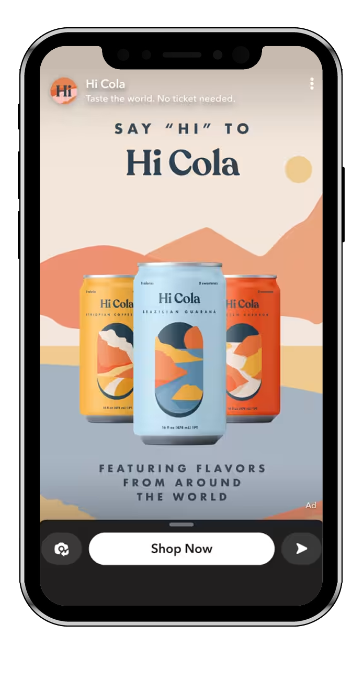
SNAPCHAT
Connect with a younger, mobile audience through playful and engaging content on Snapchat.
Younger Audience: Connect with a mobile-savvy generation.
Engaging Content: Capture attention with playful ads.
Amplify Your Impact: Become part of every fun snap. This tactic engages a younger audience and drives immediate interaction and interest.
AWARENESS
Mocks for illustrative purposes only
5 Minutes

Slide 10
EMAIL MARKETING
Deliver your message directly to the inboxes of targeted prospects, driving high ROI with email marketing.
Direct Delivery: Reach prospects in their inbox.
High ROI: Achieve strong returns on investment.
Amplify Your Impact: Land your brand’s message directly in your audience’s inbox. This tactic drives immediate engagement and conversions, maximizing your ROI.
INTEREST/CONVERSION
5 Minutes

Slide 11
PROGRAMMATIC AUDIO
Reach a highly engaged audience with impactful audio ads on platforms like Spotify with programmatic audio.
Engaged Audience: Reach listeners on popular audio platforms.
High Impact: Deliver compelling audio ads.
Amplify Your Impact: Let your brand be heard on listeners' favorite music and podcast apps. This tactic captures their attention, driving immediate interest and engagement.
DELIVERY OPTIONS:
Video
Display
AWARENESS
5 Minutes

Slide 12
ADDRESSABLE GEOFENCING
Target consumers at the household level, delivering precise and personalized ads with addressable geofencing.
Household Precision: Target ads to specific homes.
Personalized Ads: Deliver relevant messages.
Amplify Your Impact: Reach the right households at the perfect moment. This tactic delivers personalized messages that drive immediate engagement and loyalty.
AWARENESS/INTEREST/CONVERSION
5 Minutes

Slide 13
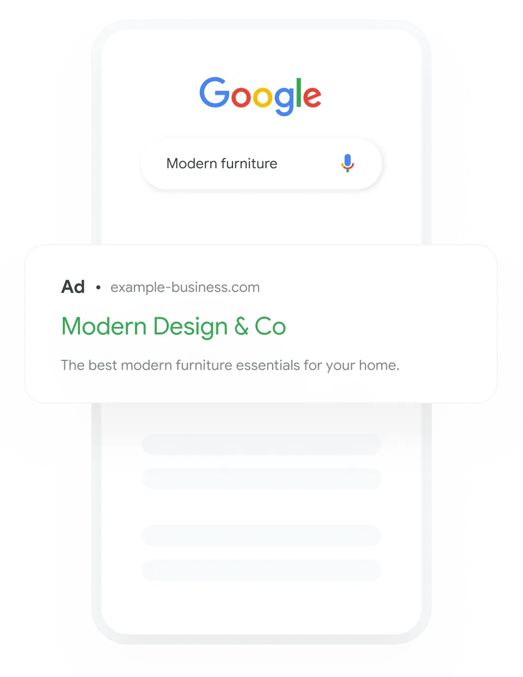
SEARCH ENGINE MARKETING
Drive phone calls, leads, or conversions with targeted text ads on search engines through search engine marketing (SEM).
Immediate Actions: Drive conversions with targeted ads.
High Visibility: Appear in search results.
Amplify Your Impact: Appear just when customers are searching for you. This tactic drives immediate actions and conversions, maximizing your visibility and impact.
AWARENESS/INTEREST/CONVERSION
Mocks for illustrative purposes only

Slide 14
IDENTIFY CONVERSION GOALS
LEAD GENERATION
ONLINE SALES
OFFLINE SALES
Request quote
Signup
Lead form
Phone call leads
Imported lead
Book appointment
Contact
Online purchase
In-app purchase
Loyalty sign up
Subscription
Store sales (Coming Soon)
Add to cart
Begin checkout
Store visit
Store sales (Coming Soon)
Local actions (Direction and Calls)

Slide 15
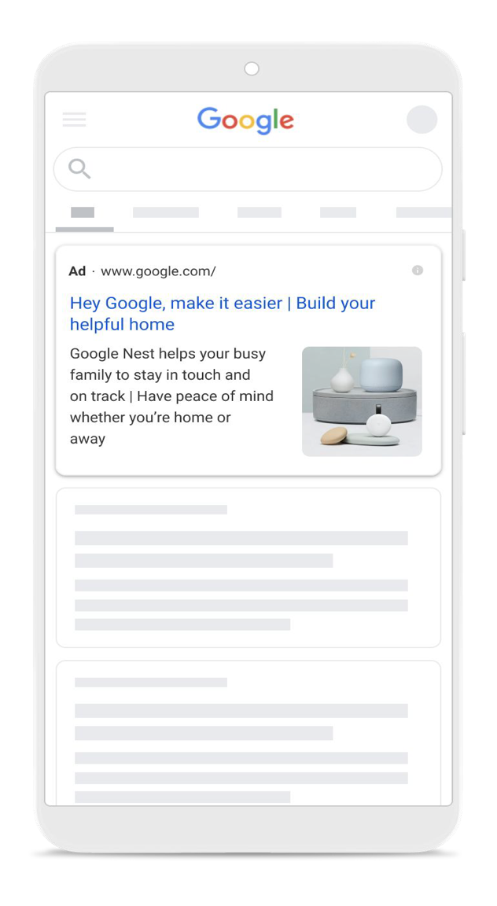
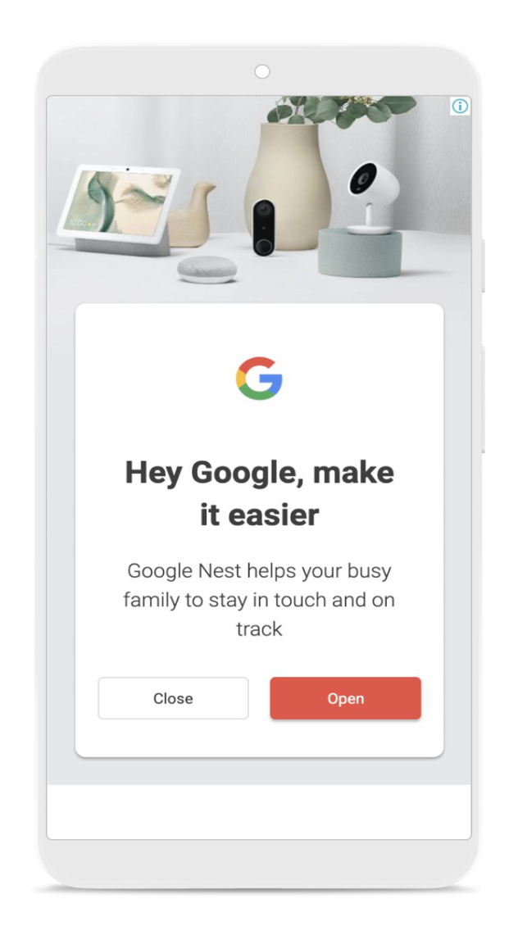
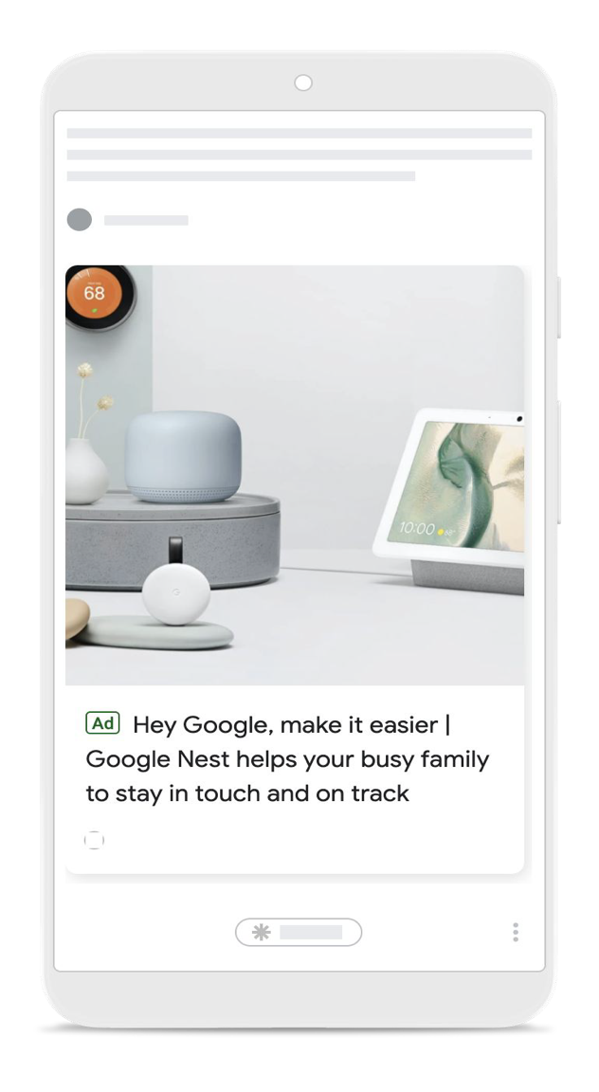
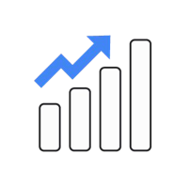
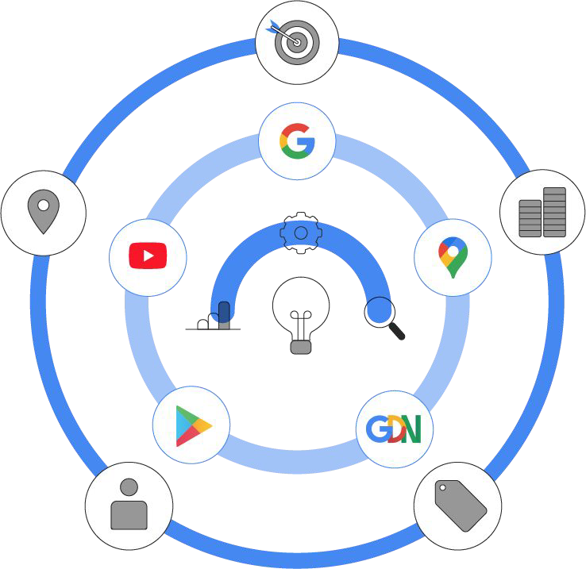
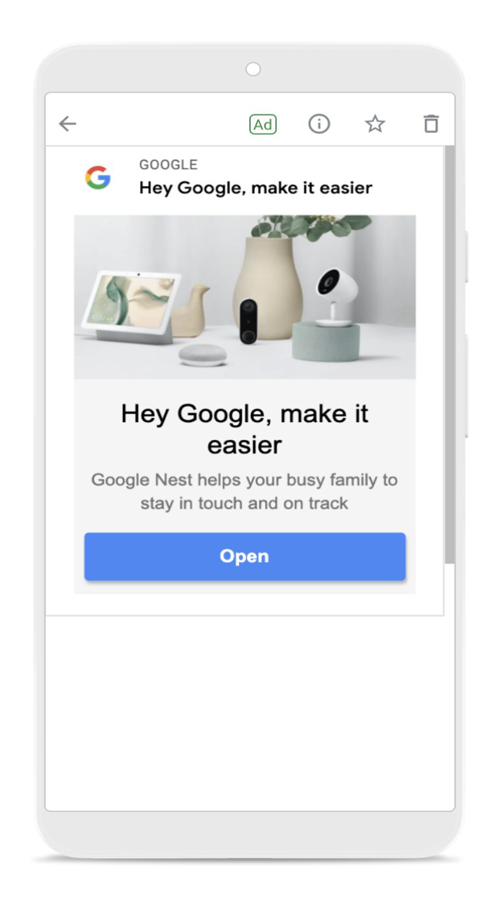
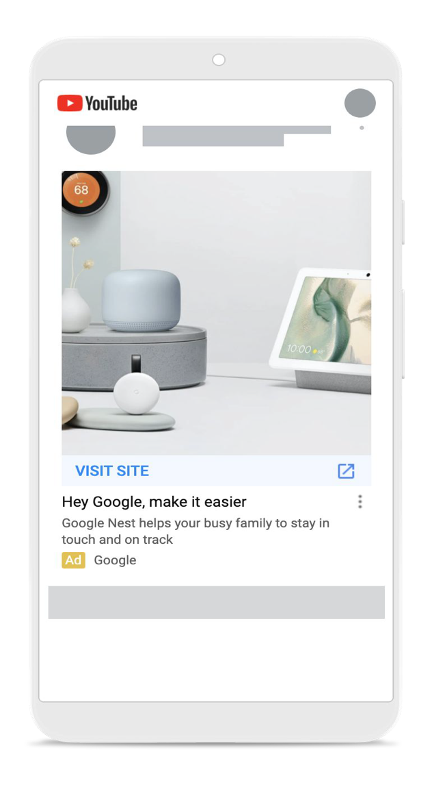
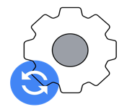
GOOGLE PERFORMANCE MAX SPARK
Search
Display
Discover
Find more converting customers
Access the full breadth of Google Ads inventory from a single campaign to engage customers throughout the purchase journey - and use Google’s real-time understanding of consumers to show up in the right moments.
Drive more value from your budget
Your budget is optimized across channels in order to optimize for the highest value opportunities with the best of Google Ads machine learning and attribution technology, customized to your business’s marketing objectives.
Gmail
YouTube
Steer automation with inputs from Audience Signals and Value Rules
To accelerate the campaign ramp-up period and deliver better results faster.
Get rich and transparent insights*
Understand how automation is working and how you can improve your campaign. See which audiences, creatives and other drivers (including consumer insights & trends) are impacting performance.

