Slide 1

MEET [insert name],
YOUR IDEAL CUSTOMER

Slide 2

MEET HAROLD,
YOUR IDEAL CUSTOMER
SILENT GENERATION
age: 78 occupation: Retired income: $$
Harold is a tech-curious grandpa who loves using his smartphone to stay connected with his grandkids. Every morning, he listens to the local news on his trusty radio while sipping his coffee. Evenings are for TV, where he catches up on the latest shows and commercials that pique his interest. He's not a fan of online shopping, so he often calls local stores to get more info before heading out to make his purchases.
BUYING DECISION CRITERIA
PLATFORMS HE ENGAGES WITH
Harold hears a commercial for Bluetooth speakers on TV and is intrigued. He calls the neighborhood electronics store to learn more, and after a detailed conversation with the salesperson, he decides to visit the store to test the speakers in person. His final purchase is heavily influenced by the hands-on experience and the salesperson's recommendations.
Family and friends
Radio endorsements
TV commercials
DAILY MEDIA INTERACTIONS
Harold uses his smartphone to stay in touch with his grandkids and streams the news every evening.

Slide 3

MEET SUSAN,
YOUR IDEAL CUSTOMER
BABY BOOMER
age: 66 occupation: Retired income: $$$
Susan is a crafty grandma who starts her day by browsing Facebook on her desktop computer to see what her friends and family are up to. She loves listening to her favorite radio station while she knits or plans her next project. When she hears about new craft supplies on the radio, she checks out their websites and loves visiting the stores to see and feel the products before buying.
BUYING DECISION CRITERIA
PLATFORMS SHE ENGAGES WITH
Susan listens to the radio while knitting and hears about a new craft store. Curious, she checks out their website on her desktop and reads positive reviews on social media. Her decision to visit the store and purchase supplies is solidified by the consistent positive messaging she encounters across multiple platforms.
Family and friends
Social media
Radio
Online reviews
BUYING BEHAVIOR
Susan visits stores after checking products online and makes in-person purchases.

Slide 4

MEET KEVIN,
YOUR IDEAL CUSTOMER
age: 50
occupation: Construction Manager
income: $$
GEN X
Kevin is a busy construction manager who spends a lot of time on the road. He enjoys listening to the radio during his commute, picking up on ads for tools and workwear that catch his ear. At home, he uses his tablet to research these products further and decides whether to buy them online or in-store based on his schedule.
BUYING DECISION CRITERIA
PLATFORMS HE ENGAGES WITH
Kevin hears an ad for durable work clothes on the radio during his commute. He looks up the brand on his tablet at home, reads reviews, and watches video testimonials. Convinced by the endorsements and the brand's reputation, he decides to visit the store to try on the clothes and make his purchase.
Social media
Radio
Online reviews
BUYING BEHAVIOR
Kevin makes purchases both online and in person, often influenced by radio ads.

Slide 5

MEET ASHLEY,
YOUR IDEAL CUSTOMER
age: 30
occupation: Financial Analyst
income: $$
MILLENNIAL
Ashley is a city-dwelling financial analyst who loves walking her dog and staying active. She spends her commute scrolling through Instagram and watching TikTok videos. Ads for subscription services and new products often catch her eye while she's streaming her favorite TV shows, leading her to do a bit of online research before making a purchase.
BUYING DECISION CRITERIA
PLATFORMS SHE ENGAGES WITH
Ashley sees an ad for a subscription dog food service while streaming a TV show. She clicks on the ad, reads customer reviews, and checks out the company’s social media. The positive feedback and the convenience of home delivery lead her to subscribe to the service.
Streaming ads
Social media
Online reviews
BUYING BEHAVIOR
Ashley subscribes to services and buys products based on social media and streaming ads.

Slide 6

MEET OLIVIA,
YOUR IDEAL CUSTOMER
age: 22
occupation: Teacher
income: $
GEN Z
Olivia is a fresh-out-of-college teacher who is always on her smartphone. She loves posting on social media and engaging with her followers. She often discovers new apps and tools for her classroom through targeted ads on her smart TV and social media platforms, which she then checks out online before buying.
BUYING DECISION CRITERIA
PLATFORMS SHE ENGAGES WITH
Olivia sees a targeted commercial for a teaching app on her smart TV. She looks up the app on her phone, watches a review video, and reads social media comments. Impressed by the app’s features and positive reviews, she downloads it and starts using it in her classroom.
Smart TV ads
Social media
Online reviews
BUYING BEHAVIOR
Olivia buys apps and tools online after seeing ads on her smart TV and social media.

Slide 7

MEET ELISE,
YOUR IDEAL CUSTOMER
age: 42
occupation: Interior Designer
income: $
FAMILY WITH CHILDREN
Elise is a multitasking mom who uses social media to find deals for her family. She enjoys watching TV ads while managing her household and planning family vacations. Reviews and promotions play a big role in her purchasing decisions, and she frequently shops both online and in-store.
BUYING DECISION CRITERIA
PLATFORMS SHE ENGAGES WITH
Elise sees an ad for suitcases while streaming her favorite show on her smart TV. She checks out multiple review websites and searches for any specials and promotions. Influenced by the positive reviews and a discount offer, she decides to purchase the suitcases online.
TV ads
Social media
Online reviews
BUYING BEHAVIOR
Elise looks for online reviews and promotions before making family purchases.

Slide 8

MEET JEN,
YOUR IDEAL CUSTOMER
age: 34
occupation: Yoga Instructor
income: $$
MOMS
Jen is a yoga instructor and a mom of three who balances her day between teaching classes and managing her kids' activities. She uses social media to stay connected with other moms and get product recommendations. While streaming TV shows for her kids, she often hears ads that lead her to explore and purchase new products through apps.
BUYING DECISION CRITERIA
PLATFORMS SHE ENGAGES WITH
Jen hears a radio ad for a home security system and sees an Instagram ad later that day. She reads reviews on a popular blog and checks social media for other moms' opinions. The positive feedback and a promotional deal prompt her to buy the system through the app.
Radio
Social media
Streaming ads
BUYING BEHAVIOR
Jen makes purchases through apps after reading reviews and hearing ads on social media.

Slide 9

MEET MIKE,
YOUR IDEAL CUSTOMER
age: 37
occupation: Pilot
income: $$
DADS
Mike is a safety-conscious pilot who spends a lot of time researching products online. He hears about new items on the radio during his flights and checks them out on review sites and social media to ensure they are the best for his family. His buying decisions are influenced by thorough research and peer recommendations.
BUYING DECISION CRITERIA
PLATFORMS HE ENGAGES WITH
Mike hears about a convertible car seat on the radio. He researches safety ratings and reads reviews on multiple websites. Seeing consistent positive feedback and endorsements, he makes his purchase online, confident that he has chosen the best option for his family.
Radio
Social media
Online reviews
BUYING BEHAVIOR
Mike ensures products are safe and cost-effective by researching online before buying.

Slide 10

MEET AMANDA,
YOUR IDEAL CUSTOMER
age: 26
occupation: Photographer
income: $$
SINGLE INCOME, NO KIDS
Amanda is a single wedding photographer who loves her job and values quality brands. She spends a lot of time on her smartphone researching new products and reading reviews to ensure she gets the best deals. She makes informed online purchases and stays loyal to brands that align with her values.
BUYING DECISION CRITERIA
PLATFORMS SHE ENGAGES WITH
Amanda sees an ad for a new camera on her streaming service. She researches the camera on several websites, reads reviews, and watches unboxing videos. Confident in her choice, she makes her purchase online, knowing the brand aligns with her values and quality standards.
Online reviews
Social media
Streaming ads
BUYING BEHAVIOR
Amanda makes online purchases after thorough research to ensure brand alignment with her values.

Slide 11

MEET CHRIS,
YOUR IDEAL CUSTOMER
age: 35
occupation: IT Specialist
income: $$$
HIGH EARNER, NOT RICH YET
Chris is an IT specialist and a tech enthusiast who always wants the latest gadgets. He keeps up with tech trends through blogs and social media and makes quick purchasing decisions to stay ahead. His buying behavior is driven by the need to have the latest and most advanced technology.
BUYING DECISION CRITERIA
PLATFORMS HE ENGAGES WITH
Chris sees an ad for new VR goggles while streaming a documentary. He checks a professional review website and reads blogs about the latest features. The positive expert reviews and the brand’s reputation convince him to make the purchase online immediately.
Online reviews
Social media
Blogs
BUYING BEHAVIOR
Chris makes quick online purchases to stay ahead with the latest tech trends.

Slide 12

MEET SEAN,
YOUR IDEAL CUSTOMER
age: 25
occupation: Sales Associate
income: $$
BIG HAT, NO CATTLE
Sean is a sales associate who loves following the latest trends. Despite being on a budget, he can't resist high-end products that he discovers through online research and social media. He's quick to adopt new trends and doesn't mind splurging on luxury items.
BUYING DECISION CRITERIA
PLATFORMS HE ENGAGES WITH
Sean sees an ad for a luxury wristwatch on his smart TV. He researches the brand online and reads social media reviews. Despite being on a budget, the product’s trendsetting status and high-end appeal lead him to make an in-store purchase.
Online reviews
Social media
Blogs
BUYING BEHAVIOR
Sean buys trendy high-end products despite being on a budget, influenced by online research.

Slide 13

MEET FRANK,
YOUR IDEAL CUSTOMER
age: 40
occupation: Plumber
income: $$
BLUE COLLAR
Frank is a local plumber who knows his customers well. He hears about new tools on the radio and checks them out at the hardware store during his breaks. Practicality and budget-friendliness are key in his buying decisions, and he values products that make his job easier.
BUYING DECISION CRITERIA
PLATFORMS HE ENGAGES WITH
Frank hears an ad for a new toolbox on the radio. He visits the hardware store during his break to see the toolbox in person. The product’s practicality and positive in-store experience convince him to make the purchase on the spot.
Radio
In-store visits
Online reviews
BUYING BEHAVIOR
Frank makes practical in-store purchases after hearing about them on the radio.

Slide 14

MEET FRANK,
YOUR IDEAL CUSTOMER
age: 40
occupation: Factory Worker
income: $$
BLUE COLLAR
Frank is a factory worker who carpools with his coworkers and enjoys listening to the radio. He learns about new tools on his commute and checks them out in-store during his off hours. He appreciates practical and cost-effective products that improve his work efficiency.
BUYING DECISION CRITERIA
PLATFORMS HE ENGAGES WITH
Frank hears about a new tool on the radio during his carpool ride. He visits the store to check it out after work. The tool’s functionality and positive feedback from store staff lead him to buy it, knowing it will improve his work efficiency.
Radio
In-store visits
Online reviews
BUYING BEHAVIOR
Frank buys tools in-store after hearing about them on the radio during carpool rides.

Slide 15

MEET SABRINA,
YOUR IDEAL CUSTOMER
age: 29
occupation: Entrepreneur
income: $$
SMALL BUSINESS OWNER
Sabrina is a small business owner who manages two boutiques in her city. She listens to motivational radio shows during her commute and uses social media to stay updated on wellness products. She loves finding new items that help her balance work and health.
BUYING DECISION CRITERIA
PLATFORMS SHE ENGAGES WITH
Sabrina hears an ad for a fitness tracker on the radio and looks up the company’s blog on her smartphone. After reading several posts and reviews, she’s convinced of the product’s benefits and buys it online, excited to improve her health and wellness routine.
Online reviews
Social media
Radio shows
BUYING BEHAVIOR
Sabrina buys wellness products after researching online and hearing motivational radio shows.

Slide 16

MEET WILLIAM,
YOUR IDEAL CUSTOMER
age: 52
occupation: CFO
income: $$$
BUSINESS EXEC
William is a recently promoted CFO who spends a lot of time online staying updated with news and product reviews. He enjoys high-end gadgets that integrate well with his existing tech and makes purchasing decisions based on detailed online research and reviews.
BUYING DECISION CRITERIA
PLATFORMS HE ENGAGES WITH
William hears about a smartwatch on the radio while working. He checks his favorite subscription website for reviews and reads about the watch’s versatility. Convinced by the detailed online reviews and the product’s integration with his tech, he makes an online purchase.
Social media
Streaming ads
Online reviews
BUYING BEHAVIOR
William buys high-end gadgets that integrate with his tech setup, influenced by online reviews.

Slide 17

MEET KAREN,
YOUR IDEAL CUSTOMER
age: 65
occupation: Retired
income: $$
CANNABOOMER
Karen is a retired health enthusiast who explores cannabis and CBD products for wellness. She listens to radio shows about new dispensaries and uses her smartphone to browse their websites. She prefers in-store purchases after thorough online research to ensure quality.
BUYING DECISION CRITERIA
PLATFORMS SHE ENGAGES WITH
Karen hears a radio ad for a new dispensary and visits their website to browse products. She reads reviews and checks social media for feedback. Satisfied with the product selection and positive reviews, she makes an appointment and buys the products in-store.
Social media
Radio
Online reviews
BUYING BEHAVIOR
Karen buys cannabis and CBD products in-store after extensive online research.

Slide 18
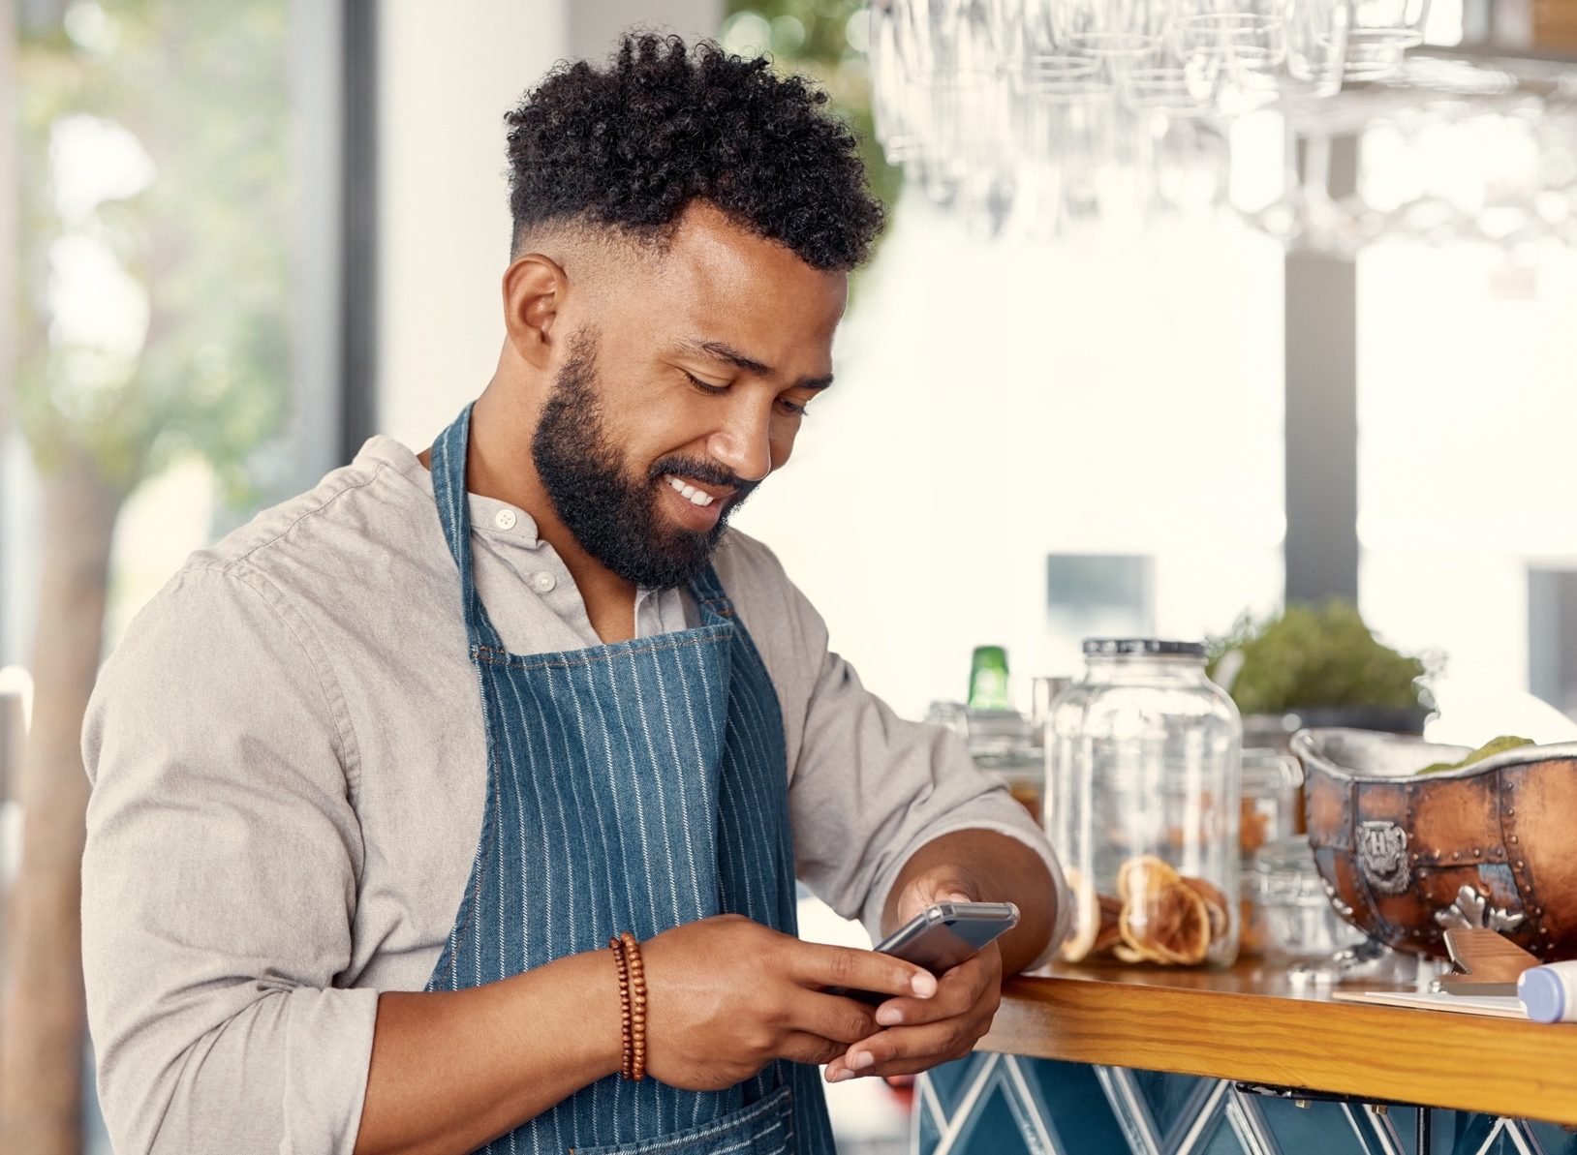
MEET JUSTIN,
YOUR IDEAL CUSTOMER
age: 30
occupation: Hospitality
income: $
RECREATIONAL CANNABIS USER
Justin is a hospitality worker who uses cannabis to relax after stressful days. He learns about new products through friends and streaming ads and makes informed purchases based on online reviews and peer recommendations.
BUYING DECISION CRITERIA
PLATFORMS HE ENGAGES WITH
Justin sees an ad for a new vape while streaming a TV show. He polls his friends on social media and reads online reviews. Convinced by the positive feedback and peer recommendations, he purchases the vape online and starts exploring other products from the same brand.
Social media
Streaming ads
Online reviews
BUYING BEHAVIOR
Justin buys cannabis products online after peer recommendations and streaming ads.

Slide 19

MEET TRISH,
YOUR IDEAL CUSTOMER
age: 39
occupation: Medical Researcher
income: $$$
CBD CONSUMER
Trish is a medical researcher who loves exploring high-quality CBD products. She uses her smartphone to research new items she sees in streaming ads, focusing on purity and quality before making online purchases.
BUYING DECISION CRITERIA
PLATFORMS SHE ENGAGES WITH
Trish sees an ad for CBD lotion while streaming a TV show. She reads reviews on her smartphone and checks the active ingredients list. Confident in the product’s quality and purity, she makes an online purchase and incorporates it into her wellness routine.
Social media
Streaming ads
Online reviews
BUYING BEHAVIOR
Trish buys high-quality CBD products online, focusing on purity and quality.

Slide 20

MEET JASON,
YOUR IDEAL CUSTOMER
age: 42
occupation: Remote Analyst
income: $$
MEDICAL CONSUMER
Jason is a remote analyst with a chronic illness who relies on medical marijuana for relief. He keeps up with industry trends through online research and prefers buying premium products online that are convenient and effective.
BUYING DECISION CRITERIA
PLATFORMS HE ENGAGES WITH
Jason sees an ad for medical-grade marijuana while streaming a TV show. He conducts online research and reads dozens of reviews. The product’s promise of pain relief and positive feedback lead him to make an online purchase and include it in his daily regimen.
Social media
Streaming ads
Online reviews
BUYING BEHAVIOR
Jason buys medical marijuana products online, ensuring they meet his chronic illness needs.

