Slide 1
OBJECTIVE SUMMARY
We heard you—understanding your unique needs is crucial for a successful campaign. In today’s digital landscape, where algorithms shift and competition is fierce, it’s easy for your message to get lost. But with the right strategy, we can ensure your brand stands out.
Delete and add logo
If wanted
OBJECTIVES & FLIGHT
Goals of Campaign:
Website: URL
FB URL:
Phone Number:
KPI:
GEO-TARGETING
TARGET AUDIENCE
STRATEGY
Add list of locations here
Target Audience 1:
Target Audience 2: Enthusiasts
Custom Keywords / Conquesting by Brand:
As your media partner, we provide a comprehensive campaign strategy across digital platforms, ensuring all your marketing efforts are working together to reach your target audience and achieve your goals.
COMPETITORS/CONQUESTING
Add list of competitor locations here

Slide 2
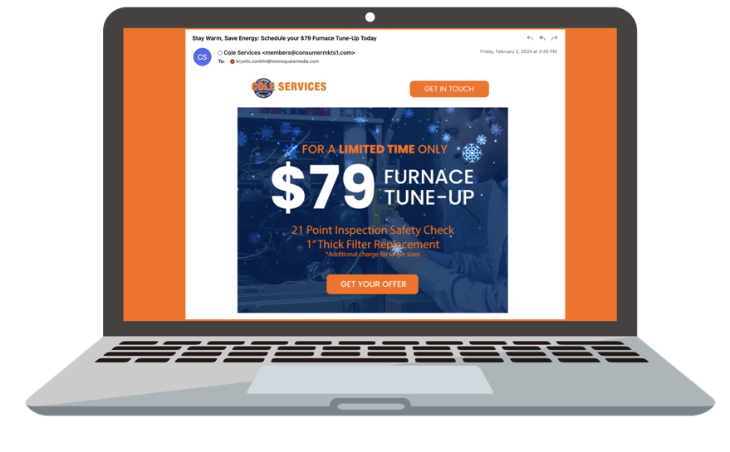
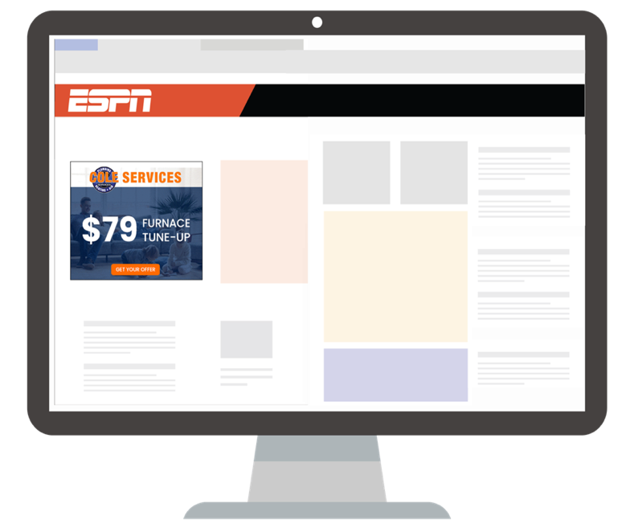
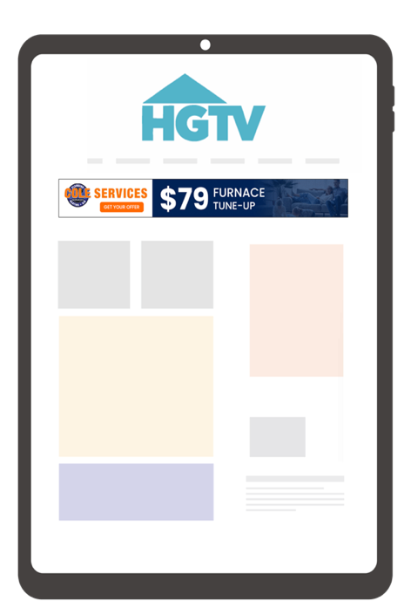
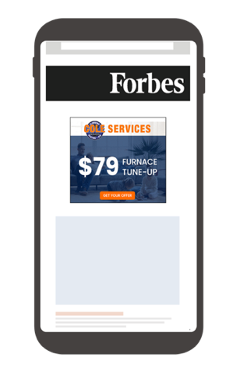
1:1 MARKETING
1:1 Marketing is a dynamic digital strategy that starts by sending tailored emails to local homeowners. Targeted display messages are then sent to re-engage with the homeowners who opened the email on all devices for the next 30 days. This strategy is built to boost lead generation and enhance your brand’s visibility.
EMAIL MARKETING
ADDRESSABLE
Customized emails are sent to homeowners in your service area
Postal addresses are collected from the email openers and uploaded into our platform to be matched against plat line data
Targeted Display, Video and/or OTT messages are sent to re-engage with the homeowners who opened the email on all devices for the next 30 days
reach customers with multiple touchpoints

Slide 3
INTEGRATED PROPOSAL
SOLUTION NAME | BEST | BETTER | GOOD
Programmatic Display (AAT + KWT) | 187,500 Impressions $1,500 | 125,000 Impressions $1,000 | 62,500 Impressions $500
Social Media + Retargeting | Facebook/Instagram 600 Clicks $1,500 | Facebook/Instagram 600 Clicks $1,500 | Facebook/Instagram 400 Clicks $1,000
Streaming TV / OTT Audience Targeting | 67,568 Streaming TV Commercials $2,500 | 54,054 Streaming TV Commercials $2,000 | 40,541 Streaming TV Commercials $1,500
MONTHLY INVESTMENT | $5,500/mo | $4,500/mo | $3,000/mo
x______________________
Townsquare Representative
x______________________
Client Authorization
x__________
Date
Both parties have the right to cancel 90 days after the start of the campaign with 30 day written notice. Terms & Conditions can be found here
Timeline:
08/01/21 - 12/31/21

Slide 4
CAPABILITIES OVERVIEW
CROSS-PLATFORM
SOCIAL
STREAMING TV
Targeted Display, Video, and Native
Uses 1st and/or third-party data to target consumers based on audience, content, keyword targeting, retargeting, website, and CRM Matching.
Facebook and Instagram
Amplify image or video messaging to targeted users on two of the most popular social media platforms.
Audience Targeted
Deliver targeted ads to specific audiences based on behavior and demographics across streaming platforms.
Addressable: Display, Video, STV
Targets the devices of consumers at specific households or businesses with based on a list of addresses provided or curated based on demographic, psychographic and location.
Snapchat
Capture engaged consumers attention through targeted static or video ads based on their location and demographics.
Channel
Reach viewers through curated channels, ensuring your ads align with content that resonates with your audience.
TikTok
Provides unique engagement solutions and immersive formats to creatively and authentically connect with audiences.
Addressable
Target specific households with personalized ads across streaming services for precise engagement.
Email Marketing
Delivers messaging directly to inboxes of viable prospects with available match-back reporting.
Spark
Leverage the power of today's technology and Artificial Intelligence to drive conversions across a range of advertising channels.
LinkedIn
Positions your messaging in users’ feeds in the world’s largest professional networking environment
Premium Subscription Services: YouTube TV, Hulu, & More
Access high-quality ad placements on premium streaming platforms like YouTube TV and Hulu, reaching engaged subscribers.
Search Engine Marketing
Delivers ads next to relevant search results for the greatest opportunity to measure conversions.
Nextdoor
Target customers in your neighborhood with this hyperlocal social networking service for local communities.
Live Sports
Capture the attention of passionate sports fans with ads during live streaming sports events on major platforms.
YouTube
TrueView and other YouTube advertising formats and placements available.
MOBILE
Geofencing
Targets mobile users based on their current location or locations previously visited (up to 365 days in the past).
Geofencing + Foot Traffic
Delivers ads to mobile users based on location, recency and tracks foot traffic to your business.
Streaming Audio
Delivers audio messaging through some of the world's largest streaming platforms.

Slide 5
OUR APPROACH
At the crossroads of Tech & Strategy where it all starts to help our clients:
01
EXPERTISE — Earn credibility & trust through our teams’ industry experience. We don’t guess, we know.
OUR AUDIENCE — Tap into the power our national and local brands to attract your ideal customers, with the most relevant messages to find people no matter where they are, on or offline.
02
03
TECH — Access to a full suite of data, buying & analytics tools to create next level performance-based marketing campaigns.
TECH
STRATEGY

Slide 6
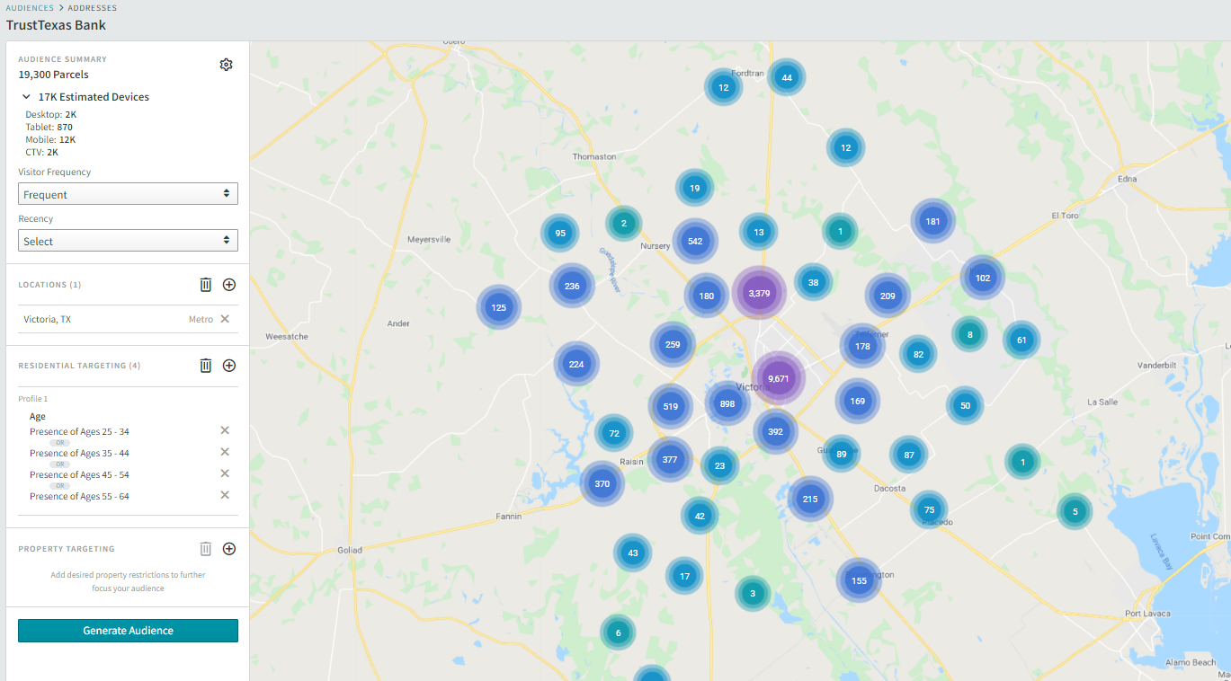
CUSTOM TARGETING WITH ADVANCED DATA & INTEREST
Reach people that are in market for (customize)
There are 19,300 people we can target in the across the Victoria.
Who are persons, 25-64
Pop 67,055
Streaming TV

