Slide 1


TITLE HERE
DELETE & ADD ADVERTISER LOGO
Name Here
Title
Email

Slide 2

AGENDA
The opportunity & strategy
The research
Campaign recommendation
Our partnership next step

Slide 3







THE OPPORTUNITY
We heard you—understanding your unique needs is crucial for a successful campaign. In today’s digital landscape, where algorithms shift and competition is fierce, it’s easy for your message to get lost. But with the right strategy, we can ensure your brand stands out.
CLIENT SPOTLIGHT: Your Unique Story and Ambitions
CAMPAIGN GOALS
CLIENT URL
[INSERT CLIENT URL]
UNIQUE SALES POSITION
[insert unique sales position here xxxxxxxxxxxxxxxxxxxxxxxxxxxxxxxx Xxxxxxxxxxxxxxxxxxxxxxxxxxxxxxxxxxxxxxxxxxxxxxxxxxxxxxxxxxxxxxxxxxxxxx Xxxxxxxxxxxxxxxxxxxxxxxxxxxxxxxxxxx
Xxxxxxxxxxxxxxxxxxxxxxxxxxxxxxxxxxx Xxxxxxxxxxxxxxxxxxxxxxxxxxxxxxxxxxx Xxxxxxxxxxxxxxxxxxxxxxxxxxxxxxxxxxx Xxxxxxxxxxxxxxxxxxxxxxxxxxxxxxxxxxx Xxxxxxxxxxxxxxxxxxxxxxxxxxxxxxxxxxx]
OVERALL OPPORTUNITY OF CAMPAIGN
[insert overall opportunity here xxxxxxxxxxxxxxxxxxxxxxxxxxxxxxxxxxxxxxxxxxxxxxxxxxxxxxxxxxxxxxxxxxxxxxxxxxxxxxxxxxxxxxxxxxxxxxxxxxxxxxxxxxXxxxxxxxxxxxxxxxxxxxxxxxxxxxxxxxxxx Xxxxxxxxxxxxxxxxxxxxxxxxxxxxxxxxxxx Xxxxxxxxxxxxxxxxxxxxxxxxxxxxxxxxxxx Xxxxxxxxxxxxxxxxxxxxxxxxxxxxxxxxxxx Xxxxxxxxxxxxxxxxxxxxxxxxxxxxxxxxxxx Xxxxxxxxxxxxxxxxxxxxxxxxxxxxxxxxxxx
KPIs
[INSERT KPI 1]
[INSERT KPI 2]

Slide 4

DATA:
IT’S IN OUR DNA

Slide 5



DATA IN ACTION
CUSTOMIZED
RESEARCH
AUDIENCE
BUILDING
INDUSTRY AND
MARKET-LEVEL INSIGHTS
MARKET TRENDS
CREATIVE MESSAGING
Our in-house research team, delivers top-tier insights using the best industry resources. Identify your client base through CRM and foot traffic analysis, understand what drives them to buy, and see how you stack up against competitors. Data-driven strategies power your success.
The future of targeting is in custom audiences. Use pixel-based retargeting, look-alike modeling, and CRM integration to grow and enhance your audience, improving both quantity and quality.
With millions of consumer data points and hundreds of platforms to choose from, digital campaigns can be overwhelming. We uncover your market potential and identifies the best platforms to reach your audience
Get insights into industry trends identifying the top advertising platforms your audience is leaning into, top challenges seen across your industry, spending patterns, CO-OP opportunities and more
Craft messaging that resonates with your audience, guided by data and tailored to your brand’s voice. Ensure your message stands out and drives results.

Slide 6

MEET [insert name],
YOUR IDEAL CUSTOMER

Slide 7

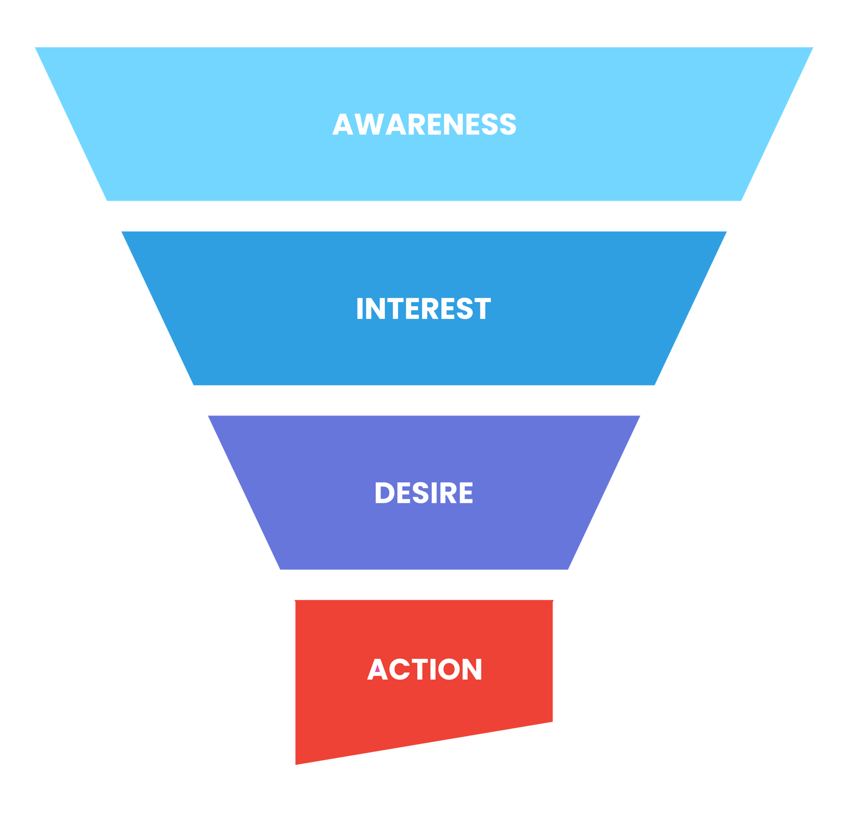
THE CONSUMER JOURNEY
Your target audience is the lifeblood of your business. Understanding who they are and what motivates them is crucial for effective marketing.
We deeply understand your ideal customer. We don’t guess, we KNOW. We not only know how they consume MEDIA, but we understand how they make BUYING decisions.

Slide 8






THE EXECUTION
RESEARCH & DATA
CREATIVE MESSAGING
CAMPAIGN SET UP
REPORTING & SUCCESS METRICS
Insert research and data insight here xxxxxxxxxxxxxxxxxxxxxxxxxxxxxxxx
Insert research and data insight here xxxxxxxxxxxxxxxxxxxxxxxxxxxxxxxx
Insert research and data insight here xxxxxxxxxxxxxxxxxxxxxxxxxxxxxxxx
Insert research and data insight here xxxxxxxxxxxxxxxxxxxxxxxxxxxxxxxx
Insert creative campaign guidance xxxxxxxxxxxxxxxxxxxxxxxxxxxxxxxx
Insert creative campaign guidance xxxxxxxxxxxxxxxxxxxxxxxxxxxxxxxx
Insert platform guidance here xxxxxxxxxxxxxxxxxxxxxxxxxxxxxxxx
Insert platform guidance here xxxxxxxxxxxxxxxxxxxxxxxxxxxxxxxx
Insert execution and launch info here xxxxxxxxxxxxxxxxxxxxxxxxxxxxxxxx
Insert execution and launch info here xxxxxxxxxxxxxxxxxxxxxxxxxxxxxxxx
Insert execution and launch info here xxxxxxxxxxxxxxxxxxxxxxxxxxxxxxxx
Insert execution and launch info here xxxxxxxxxxxxxxxxxxxxxxxxxxxxxxxx
Insert reporting and insights info xxxxxxxxxxxxxxxxxxxxxxxxxxxxxxxx
Insert reporting and insights info xxxxxxxxxxxxxxxxxxxxxxxxxxxxxxxx
Insert reporting and insights info xxxxxxxxxxxxxxxxxxxxxxxxxxxxxxxx
Insert reporting and insights info xxxxxxxxxxxxxxxxxxxxxxxxxxxxxxxx

Slide 9

RECOMMENDED SOLUTIONS

Slide 10

CAMPAIGN MEDIA PLAN
x______________________
Provider Representative
x______________________
Client Authorization
x__________
Date
Timeline:
08/01/21 - 12/31/21
Both parties have the right to cancel 90 days after the start of the campaign with 30 day written notice.

Slide 11
CAMPAIGN MEDIA PLAN
SOLUTION NAME | SOLUTION GOAL | AUDIENCE DETAIL | SOLUTION FOOTPRINT | MEDIA DELIVERED | VOLUME | MEDIA COST | COST STRUCTURE | BUDGET
Programmatic Display | Pull from Prog Display Tab | Enter Audience Detail | US, State, DMA, Zip Codes or Addresses | Display | 123,456 | $0.00 | CPM | $1.000
Addressable Geo (Banner) | Foot Traffic | Enter Audience Detail | Specific Postal Addresses | Display | 123,456 | $0.00 | CPM | $1,000
Retargeting | Site Traffic | Previous Site Visitors | United States | Display | Based on Site Traffic | $0.00 | CPM | N/A
STV | Awareness | Enter Audience Detail | ???? | Video | 123,456 | $0.00 | CPM | $1,000
Social - Link | Site Traffic | Enter Audience Detail | US, State, DMA or Zip Codes | Video or Display | 123,456 | $0.00 | CPLC | $1,000
INVESTMENT | $4,000
x______________________
Provider Representative
x______________________
Client Authorization
x__________
Date
Timeline:
08/01/21 - 12/31/21
Both parties have the right to cancel 90 days after the start of the campaign with 30 day written notice.

Slide 12

INTEGRATED PROPOSAL
SOLUTION NAME | BEST | BETTER | GOOD
Programmatic Display (AAT + KWT) | 187,500 Impressions $1,500 | 125,000 Impressions $1,000 | 62,500 Impressions $500
Social Media + Retargeting | Facebook/Instagram 600 Clicks $1,500 | Facebook/Instagram 600 Clicks $1,500 | Facebook/Instagram 400 Clicks $1,000
Streaming TV / OTT Audience Targeting | 67,568 Streaming TV Commercials $2,500 | 54,054 Streaming TV Commercials $2,000 | 40,541 Streaming TV Commercials $1,500
MONTHLY INVESTMENT | $5,500/mo | $4,500/mo | $3,000/mo
x______________________
Townsquare Representative
x______________________
Client Authorization
x__________
Date
Both parties have the right to cancel 90 days after the start of the campaign with 30 day written notice.
Terms & Conditions can be found here
Timeline:
08/01/21 - 12/31/21

Slide 13
MEDIA PLAN – 2025 GROWTH CAMPAIGN
40 miles of Springfield, MO | DOMINANT | ESTABLISHED | STARTER
Custom SEM - Paid Search on Google and Bing. Includes Call Tracking. $7,500+ max available | 50 – 160 clicks / mo $3,500 / mo | 50 – 150 clicks / mo $2,500 / mo | 40 – 130 clicks / mo $1,500 / mo
Targeted Display – use 1st and 3rd party data to target the specific audience you are looking for - combined with websites, and article content relevant to your services Target Homeowners with a HHI of $150K+ OR in market / interest in HVAC repair or replacement services. Retargeting – Deliver your reminder message to site visitors. Use a 2nd set of creative to encourage users to take the next step and become a customer. | 230,769 Imp / mo $1,500 / mo | 153,846 Imp / mo $1,000 / mo | 153,846 Imp / mo $1,000 / mo
Social Media Link Click – Facebook / Instagram posts – only pay for posts that lead to a click to site. All other actions are NO CHARGE. Target Homeowners with a HHI of $150K+ OR in market / interest in HVAC repair or replacement services. | 600 link clicks / mo $1,500 / mo | 400 link clicks / mo $1,000 / mo | 400 link clicks / mo $1,000 / mo
STV (Audience Targeted) – Deliver :30 ads on Streaming TV platforms across Smart TVs / desktops / laptops / tablets / mobile devices. Target Homeowners with a HHI of $150K+ OR in market / interest in HVAC repair or replacement services. | 47,297 Imp / mo $1,750 / mo | 40,540 Imp / mo $1,500 / mo
Email Blast – 4 drops (Jan / April / July / Oct) – Send email blasts to your target demo. Guaranteed 10% open rate and 1% click thru. Provide the postal addresses of openers and use them for geofencing. Target Homeowners with a HHI of $150K+ OR in market / interest in HVAC repair or replacement services. | 50,000 emails $1,500 / Sept, Dec, March, June
Addressable Geo Fencing Display Ads – Place a geofence around home addresses. Use a combination of addresses provided from CRM system as well as the following demographic: Target: Residence => Home owner Type => Home Owner AND Consumer Finance => Estimated HHI => $150,000 + (all) PLUS openers from email campaign | 125,000 Imp / mo $1,500 / mo
MONTHLY INVESTMENT | $11,250/mo Plus $1,500 in Jan, April, July, Oct | $6,000/mo | $6,000/mo
Flight Dates: October 1, 2024 thru December 31, 2024 (3 months) KPI: Calls / form fills / site traffic Website: https://h-vac.net/
x__________________
Name
x__________________
Client Authorization
x________
Date
Both parties have the right to cancel 90 days after the start of the campaign with 30 day written notice.

Slide 14

PRE AND POST
LAUNCH SUPPORT

Slide 15

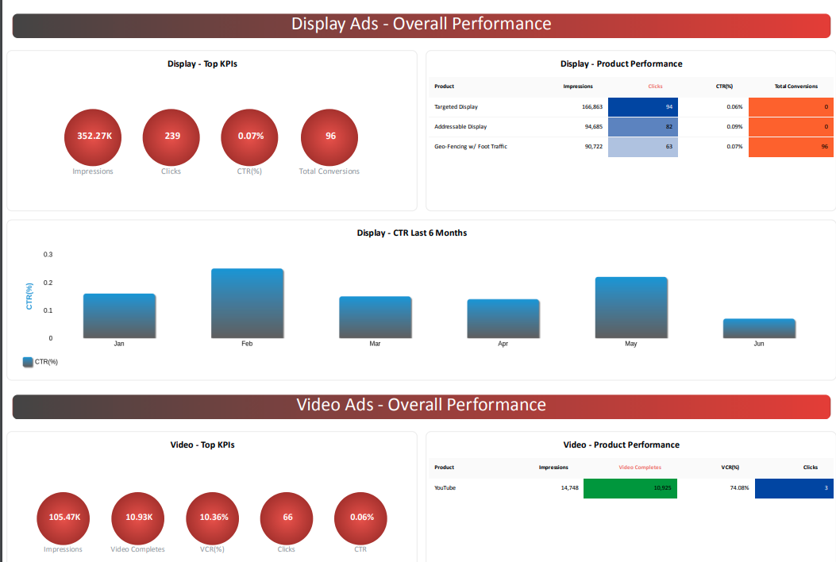


BOOST YOUR CAMPAIGNS WITH
LIVE REPORTING DASHBOARDS
EXCLUSIVE DASHBOARD ACCESS
Real-Time Performance Tracking. Monitor campaigns live with clear, impactful metrics on any device
Customizable Interface. Navigate a user-friendly dashboard tailored to your needs
Advanced Analytics. Dive into deep analytics, predictive insights, and trend analysis
Seamless Data Integration. Combine multiple data sources and customize KPI tracking effortlessly
WHY IT MATTERS
Informed Decisions. Quickly act on data and improve client communication
Efficiency & Adaptability. Save time and stay ahead with insights and streamlined reporting
PRO TIPS
Agree on a reporting cadence with your account manger before your campaign launches!
Log in and review your dashboard

Slide 16

CREATIVE SERVICES
Having the right creative can make or break your campaign’s performance, and we’re here to take that challenge off your plate. With our Creative Services team, you get top-notch solutions tailored to your needs, ensuring your campaign is set up for success from the start.
Creative Vision Alignment: Ensure your campaign’s creative vision is fully realized with a dedicated team that aligns ad copy and design to your goals.
Optimized Design: Get visually stunning designs tailored for maximum engagement, driving results that resonate with your audience.
Impactful Video Production: Capture attention with dynamic video content designed to perform across platforms like STV and social, delivering high-quality results that drive your campaign's success.

Slide 17

YOUR PATH TO RESULTS
STARTS HERE
Choosing us as a partner is a no-brainer because we understand your challenges and have the solutions you need. Here’s why partnering with us is the best decision:
Expertise & Experience: our team brings years of industry knowledge and a proven track record of success.
Tailored Solutions: we provide customized strategies designed specifically to meet your business goals.
Data-Driven Results: our campaigns are backed by data and analytics to ensure maximum ROI.
Comprehensive Support: from strategy to execution, we’re with you every step of the way.

Slide 18


JOURNEY TO LAUNCH:
WHAT HAPPENS NEXT
CAMPAIGN BUILD AND QA
Our team builds your campaign and conducts thorough quality checks.
LAUNCH
ACTIVATION CALL
Congratulations – your campaign is live!
Your dedicated Digital Campaign Manager (DCM) will review your assets and clarify any details and establish timeline to launch.
Why It Matters: Ensures all campaign elements are aligned with your goals from the start.
CREATIVE NEEDS DETERMINED
What to Expect: We identify and gather all necessary creative assets.
SIGNED CONTRACT
Our team processes your contract promptly

Slide 19

THANK YOU

