Slide 1
PRO TIPS FOR USING THIS DECK
Decide on what you need and what you don't need in your pitch!
  Pick the cover slide you want to use. Add your company logo to the cover page in the bottom left-hand corner.
  After your discovery call fill out slides 12 (The Opportunity) and slide 36 (The Execution). See completed sample deck on your partner portal for more inspiration!
  Choose the persona that best fits your client's ideal audience and delete the others .
  Delete tactic slides that aren't pertinent to your pitch.
Media Grid/Recommendation
  Complete the media grid for your pitch.
For best results this deck should not exceed more than 12-20 slides.
**You can even put all the tactics at the end AFTER the thank you page if you want to make it even more concise!
INTERNAL USE ONLY
DELETE BEFORE USE

Slide 2
TITLE HERE
DELETE & ADD ADVERTISER LOGO
Name Here
Title
Email

Slide 3
TITLE HERE
DELETE & ADD ADVERTISER LOGO
Name Here
Title
Email

Slide 4
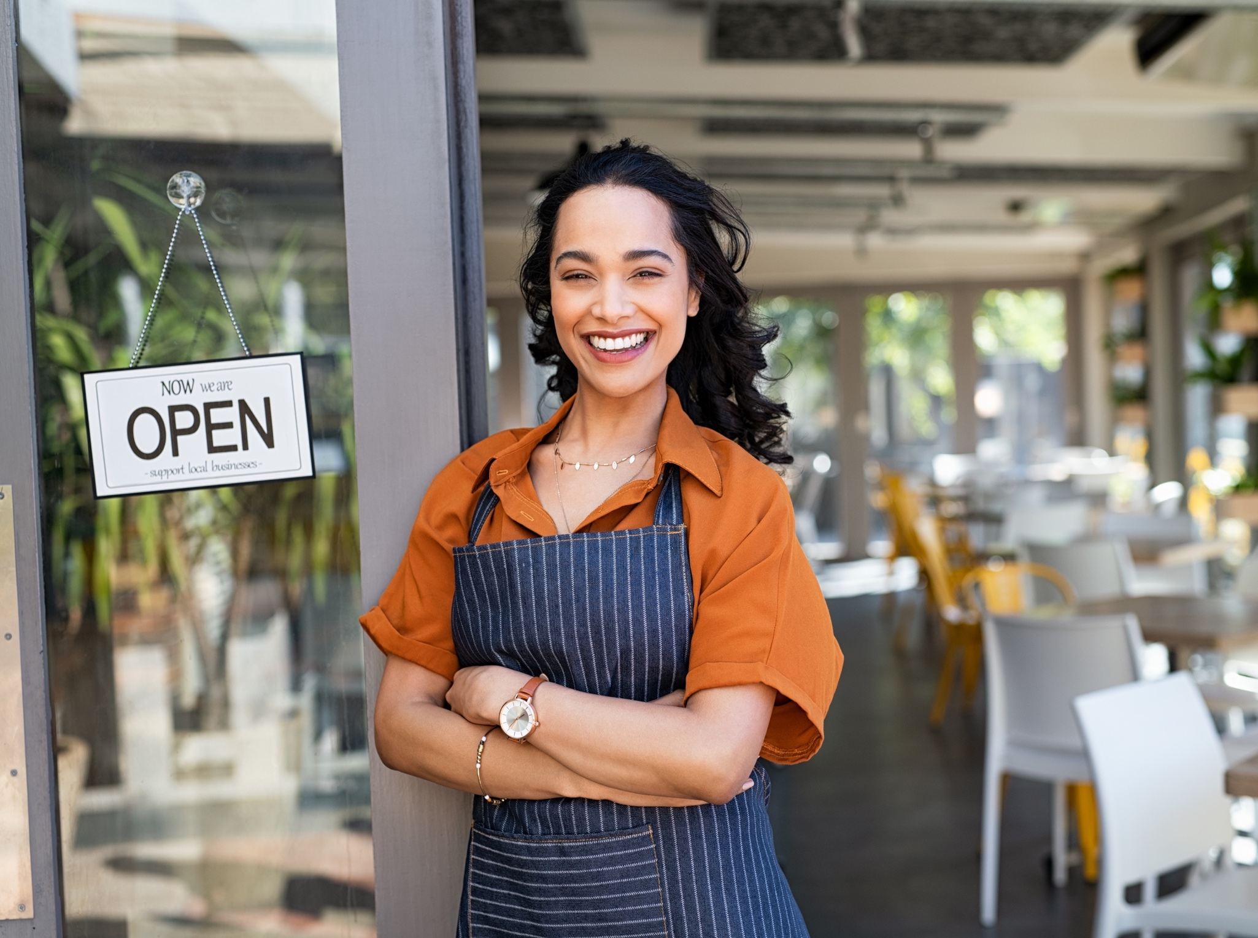
TITLE HERE
DELETE & ADD ADVERTISER LOGO
Name Here
Title
Email

Slide 5

TITLE HERE
DELETE & ADD ADVERTISER LOGO
Name Here
Title
Email

Slide 6

TITLE HERE
DELETE & ADD ADVERTISER LOGO
Name Here
Title
Email

Slide 7

TITLE HERE
DELETE & ADD ADVERTISER LOGO
Name Here
Title
Email

Slide 8

TITLE HERE
DELETE & ADD ADVERTISER LOGO
Name Here
Title
Email

Slide 9

TITLE HERE
DELETE & ADD ADVERTISER LOGO
Name Here
Title
Email

Slide 10

TITLE HERE
DELETE & ADD ADVERTISER LOGO
Name Here
Title
Email

Slide 11

AGENDA
The opportunity & strategy
The research
Campaign recommendation
Our partnership next step

Slide 12







THE OPPORTUNITY
We heard you—understanding your unique needs is crucial for a successful campaign. In today’s digital landscape, where algorithms shift and competition is fierce, it’s easy for your message to get lost. But with the right strategy, we can ensure your brand stands out.
CLIENT SPOTLIGHT: Your Unique Story and Ambitions
CAMPAIGN GOALS
CLIENT URL
[INSERT CLIENT URL]
UNIQUE SALES POSITION
[insert unique sales position here xxxxxxxxxxxxxxxxxxxxxxxxxxxxxxxx Xxxxxxxxxxxxxxxxxxxxxxxxxxxxxxxxxxxxxxxxxxxxxxxxxxxxxxxxxxxxxxxxxxxxxx Xxxxxxxxxxxxxxxxxxxxxxxxxxxxxxxxxxx
Xxxxxxxxxxxxxxxxxxxxxxxxxxxxxxxxxxx Xxxxxxxxxxxxxxxxxxxxxxxxxxxxxxxxxxx Xxxxxxxxxxxxxxxxxxxxxxxxxxxxxxxxxxx Xxxxxxxxxxxxxxxxxxxxxxxxxxxxxxxxxxx Xxxxxxxxxxxxxxxxxxxxxxxxxxxxxxxxxxx]
OVERALL OPPORTUNITY OF CAMPAIGN
[insert overall opportunity here xxxxxxxxxxxxxxxxxxxxxxxxxxxxxxxxxxxxxxxxxxxxxxxxxxxxxxxxxxxxxxxxxxxxxxxxxxxxxxxxxxxxxxxxxxxxxxxxxxxxxxxxxxXxxxxxxxxxxxxxxxxxxxxxxxxxxxxxxxxxx Xxxxxxxxxxxxxxxxxxxxxxxxxxxxxxxxxxx Xxxxxxxxxxxxxxxxxxxxxxxxxxxxxxxxxxx Xxxxxxxxxxxxxxxxxxxxxxxxxxxxxxxxxxx Xxxxxxxxxxxxxxxxxxxxxxxxxxxxxxxxxxx Xxxxxxxxxxxxxxxxxxxxxxxxxxxxxxxxxxx
KPIs
[INSERT KPI 1]
[INSERT KPI 2]

Slide 13

DATA:
IT’S IN OUR DNA

Slide 14



DATA IN ACTION
CUSTOMIZED
RESEARCH
AUDIENCE
BUILDING
INDUSTRY AND
MARKET-LEVEL INSIGHTS
MARKET TRENDS
CREATIVE MESSAGING
Our in-house research team, delivers top-tier insights using the best industry resources. Identify your client base through CRM and foot traffic analysis, understand what drives them to buy, and see how you stack up against competitors. Data-driven strategies power your success.
The future of targeting is in custom audiences. Use pixel-based retargeting, look-alike modeling, and CRM integration to grow and enhance your audience, improving both quantity and quality.
With millions of consumer data points and hundreds of platforms to choose from, digital campaigns can be overwhelming. We uncover your market potential and identifies the best platforms to reach your audience
Get insights into industry trends identifying the top advertising platforms your audience is leaning into, top challenges seen across your industry, spending patterns, CO-OP opportunities and more
Craft messaging that resonates with your audience, guided by data and tailored to your brand’s voice. Ensure your message stands out and drives results.

Slide 15

MEET [insert name],
YOUR IDEAL CUSTOMER

Slide 16

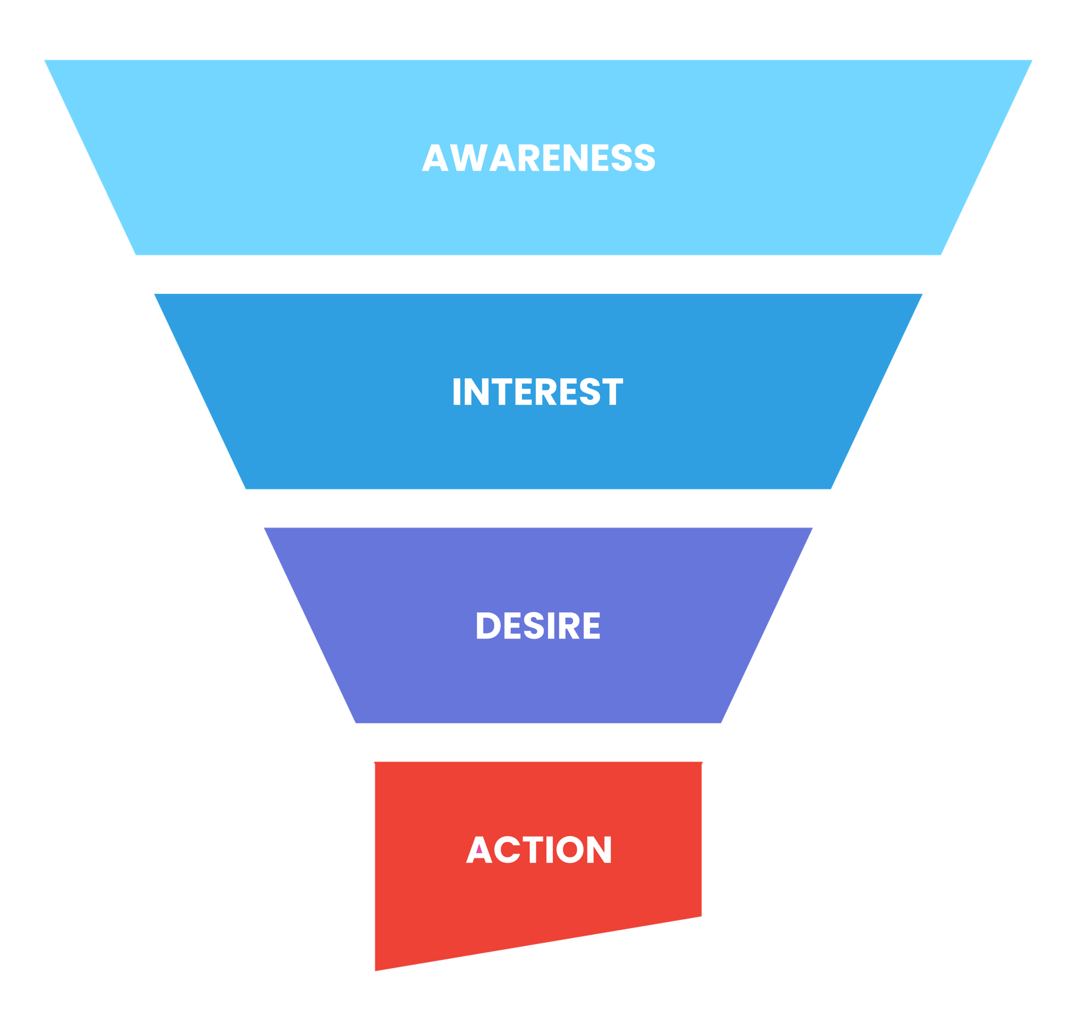
THE CONSUMER JOURNEY
Your target audience is the lifeblood of your business. Understanding who they are and what motivates them is crucial for effective marketing.
We deeply understand your ideal customer. We don’t guess, we KNOW. We not only know how they consume MEDIA, but we understand how they make BUYING decisions.

Slide 17

MEET HAROLD,
YOUR IDEAL CUSTOMER
SILENT GENERATION
age: 78 occupation: Retired income: $$
Harold is a tech-curious grandpa who loves using his smartphone to stay connected with his grandkids. Every morning, he listens to the local news on his trusty radio while sipping his coffee. Evenings are for TV, where he catches up on the latest shows and commercials that pique his interest. He's not a fan of online shopping, so he often calls local stores to get more info before heading out to make his purchases.
BUYING DECISION CRITERIA
PLATFORMS HE ENGAGES WITH
Harold hears a commercial for Bluetooth speakers on TV and is intrigued. He calls the neighborhood electronics store to learn more, and after a detailed conversation with the salesperson, he decides to visit the store to test the speakers in person. His final purchase is heavily influenced by the hands-on experience and the salesperson's recommendations.
Family and friends
Radio endorsements
TV commercials
DAILY MEDIA INTERACTIONS
Harold uses his smartphone to stay in touch with his grandkids and streams the news every evening.

Slide 18

MEET SUSAN,
YOUR IDEAL CUSTOMER
BABY BOOMER
age: 66 occupation: Retired income: $$$
Susan is a crafty grandma who starts her day by browsing Facebook on her desktop computer to see what her friends and family are up to. She loves listening to her favorite radio station while she knits or plans her next project. When she hears about new craft supplies on the radio, she checks out their websites and loves visiting the stores to see and feel the products before buying.
BUYING DECISION CRITERIA
PLATFORMS SHE ENGAGES WITH
Susan listens to the radio while knitting and hears about a new craft store. Curious, she checks out their website on her desktop and reads positive reviews on social media. Her decision to visit the store and purchase supplies is solidified by the consistent positive messaging she encounters across multiple platforms.
Family and friends
Social media
Radio
Online reviews
BUYING BEHAVIOR
Susan visits stores after checking products online and makes in-person purchases.

Slide 19

MEET KEVIN,
YOUR IDEAL CUSTOMER
age: 50
occupation: Construction Manager
income: $$
GEN X
Kevin is a busy construction manager who spends a lot of time on the road. He enjoys listening to the radio during his commute, picking up on ads for tools and workwear that catch his ear. At home, he uses his tablet to research these products further and decides whether to buy them online or in-store based on his schedule.
BUYING DECISION CRITERIA
PLATFORMS HE ENGAGES WITH
Kevin hears an ad for durable work clothes on the radio during his commute. He looks up the brand on his tablet at home, reads reviews, and watches video testimonials. Convinced by the endorsements and the brand's reputation, he decides to visit the store to try on the clothes and make his purchase.
Social media
Radio
Online reviews
BUYING BEHAVIOR
Kevin makes purchases both online and in person, often influenced by radio ads.

Slide 20

MEET ASHLEY,
YOUR IDEAL CUSTOMER
age: 30
occupation: Financial Analyst
income: $$
MILLENNIAL
Ashley is a city-dwelling financial analyst who loves walking her dog and staying active. She spends her commute scrolling through Instagram and watching TikTok videos. Ads for subscription services and new products often catch her eye while she's streaming her favorite TV shows, leading her to do a bit of online research before making a purchase.
BUYING DECISION CRITERIA
PLATFORMS SHE ENGAGES WITH
Ashley sees an ad for a subscription dog food service while streaming a TV show. She clicks on the ad, reads customer reviews, and checks out the company’s social media. The positive feedback and the convenience of home delivery lead her to subscribe to the service.
Streaming ads
Social media
Online reviews
BUYING BEHAVIOR
Ashley subscribes to services and buys products based on social media and streaming ads.

Slide 21

MEET OLIVIA,
YOUR IDEAL CUSTOMER
age: 22
occupation: Teacher
income: $
GEN Z
Olivia is a fresh-out-of-college teacher who is always on her smartphone. She loves posting on social media and engaging with her followers. She often discovers new apps and tools for her classroom through targeted ads on her smart TV and social media platforms, which she then checks out online before buying.
BUYING DECISION CRITERIA
PLATFORMS SHE ENGAGES WITH
Olivia sees a targeted commercial for a teaching app on her smart TV. She looks up the app on her phone, watches a review video, and reads social media comments. Impressed by the app’s features and positive reviews, she downloads it and starts using it in her classroom.
Smart TV ads
Social media
Online reviews
BUYING BEHAVIOR
Olivia buys apps and tools online after seeing ads on her smart TV and social media.

Slide 22

MEET ELISE,
YOUR IDEAL CUSTOMER
age: 42
occupation: Interior Designer
income: $
FAMILY WITH CHILDREN
Elise is a multitasking mom who uses social media to find deals for her family. She enjoys watching TV ads while managing her household and planning family vacations. Reviews and promotions play a big role in her purchasing decisions, and she frequently shops both online and in-store.
BUYING DECISION CRITERIA
PLATFORMS SHE ENGAGES WITH
Elise sees an ad for suitcases while streaming her favorite show on her smart TV. She checks out multiple review websites and searches for any specials and promotions. Influenced by the positive reviews and a discount offer, she decides to purchase the suitcases online.
TV ads
Social media
Online reviews
BUYING BEHAVIOR
Elise looks for online reviews and promotions before making family purchases.

Slide 23

MEET JEN,
YOUR IDEAL CUSTOMER
age: 34
occupation: Yoga Instructor
income: $$
MOMS
Jen is a yoga instructor and a mom of three who balances her day between teaching classes and managing her kids' activities. She uses social media to stay connected with other moms and get product recommendations. While streaming TV shows for her kids, she often hears ads that lead her to explore and purchase new products through apps.
BUYING DECISION CRITERIA
PLATFORMS SHE ENGAGES WITH
Jen hears a radio ad for a home security system and sees an Instagram ad later that day. She reads reviews on a popular blog and checks social media for other moms' opinions. The positive feedback and a promotional deal prompt her to buy the system through the app.
Radio
Social media
Streaming ads
BUYING BEHAVIOR
Jen makes purchases through apps after reading reviews and hearing ads on social media.

Slide 24

MEET MIKE,
YOUR IDEAL CUSTOMER
age: 37
occupation: Pilot
income: $$
DADS
Mike is a safety-conscious pilot who spends a lot of time researching products online. He hears about new items on the radio during his flights and checks them out on review sites and social media to ensure they are the best for his family. His buying decisions are influenced by thorough research and peer recommendations.
BUYING DECISION CRITERIA
PLATFORMS HE ENGAGES WITH
Mike hears about a convertible car seat on the radio. He researches safety ratings and reads reviews on multiple websites. Seeing consistent positive feedback and endorsements, he makes his purchase online, confident that he has chosen the best option for his family.
Radio
Social media
Online reviews
BUYING BEHAVIOR
Mike ensures products are safe and cost-effective by researching online before buying.

Slide 25

MEET AMANDA,
YOUR IDEAL CUSTOMER
age: 26
occupation: Photographer
income: $$
SINGLE INCOME, NO KIDS
Amanda is a single wedding photographer who loves her job and values quality brands. She spends a lot of time on her smartphone researching new products and reading reviews to ensure she gets the best deals. She makes informed online purchases and stays loyal to brands that align with her values.
BUYING DECISION CRITERIA
PLATFORMS SHE ENGAGES WITH
Amanda sees an ad for a new camera on her streaming service. She researches the camera on several websites, reads reviews, and watches unboxing videos. Confident in her choice, she makes her purchase online, knowing the brand aligns with her values and quality standards.
Online reviews
Social media
Streaming ads
BUYING BEHAVIOR
Amanda makes online purchases after thorough research to ensure brand alignment with her values.

Slide 26

MEET CHRIS,
YOUR IDEAL CUSTOMER
age: 35
occupation: IT Specialist
income: $$$
HIGH EARNER, NOT RICH YET
Chris is an IT specialist and a tech enthusiast who always wants the latest gadgets. He keeps up with tech trends through blogs and social media and makes quick purchasing decisions to stay ahead. His buying behavior is driven by the need to have the latest and most advanced technology.
BUYING DECISION CRITERIA
PLATFORMS HE ENGAGES WITH
Chris sees an ad for new VR goggles while streaming a documentary. He checks a professional review website and reads blogs about the latest features. The positive expert reviews and the brand’s reputation convince him to make the purchase online immediately.
Online reviews
Social media
Blogs
BUYING BEHAVIOR
Chris makes quick online purchases to stay ahead with the latest tech trends.

Slide 27

MEET SEAN,
YOUR IDEAL CUSTOMER
age: 25
occupation: Sales Associate
income: $$
BIG HAT, NO CATTLE
Sean is a sales associate who loves following the latest trends. Despite being on a budget, he can't resist high-end products that he discovers through online research and social media. He's quick to adopt new trends and doesn't mind splurging on luxury items.
BUYING DECISION CRITERIA
PLATFORMS HE ENGAGES WITH
Sean sees an ad for a luxury wristwatch on his smart TV. He researches the brand online and reads social media reviews. Despite being on a budget, the product’s trendsetting status and high-end appeal lead him to make an in-store purchase.
Online reviews
Social media
Blogs
BUYING BEHAVIOR
Sean buys trendy high-end products despite being on a budget, influenced by online research.

Slide 28
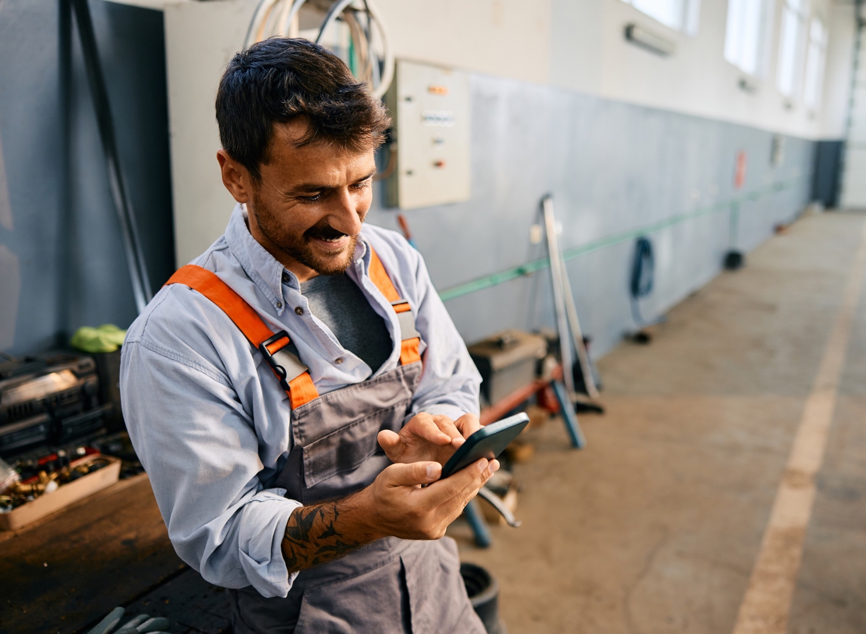
MEET FRANK,
YOUR IDEAL CUSTOMER
age: 40
occupation: Plumber
income: $$
BLUE COLLAR
Frank is a local plumber who knows his customers well. He hears about new tools on the radio and checks them out at the hardware store during his breaks. Practicality and budget-friendliness are key in his buying decisions, and he values products that make his job easier.
BUYING DECISION CRITERIA
PLATFORMS HE ENGAGES WITH
Frank hears an ad for a new toolbox on the radio. He visits the hardware store during his break to see the toolbox in person. The product’s practicality and positive in-store experience convince him to make the purchase on the spot.
Radio
In-store visits
Online reviews
BUYING BEHAVIOR
Frank makes practical in-store purchases after hearing about them on the radio.

Slide 29

MEET FRANK,
YOUR IDEAL CUSTOMER
age: 40
occupation: Factory Worker
income: $$
BLUE COLLAR
Frank is a factory worker who carpools with his coworkers and enjoys listening to the radio. He learns about new tools on his commute and checks them out in-store during his off hours. He appreciates practical and cost-effective products that improve his work efficiency.
BUYING DECISION CRITERIA
PLATFORMS HE ENGAGES WITH
Frank hears about a new tool on the radio during his carpool ride. He visits the store to check it out after work. The tool’s functionality and positive feedback from store staff lead him to buy it, knowing it will improve his work efficiency.
Radio
In-store visits
Online reviews
BUYING BEHAVIOR
Frank buys tools in-store after hearing about them on the radio during carpool rides.

Slide 30

MEET SABRINA,
YOUR IDEAL CUSTOMER
age: 29
occupation: Entrepreneur
income: $$
SMALL BUSINESS OWNER
Sabrina is a small business owner who manages two boutiques in her city. She listens to motivational radio shows during her commute and uses social media to stay updated on wellness products. She loves finding new items that help her balance work and health.
BUYING DECISION CRITERIA
PLATFORMS SHE ENGAGES WITH
Sabrina hears an ad for a fitness tracker on the radio and looks up the company’s blog on her smartphone. After reading several posts and reviews, she’s convinced of the product’s benefits and buys it online, excited to improve her health and wellness routine.
Online reviews
Social media
Radio shows
BUYING BEHAVIOR
Sabrina buys wellness products after researching online and hearing motivational radio shows.

Slide 31
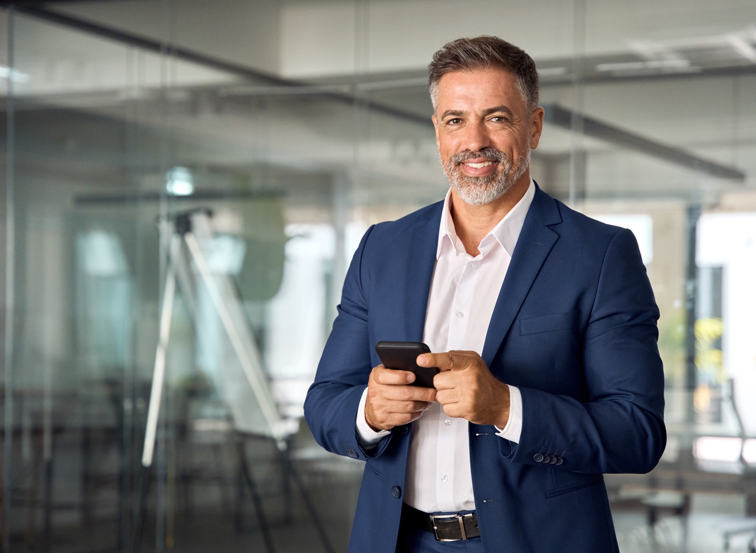
MEET WILLIAM,
YOUR IDEAL CUSTOMER
age: 52
occupation: CFO
income: $$$
BUSINESS EXEC
William is a recently promoted CFO who spends a lot of time online staying updated with news and product reviews. He enjoys high-end gadgets that integrate well with his existing tech and makes purchasing decisions based on detailed online research and reviews.
BUYING DECISION CRITERIA
PLATFORMS HE ENGAGES WITH
William hears about a smartwatch on the radio while working. He checks his favorite subscription website for reviews and reads about the watch’s versatility. Convinced by the detailed online reviews and the product’s integration with his tech, he makes an online purchase.
Social media
Streaming ads
Online reviews
BUYING BEHAVIOR
William buys high-end gadgets that integrate with his tech setup, influenced by online reviews.

Slide 32

MEET KAREN,
YOUR IDEAL CUSTOMER
age: 65
occupation: Retired
income: $$
CANNABOOMER
Karen is a retired health enthusiast who explores cannabis and CBD products for wellness. She listens to radio shows about new dispensaries and uses her smartphone to browse their websites. She prefers in-store purchases after thorough online research to ensure quality.
BUYING DECISION CRITERIA
PLATFORMS SHE ENGAGES WITH
Karen hears a radio ad for a new dispensary and visits their website to browse products. She reads reviews and checks social media for feedback. Satisfied with the product selection and positive reviews, she makes an appointment and buys the products in-store.
Social media
Radio
Online reviews
BUYING BEHAVIOR
Karen buys cannabis and CBD products in-store after extensive online research.

Slide 33
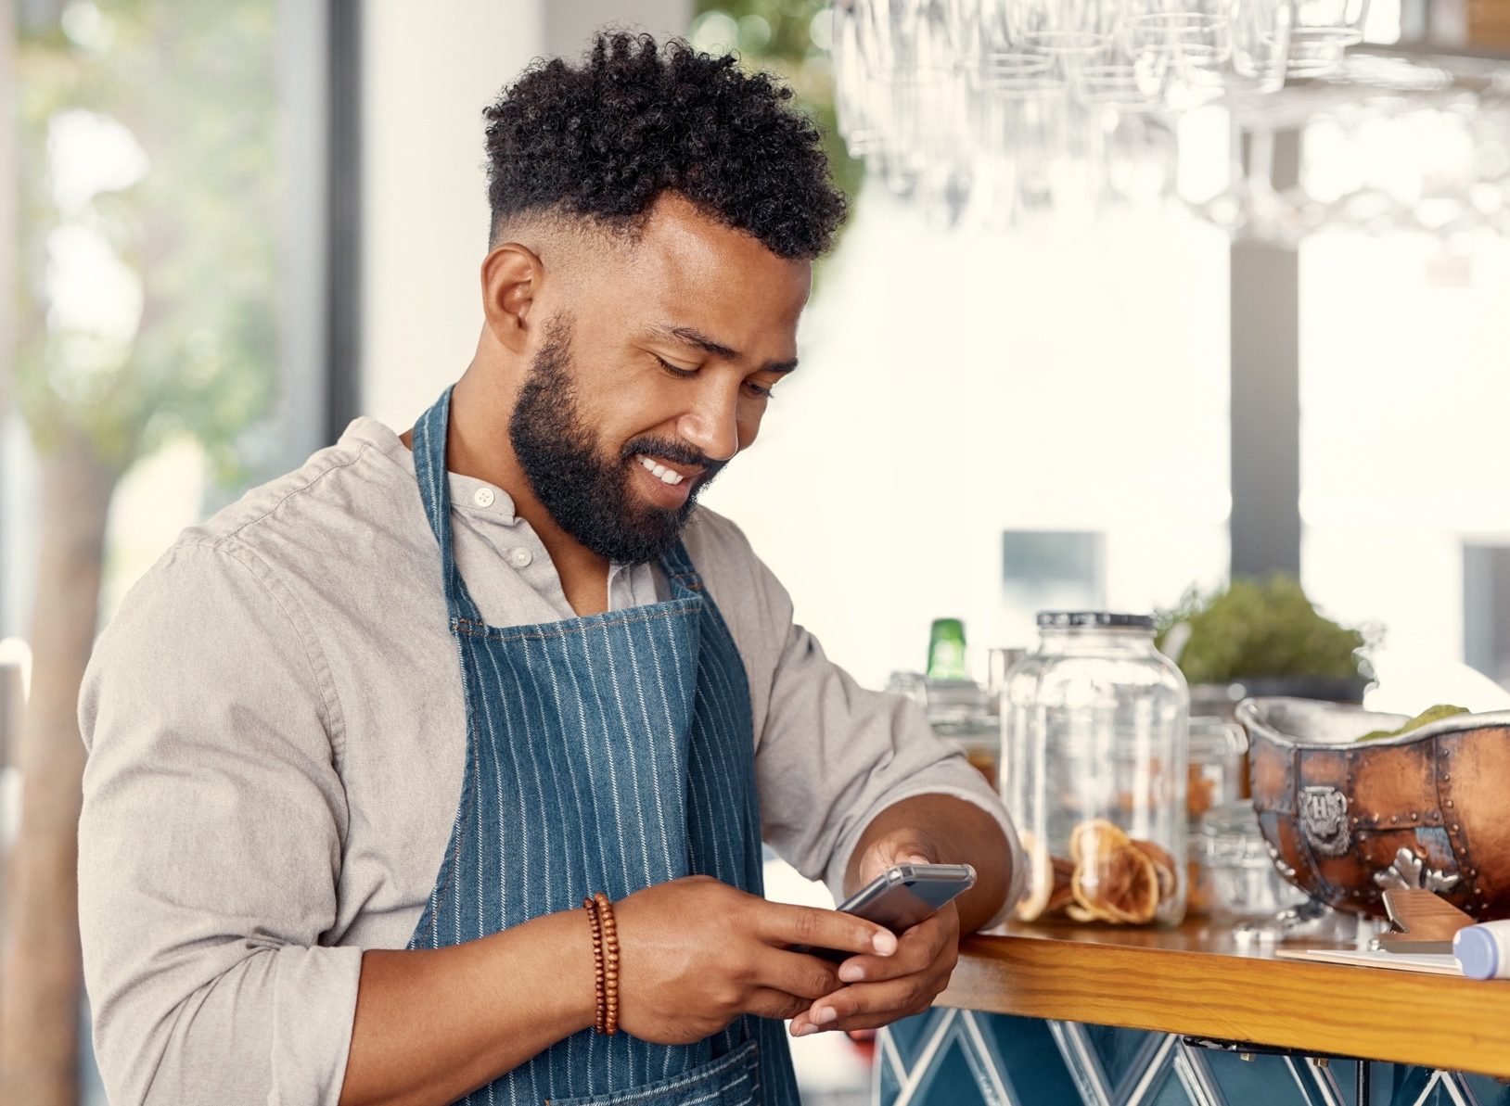
MEET JUSTIN,
YOUR IDEAL CUSTOMER
age: 30
occupation: Hospitality
income: $
RECREATIONAL CANNABIS USER
Justin is a hospitality worker who uses cannabis to relax after stressful days. He learns about new products through friends and streaming ads and makes informed purchases based on online reviews and peer recommendations.
BUYING DECISION CRITERIA
PLATFORMS HE ENGAGES WITH
Justin sees an ad for a new vape while streaming a TV show. He polls his friends on social media and reads online reviews. Convinced by the positive feedback and peer recommendations, he purchases the vape online and starts exploring other products from the same brand.
Social media
Streaming ads
Online reviews
BUYING BEHAVIOR
Justin buys cannabis products online after peer recommendations and streaming ads.

Slide 34

MEET TRISH,
YOUR IDEAL CUSTOMER
age: 39
occupation: Medical Researcher
income: $$$
CBD CONSUMER
Trish is a medical researcher who loves exploring high-quality CBD products. She uses her smartphone to research new items she sees in streaming ads, focusing on purity and quality before making online purchases.
BUYING DECISION CRITERIA
PLATFORMS SHE ENGAGES WITH
Trish sees an ad for CBD lotion while streaming a TV show. She reads reviews on her smartphone and checks the active ingredients list. Confident in the product’s quality and purity, she makes an online purchase and incorporates it into her wellness routine.
Social media
Streaming ads
Online reviews
BUYING BEHAVIOR
Trish buys high-quality CBD products online, focusing on purity and quality.

Slide 35

MEET JASON,
YOUR IDEAL CUSTOMER
age: 42
occupation: Remote Analyst
income: $$
MEDICAL CONSUMER
Jason is a remote analyst with a chronic illness who relies on medical marijuana for relief. He keeps up with industry trends through online research and prefers buying premium products online that are convenient and effective.
BUYING DECISION CRITERIA
PLATFORMS HE ENGAGES WITH
Jason sees an ad for medical-grade marijuana while streaming a TV show. He conducts online research and reads dozens of reviews. The product’s promise of pain relief and positive feedback lead him to make an online purchase and include it in his daily regimen.
Social media
Streaming ads
Online reviews
BUYING BEHAVIOR
Jason buys medical marijuana products online, ensuring they meet his chronic illness needs.

Slide 36






THE EXECUTION
RESEARCH & DATA
CREATIVE MESSAGING
CAMPAIGN SET UP
REPORTING & SUCCESS METRICS
Insert research and data insight here xxxxxxxxxxxxxxxxxxxxxxxxxxxxxxxx
Insert research and data insight here xxxxxxxxxxxxxxxxxxxxxxxxxxxxxxxx
Insert research and data insight here xxxxxxxxxxxxxxxxxxxxxxxxxxxxxxxx
Insert research and data insight here xxxxxxxxxxxxxxxxxxxxxxxxxxxxxxxx
Insert creative campaign guidance xxxxxxxxxxxxxxxxxxxxxxxxxxxxxxxx
Insert creative campaign guidance xxxxxxxxxxxxxxxxxxxxxxxxxxxxxxxx
Insert platform guidance here xxxxxxxxxxxxxxxxxxxxxxxxxxxxxxxx
Insert platform guidance here xxxxxxxxxxxxxxxxxxxxxxxxxxxxxxxx
Insert execution and launch info here xxxxxxxxxxxxxxxxxxxxxxxxxxxxxxxx
Insert execution and launch info here xxxxxxxxxxxxxxxxxxxxxxxxxxxxxxxx
Insert execution and launch info here xxxxxxxxxxxxxxxxxxxxxxxxxxxxxxxx
Insert execution and launch info here xxxxxxxxxxxxxxxxxxxxxxxxxxxxxxxx
Insert reporting and insights info xxxxxxxxxxxxxxxxxxxxxxxxxxxxxxxx
Insert reporting and insights info xxxxxxxxxxxxxxxxxxxxxxxxxxxxxxxx
Insert reporting and insights info xxxxxxxxxxxxxxxxxxxxxxxxxxxxxxxx
Insert reporting and insights info xxxxxxxxxxxxxxxxxxxxxxxxxxxxxxxx

Slide 37

RECOMMENDED SOLUTIONS

Slide 38



TARGETED DISPLAY & VIDEO
Place your brand on popular streaming channels and websites, making sure your ads are seen by the right people at the right time.
Strategic Placement: Ensure your ads are seen by the right people at the right time.
High Engagement: Capture attention with visually appealing ads.
Amplify Your Impact: Captivate viewers on their favorite sites with your ads via video or display. This tactic can transform casual browsers into loyal customers, boosting both brand awareness and sales.
  TARGETING EXAMPLES
  Who They Are:
  Male/Female, Income, Age, Number of Children, Language, Job Title, etc.
  What They Are Interested In:
  Sports, Gourmet Foods, Travel, History, etc.
  What They Show Intent to Purchase:
  In-Market Automobile, In-Market Real Estate, etc.
DELIVERY OPTIONS:
Video
Display
AWARENESS

Slide 39

STREAMING TELEVISION (STV)
Reach consumers who watch their shows and news online by delivering :15 and :30 non-skippable video ads on streaming platforms like Sling, Pluto, and Tubi, through devices like Roku, Amazon Fire, and PlayStation. Utilize precise audience targeting to deliver ads to specific demographics, interests, or behaviors.
Engaged Viewers: Reach consumers watching their favorite shows on popular streaming platforms.
Precise Targeting: Tailor your ads to specific demographics, interests, and behaviors.
Amplify Your Impact: Imagine being part of viewers’ favorite shows with non-skippable ads. This tactic ensures your message gets through and resonates deeply, driving immediate engagement and brand loyalty. With over 33 million cord-cutters in the US and a 20% increase in streaming viewership, leveraging STV ensures you capture a significant audience shifting from traditional cable to streaming.
AWARENESS
5 Minutes

Slide 40

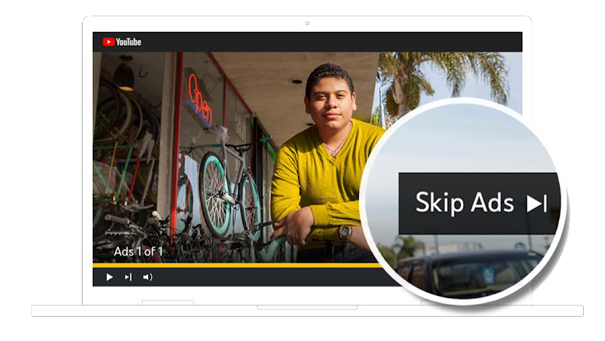

YOUTUBE TRUEVIEW
Deliver highly targeted, skippable pre-roll videos to engaged viewers on YouTube with TrueView.
High Engagement: Capture attention with skippable videos.
Targeted Reach: Deliver ads to specific audiences.
Amplify Your Impact: Hold viewers’ attention right before their favorite videos. This tactic drives immediate engagement and interest, turning viewers into customers.
AWARENESS
Mocks for illustrative purposes only
5 Minutes

Slide 41
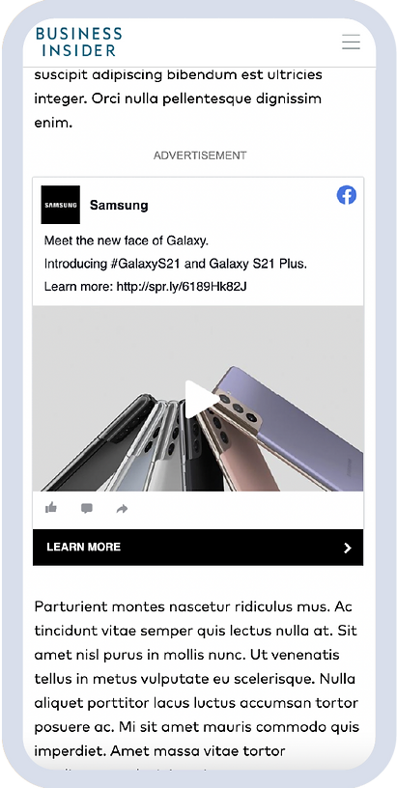
SOCIAL DISPLAY
Distribute your social creative as standard display ads across the web, maximizing reach with social display.
Extended Reach: Distribute social content widely.
High Engagement: Increase interaction with display ads.
Amplify Your Impact: Reach every corner of the web with your social content. This tactic maximizes your ad’s visibility and engagement, driving immediate interest and conversions.
AWARENESS
Mocks for illustrative purposes only
5 Minutes

Slide 42

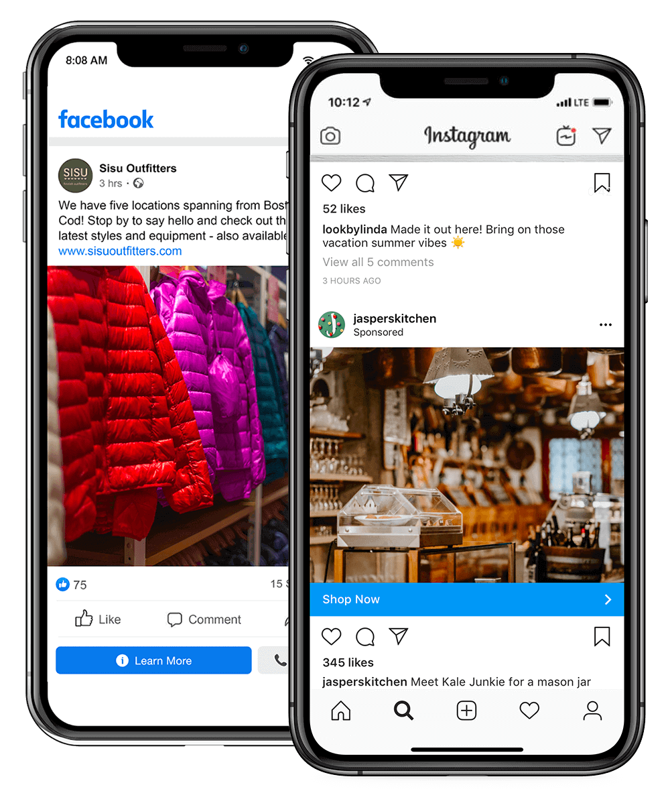


FACEBOOK/INSTAGRAM MARKETING
Deliver your message to a vast audience on the world's most dominant social platforms with Facebook/Instagram marketing.
Vast Reach: Engage a large social media audience.
Precise Targeting: Deliver ads to specific demographics.
Amplify Your Impact: Be the talk of social media. This tactic reaches millions with targeted ads, driving immediate engagement and conversions.
AWARENESS/INTEREST/CONVERSION
Mocks for illustrative purposes only

Slide 43
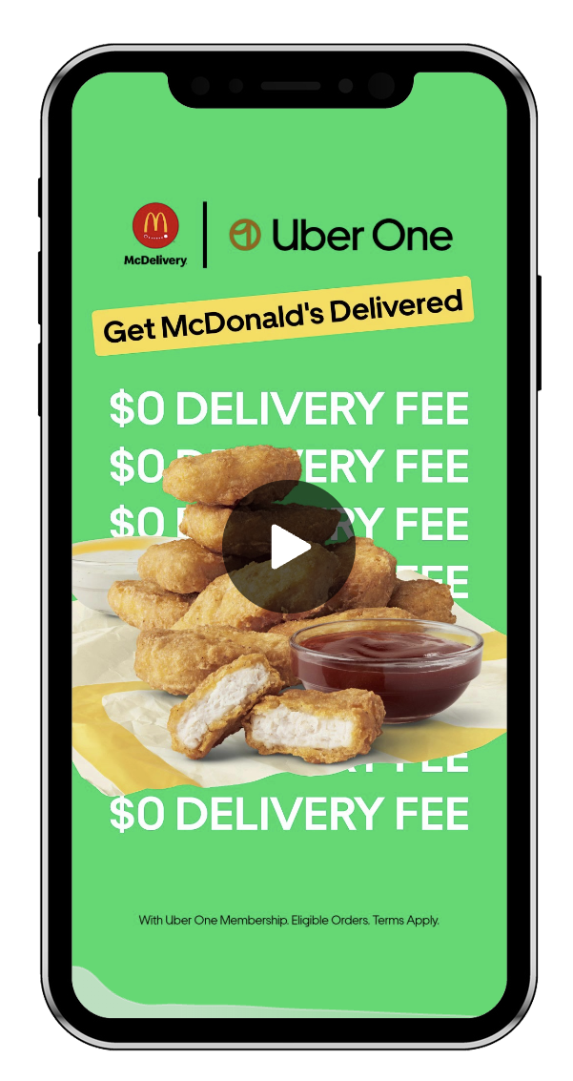


TIKTOK
TARGETING
Reach a creative and entertained audience on the hottest video platform with TikTok targeting.
Creative Platform: Connect with an engaged audience.
High Interaction: Capture attention with video content.
Amplify Your Impact: Be part of the latest TikTok trend. This tactic drives high interaction and engagement, boosting your brand’s visibility and impact.
AWARENESS/INTEREST
Mocks for illustrative purposes only

Slide 44
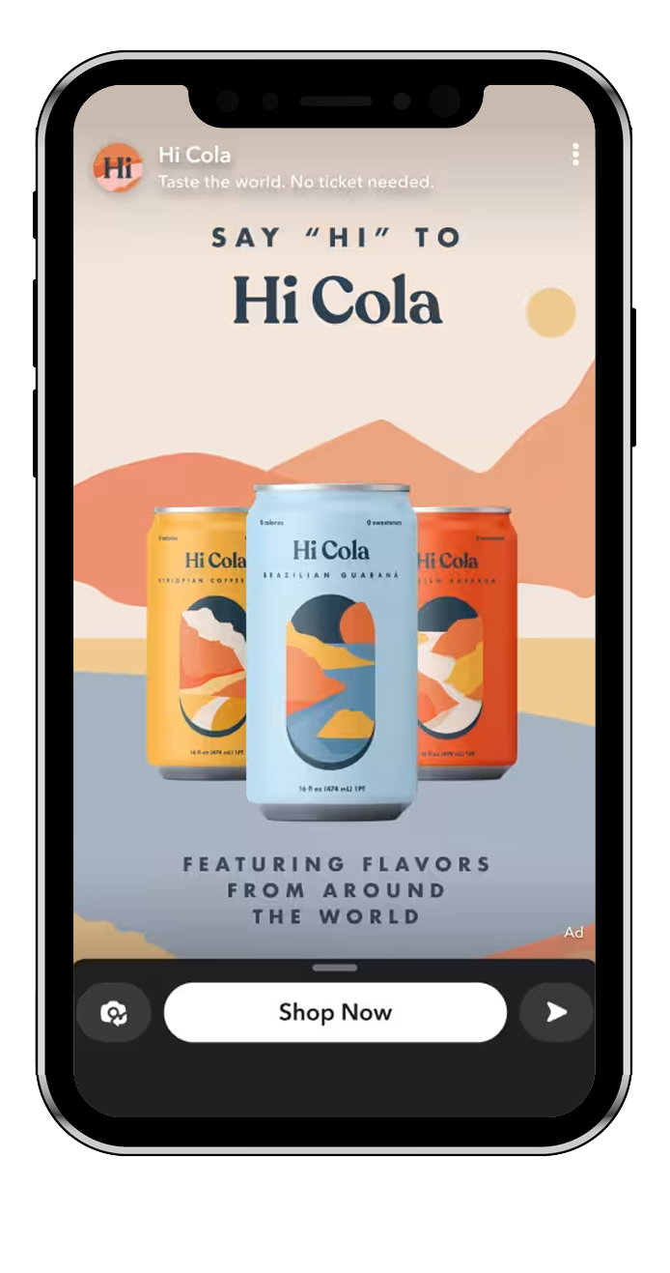


SNAPCHAT
Connect with a younger, mobile audience through playful and engaging content on Snapchat.
Younger Audience: Connect with a mobile-savvy generation.
Engaging Content: Capture attention with playful ads.
Amplify Your Impact: Become part of every fun snap. This tactic engages a younger audience and drives immediate interaction and interest.
AWARENESS
Mocks for illustrative purposes only
5 Minutes

Slide 45

EMAIL MARKETING
Deliver your message directly to the inboxes of targeted prospects, driving high ROI with email marketing.
Direct Delivery: Reach prospects in their inbox.
High ROI: Achieve strong returns on investment.
Amplify Your Impact: Land your brand’s message directly in your audience’s inbox. This tactic drives immediate engagement and conversions, maximizing your ROI.
INTEREST/CONVERSION
5 Minutes

Slide 46

PROGRAMMATIC AUDIO
Reach a highly engaged audience with impactful audio ads on platforms like Spotify with programmatic audio.
Engaged Audience: Reach listeners on popular audio platforms.
High Impact: Deliver compelling audio ads.
Amplify Your Impact: Let your brand be heard on listeners' favorite music and podcast apps. This tactic captures their attention, driving immediate interest and engagement.
DELIVERY OPTIONS:
Video
Display
AWARENESS
5 Minutes

Slide 47

ADDRESSABLE GEOFENCING
Target consumers at the household level, delivering precise and personalized ads with addressable geofencing.
Household Precision: Target ads to specific homes.
Personalized Ads: Deliver relevant messages.
Amplify Your Impact: Reach the right households at the perfect moment. This tactic delivers personalized messages that drive immediate engagement and loyalty.
AWARENESS/INTEREST/CONVERSION
5 Minutes

Slide 48

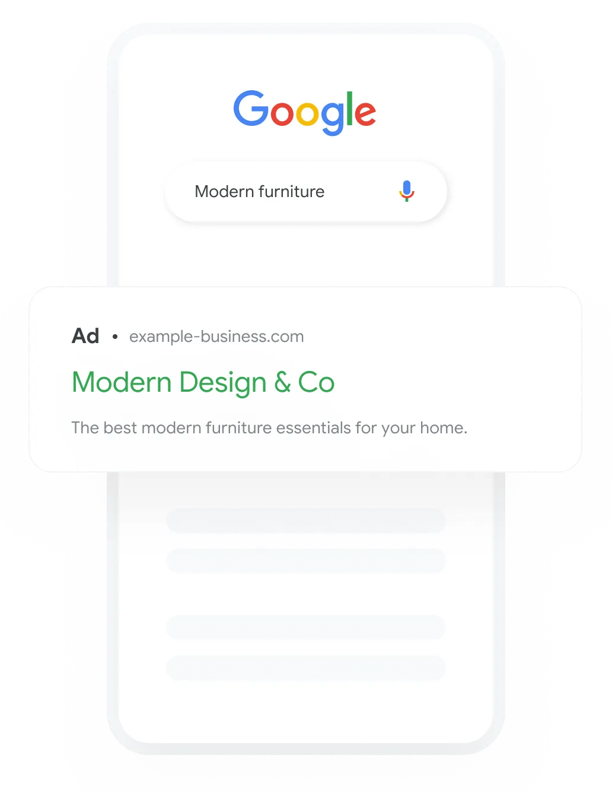

SEARCH ENGINE MARKETING
Drive phone calls, leads, or conversions with targeted text ads on search engines through search engine marketing (SEM).
Immediate Actions: Drive conversions with targeted ads.
High Visibility: Appear in search results.
Amplify Your Impact: Appear just when customers are searching for you. This tactic drives immediate actions and conversions, maximizing your visibility and impact.
AWARENESS/INTEREST/CONVERSION
Mocks for illustrative purposes only

Slide 49

CAMPAIGN MEDIA PLAN
x______________________
Provider Representative
x______________________
Client Authorization
x__________
Date
Timeline:
08/01/21 - 12/31/21
Both parties have the right to cancel 90 days after the start of the campaign with 30 day written notice.

Slide 50
CAMPAIGN MEDIA PLAN
SOLUTION NAME | SOLUTION GOAL | AUDIENCE DETAIL | SOLUTION FOOTPRINT | MEDIA DELIVERED | VOLUME | MEDIA COST | COST STRUCTURE | BUDGET
Programmatic Display | Pull from Prog Display Tab | Enter Audience Detail | US, State, DMA, Zip Codes or Addresses | Display | 123,456 | $0.00 | CPM | $1.000
Addressable Geo (Banner) | Foot Traffic | Enter Audience Detail | Specific Postal Addresses | Display | 123,456 | $0.00 | CPM | $1,000
Retargeting | Site Traffic | Previous Site Visitors | United States | Display | Based on Site Traffic | $0.00 | CPM | N/A
STV | Awareness | Enter Audience Detail | ???? | Video | 123,456 | $0.00 | CPM | $1,000
Social - Link | Site Traffic | Enter Audience Detail | US, State, DMA or Zip Codes | Video or Display | 123,456 | $0.00 | CPLC | $1,000
INVESTMENT | $4,000
x______________________
Provider Representative
x______________________
Client Authorization
x__________
Date
Timeline:
08/01/21 - 12/31/21
Both parties have the right to cancel 90 days after the start of the campaign with 30 day written notice.

Slide 51

PRE AND POST
LAUNCH SUPPORT

Slide 52

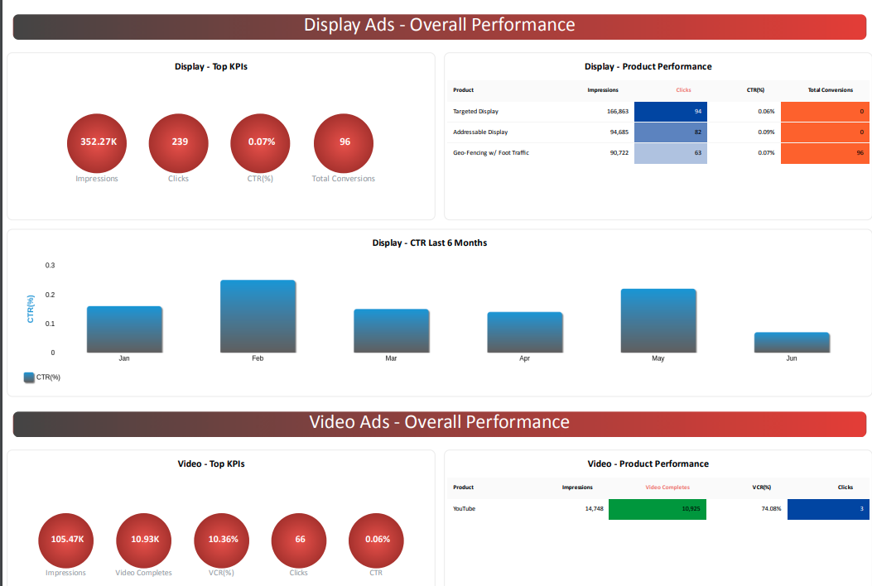


BOOST YOUR CAMPAIGNS WITH
LIVE REPORTING DASHBOARDS
EXCLUSIVE DASHBOARD ACCESS
Real-Time Performance Tracking. Monitor campaigns live with clear, impactful metrics on any device
Customizable Interface. Navigate a user-friendly dashboard tailored to your needs
Advanced Analytics. Dive into deep analytics, predictive insights, and trend analysis
Seamless Data Integration. Combine multiple data sources and customize KPI tracking effortlessly
WHY IT MATTERS
Informed Decisions. Quickly act on data and improve client communication
Efficiency & Adaptability. Save time and stay ahead with insights and streamlined reporting
PRO TIPS
Agree on a reporting cadence with your account manger before your campaign launches!
Log in and review your dashboard

Slide 53

CREATIVE SERVICES
Having the right creative can make or break your campaign’s performance, and we’re here to take that challenge off your plate. With our Creative Services team, you get top-notch solutions tailored to your needs, ensuring your campaign is set up for success from the start.
Creative Vision Alignment: Ensure your campaign’s creative vision is fully realized with a dedicated team that aligns ad copy and design to your goals.
Optimized Design: Get visually stunning designs tailored for maximum engagement, driving results that resonate with your audience.
Impactful Video Production: Capture attention with dynamic video content designed to perform across platforms like STV and social, delivering high-quality results that drive your campaign's success.

Slide 54

YOUR PATH TO RESULTS
STARTS HERE
Choosing us as a partner is a no-brainer because we understand your challenges and have the solutions you need. Here’s why partnering with us is the best decision:
Expertise & Experience: our team brings years of industry knowledge and a proven track record of success.
Tailored Solutions: we provide customized strategies designed specifically to meet your business goals.
Data-Driven Results: our campaigns are backed by data and analytics to ensure maximum ROI.
Comprehensive Support: from strategy to execution, we’re with you every step of the way.

Slide 55


JOURNEY TO LAUNCH:
WHAT HAPPENS NEXT
CAMPAIGN BUILD AND QA
Our team builds your campaign and conducts thorough quality checks.
LAUNCH
ACTIVATION CALL
Congratulations – your campaign is live!
Your dedicated Digital Campaign Manager (DCM) will review your assets and clarify any details and establish timeline to launch.
Why It Matters: Ensures all campaign elements are aligned with your goals from the start.
CREATIVE NEEDS DETERMINED
What to Expect: We identify and gather all necessary creative assets.
SIGNED CONTRACT
Our team processes your contract promptly

Slide 56

THANK YOU

